Slide 1
Antebellum Issues

Slide 2
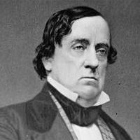
Effects of the Mexican-American War
Increased Sectionalism
Wilmot Proviso– any land gained from Mexico would be free.
Popular Sovereignty– proposed by Sen. Lewis Cass

Slide 3
Contradictions & Confusion
With regards to the expansion of slavery
Missouri Compromise (1820) = 36°30’
Wilmot Proviso (1846) = territory free
Popular Sovereignty (1846) = citizens choose
What’s Next???

Slide 4
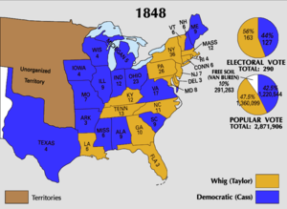
The Elections of 1848
WHIGS | DEMOCRATS | FREE-SOILERS
Zachary Taylor | Lewis Cass | Martin Van Buren
Owned slaves & ppl thought he’d expand | Popular Sovereignty | Opposed expansion of slavery
47.3% | 42.5% | 10.1%
163 | 127 | 0

Slide 5
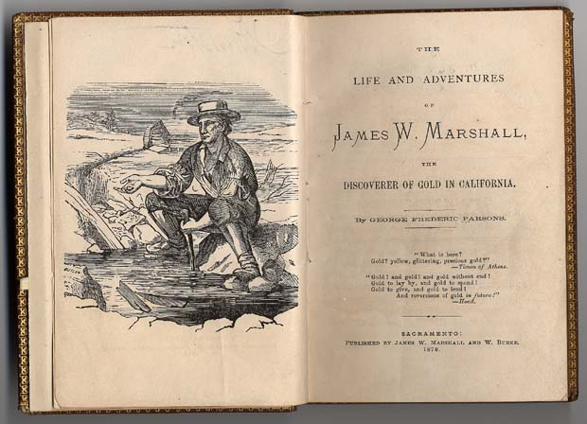
The Gold Rush
1848 gold was found in California
  1-24-1847: James Marshall & Peter Wimmer find gold at Sutter’s Mill
  The California Star starts “gold fever”

Slide 6
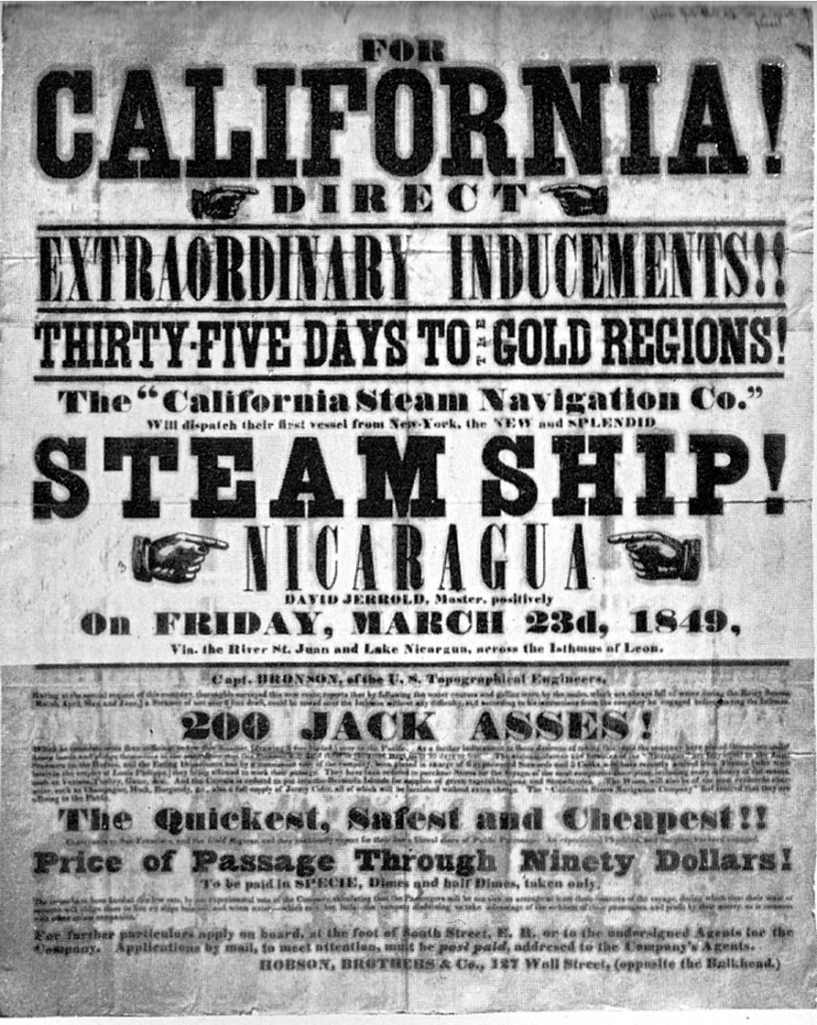
By 1849 there were enough people to make CA a state.
  November, 1849 CA citizens vote on the constitution.
  CA wanted to be free, but was below 36°30’
  South was unhappy because it threw the Congress off balance

Slide 7
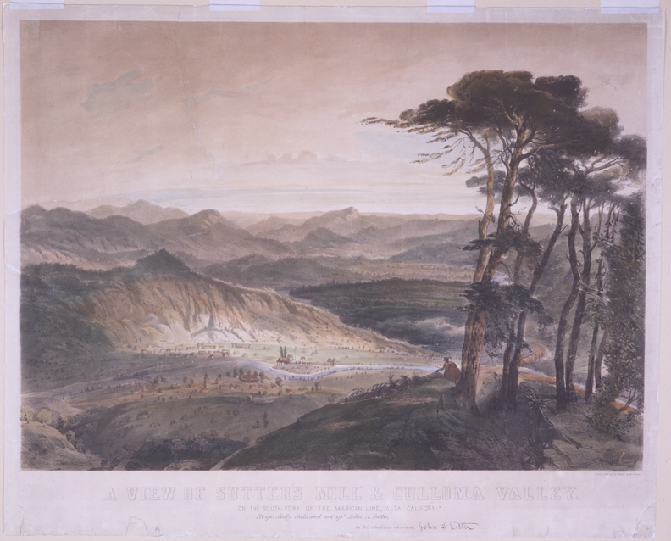
A View of Sutter’s Mill and Colluma Valley, Jewett (1850)

Slide 8
The Compromise of 1850
Henry Clay
tried to
smooth
over problems
in Congress
Calhoun &
Webster
debate the
details
of California’s
admission
Congress
passes
the
Compromise
of 1850

Slide 9
The Compromise of 1850
California admitted as FREE state
Popular Sovereignty in UT & NM territories
Border between TX & NM set
TX receives $10 million
No more slave trade in Washington, D.C.
Stronger Federal Fugitive Slave Act

Slide 10
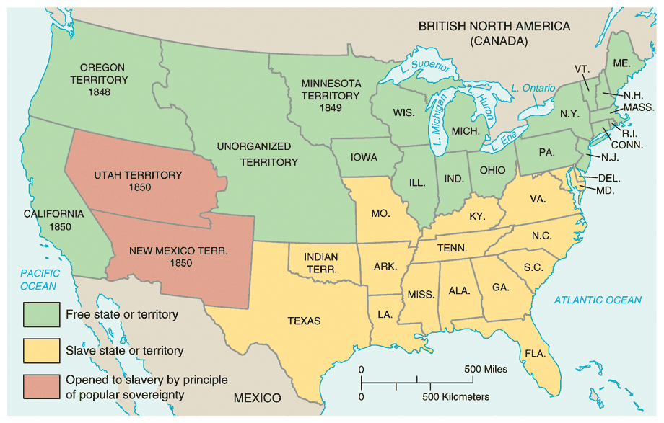

Slide 11
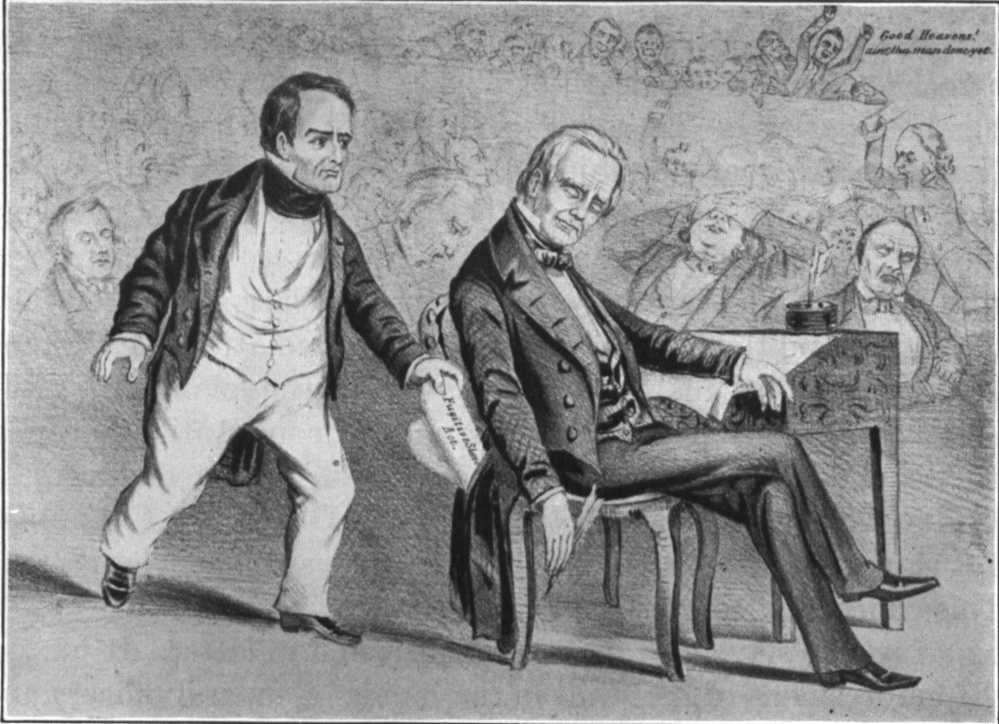
An Old Cartoon Representing Webster "Stealing Clay's Thunder"

Slide 12
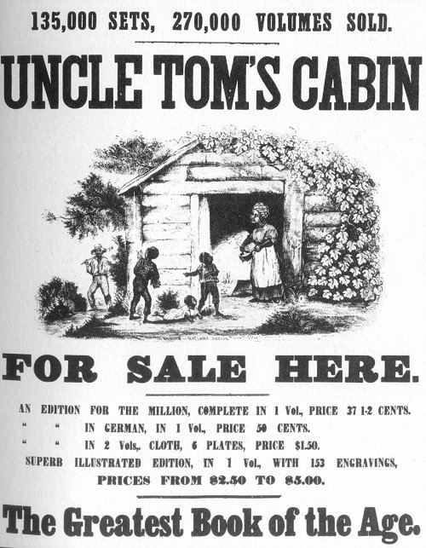
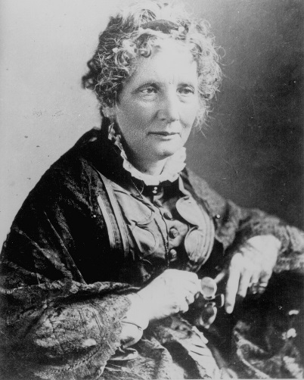
Fugitive Slave Act’s Impact
Uncle Tom’s Cabin & other literature denounce slavery
Civil Disobedience
Underground RR
Personal Liberty Laws
Sold 300,000
copies in
the first year.
2 million in a decade!

Slide 13
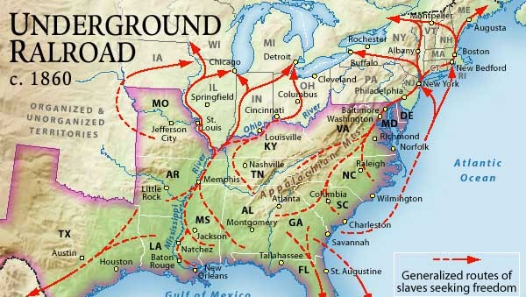
The Underground Railroad

Slide 14
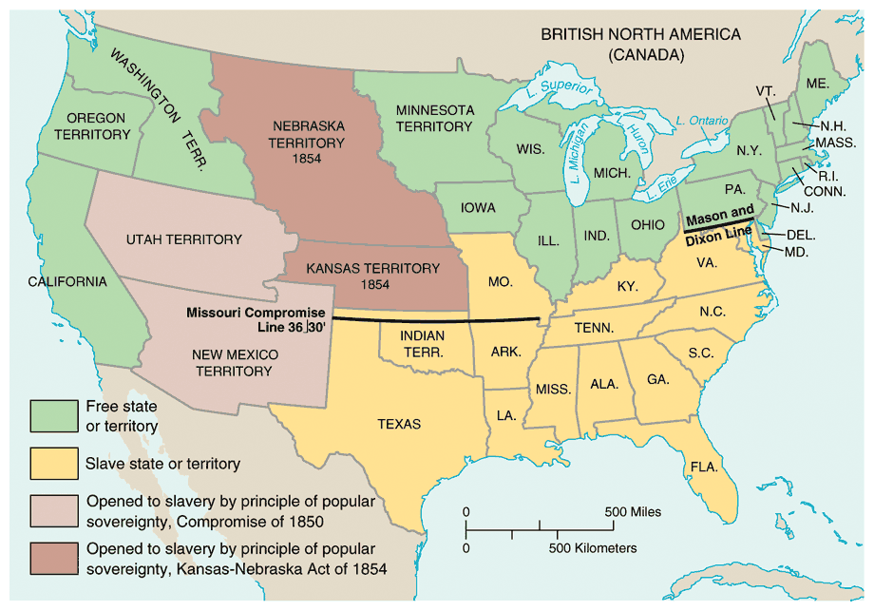
The Kansas-Nebraska Act, 1854
To move the transcontinental RR west– Congress needed to organize the territories
Stephan Douglas must repeal the MO Compromise

Slide 15
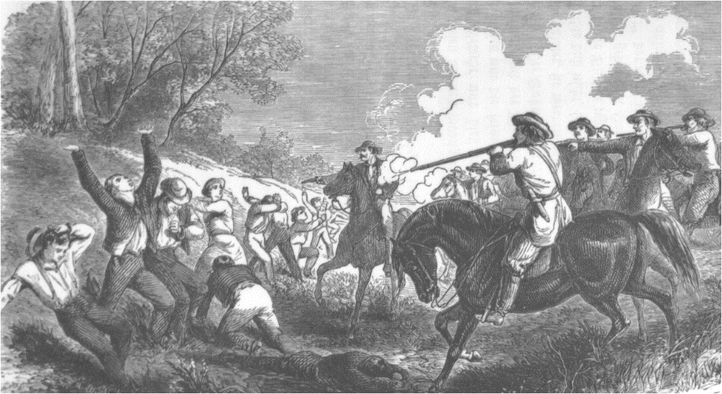
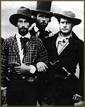
Bleeding Kansas
The First Civil War
Slave decision was based on pop sov
“Border Ruffians” flood into KA from MO to “help” with voting

Slide 16
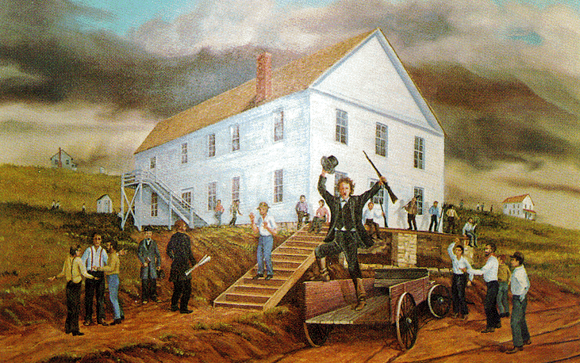
Two Governments
  Lecompton ⇨ Pro-slavery capital
  Topeka ⇨ Anti-slavery capital
Constitution Hall, Lecompton, KA

Slide 17
Have out your “Antebellum issues”, page #8, before the bell rings please.
Check to see that you have Lecompton as the proslavery capital of Kansas & topeka as the anti-slavery capital.

Slide 18
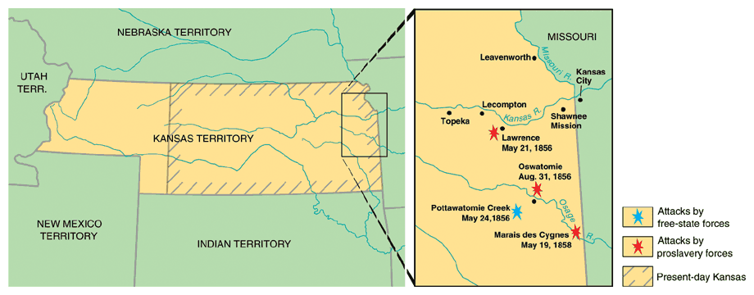
The Sack of Lawrence
An antislavery town
Proslavery sheriff arrested several ppl
  Looted
  Burned
  No one killed

Slide 19
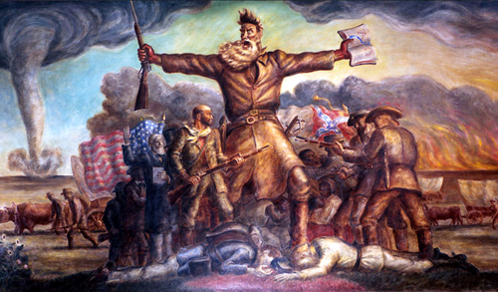

Slide 20
Pottawatomie Massacre
John Brown thought five were killed
Took 5 men from their beds & killed them
  Effect: “Civil War: in KA with ~200 dead

Slide 21
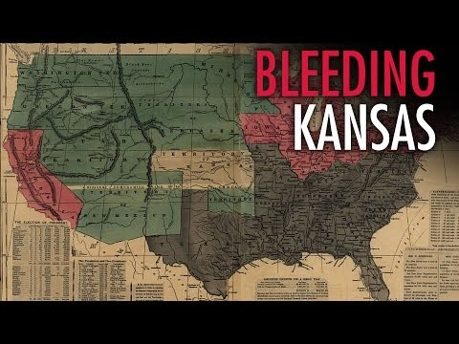
Bleeding Kansas video

Slide 22
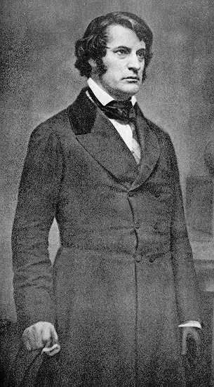
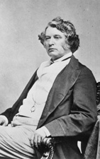
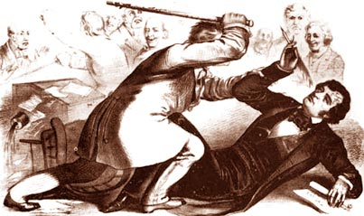
“Bleeding Sumner”
Sen. Charles Sumner (R-MA)
Congr. Preston Brooks (D-SC)

Slide 23
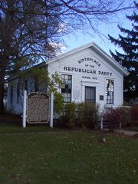
The Republican Party
When? Organized in the summer of 1854 in Michigan or Wisconsin
Why? Splinter groups organized who opposed the expansion of slavery
Who? Whigs, Free-Soilers, Anti-Slavery Democrats, opponents of KA-NE Act

Slide 24
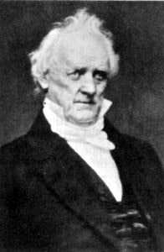
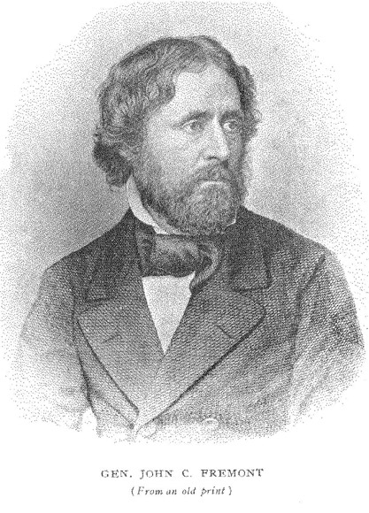
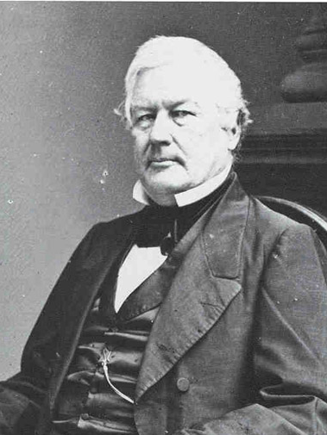
Election of 1856
James Buchanan John C. Frémont Millard Fillmore Democrat Republican American
*Took enough votes
from Rep Party
Issues: Preservation of the Union

Slide 25
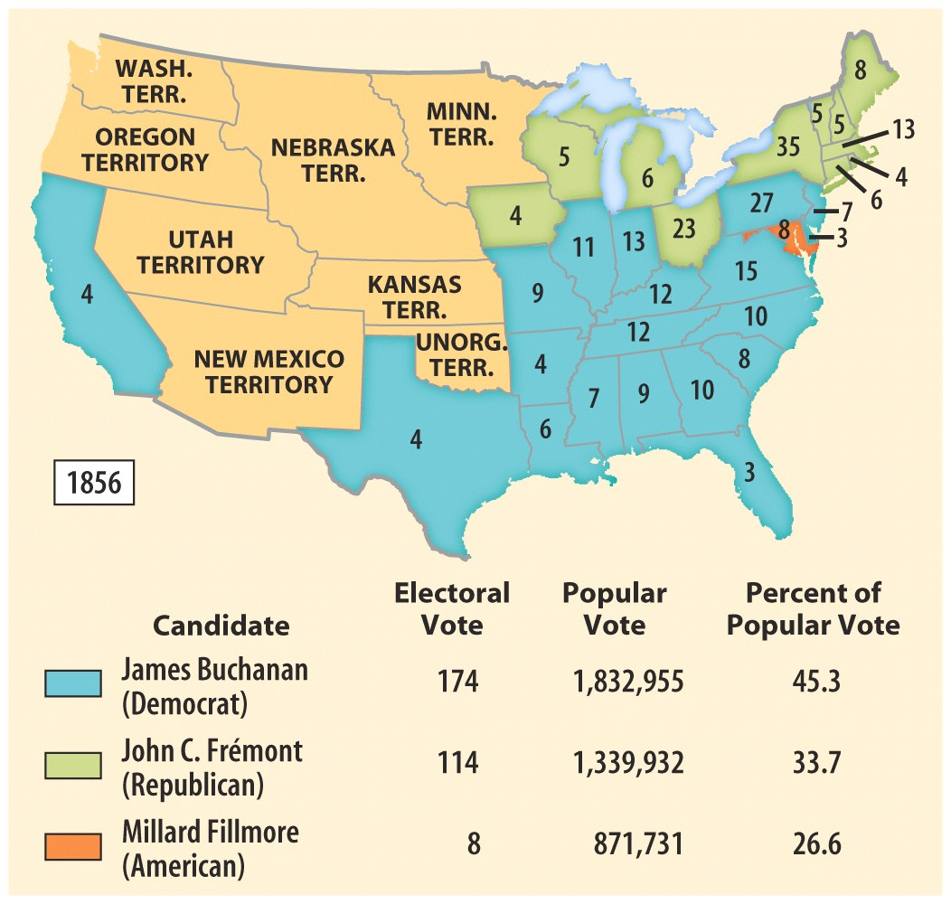

Slide 26
Party | Characteristics | Major Leaders
Whigs (1834-1854) | Divided sectionally, united to oppose Dem. | Daniel Webster Henry Clay
Democrats (1828-present) | Controlled fed gov, dominated by Southerners | John C. Calhoun
Liberty (1839-1844) | Abolition; members moved to Free Soil & Rep | James Birney
Free-Soil (1848-1854) | Composed of Liberty Party, anti-slavery Whigs & Dem | Martin Van Buren
Republican (1854-present) | No.Whigs, Free-Soilers; opposed expansion of slavery | Abe Lincoln
American (1849-1860) AKA: Know-Nothings | Anti-immigration, Anti-Catholic | Millard Filmore

Slide 27
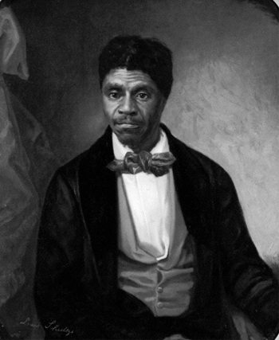
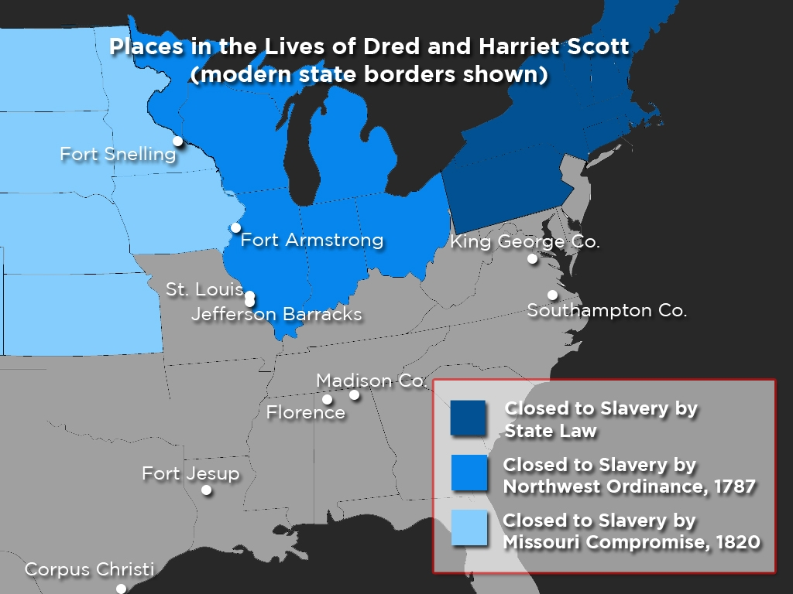
Dred Scott Decision (1857)
Scott was taken into free terr ⇨ believed he was free ⇨ sued his master
Chief Justice: Roger B. Taney
Case Decision: Slaves are property and not citizens

Slide 28
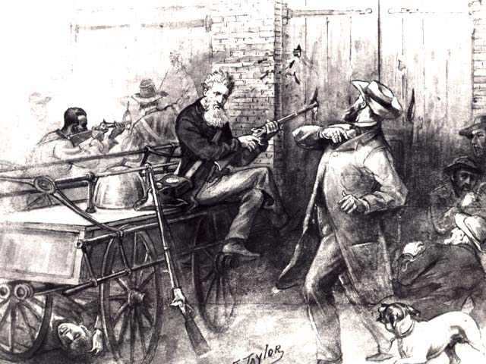
John Brown’s Raid
When? 1859 in Harper’s Ferry, VA
  Now West Virginia
Causes? Desired to free slaves & begin a rebellion
Effect? Abolition had a martyr

Slide 29
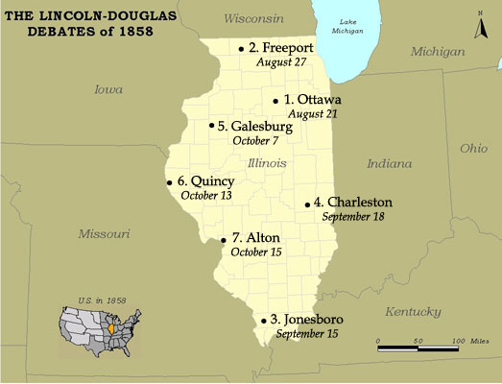
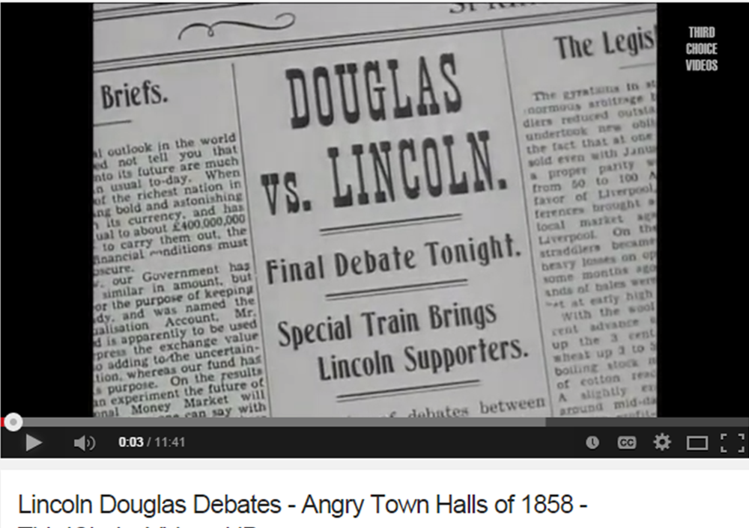
Lincoln-Douglas Debates
Illinois Senate Race– 1858

Slide 30
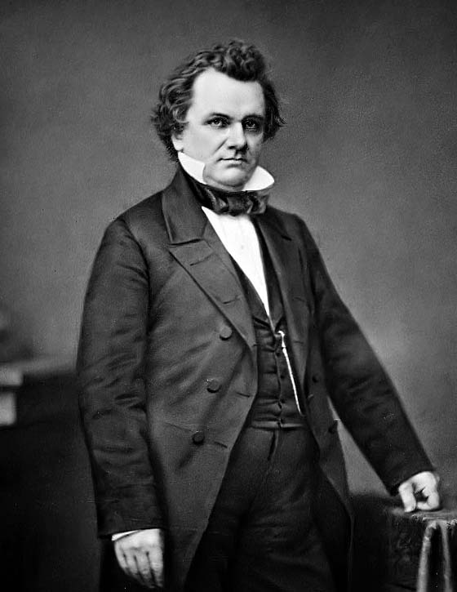
Stephan Douglas and the Freeport Doctrine
Popular Sovereignty?

Slide 31
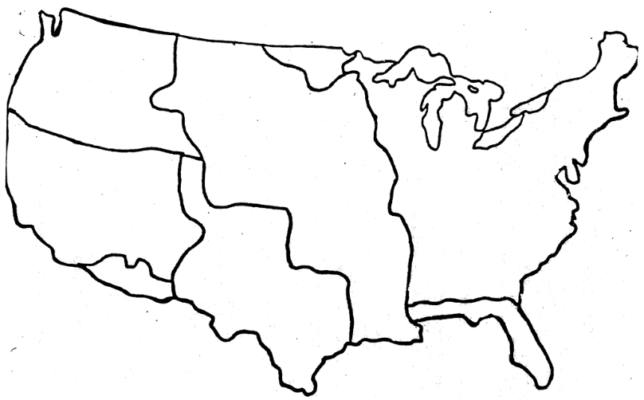

Slide 32
Activity
Choose a party from the chart in your notes.
Create a BUGGY sticker that promotes your party.
Share with the class ☺

