Slide 1
Antebellum
Revivalism
&
Reform
Notes:
State of religion in early 19th century
75% of 23 million Americans attended church regularly
Became more liberal in their thinking
Moved away from Calvinism
Some moved towards Deism (reason rather than revelation)
Science rather than Bible, believed in Supreme Being who created a knowable universe and endowed human beings with a capacity for moral behavior
Others toward Unitarianism (God exists in one person not the Trinity)
Free will and salvation through good works
Stressed essential goodness of human nature rather than evil
God was a loving father, not a stern creator

Slide 2
1. The Second Great
Awakening
“Spiritual Reform From Within” [Religious Revivalism]
Social Reforms & Redefining the Ideal of Equality
Temperance
Abolitionism
Education
Asylum & Penal Reform
Women’s Rights
Notes:
Reaction to the growing liberalism
Began on Southern frontier and moved Northeast and became the most important era in history of American religion
Influenced more people than 1st Great Awakening
Large numbers of Americans embraced evangelicalism (the belief that they must take their message of salvation to others)
Expected to create a more godly nation through conversion and good works
Shattered and reorganized churches and new sects
Fostered reform movements

Slide 3
The Rise of Popular Religion
In France, I had almost always seen the spirit of religion and the spirit of freedom pursuing courses diametrically opposed to each other; but in America, I found that they were intimately united, and that they reigned in common over the same country… Religion was the foremost of the political institutions of the United States.
-- Alexis de Tocqueville, 1832
R1-1

Slide 4
“The Pursuit of Perfection”
In Antebellum America

Slide 5
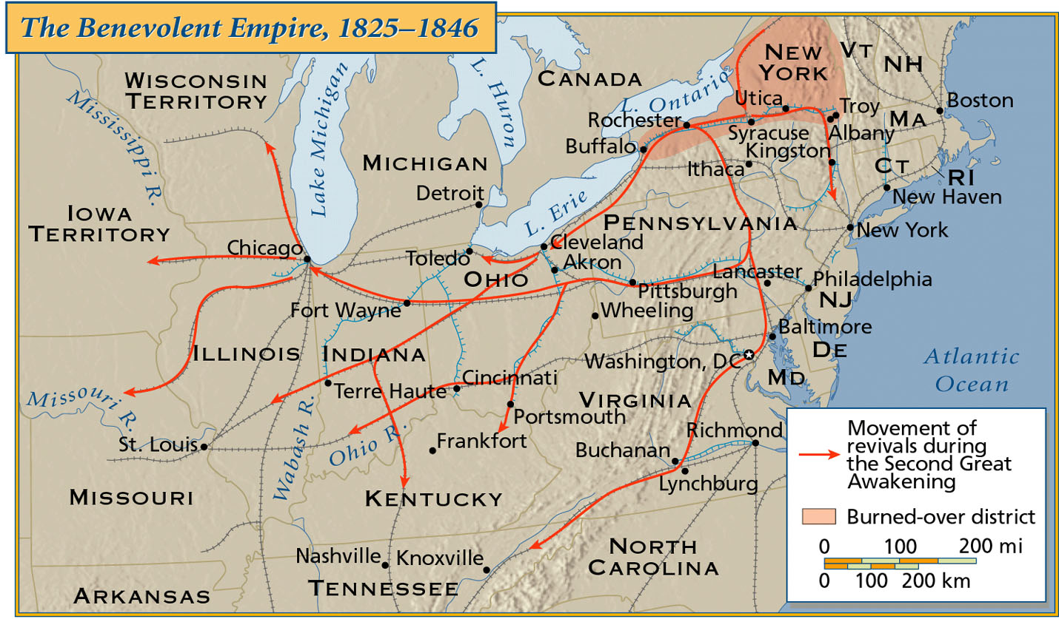
“The Benevolent Empire”: 1825 - 1846

Slide 6
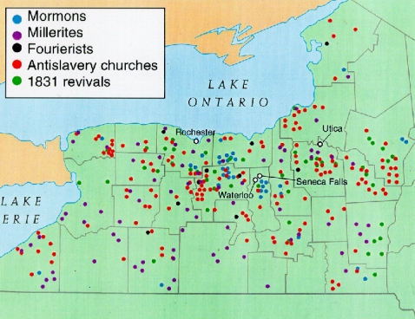
The “Burned-Over” District in Upstate New York
Notes:
Became known for its hellfire and damnation sermons
One revival after another surged through its towns and farms
Finney was from here, as were many of the other religious leaders we will meet

Slide 7
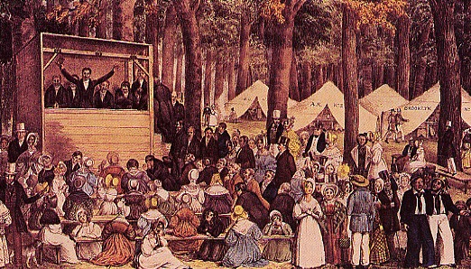
Second Great Awakening Revival Meeting
Notes:
Revivalism spread to masses via camp meetings
As many as 25,000 people gathered for several days to hear hellfire gospel
People would gather for days to hear hellfire gospel
Most famous was in Kentucky where clergy preached for about a week to close to 20,000 people.
Methodists and Baptists benefited most from revivalism
Both stressed personal conversion instead of predestination
Emotionalism!

Slide 8
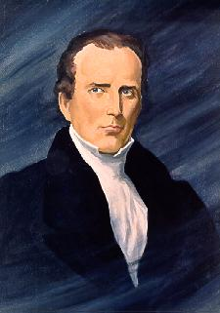
Charles G. Finney (1792 – 1875)
The ranges of tents, the fires, reflecting light…; the candles and lamps illuminating the encampment; hundreds moving to and fro…;the preaching, praying, singing, and shouting,… like the sound of many waters, was enough to swallow up all the powers of contemplation.
“soul-shaking” conversion
R1-2
Notes:
Finney was a lawyer from NY who did not attend church regularly
He started when his fiancee encouraged him to do so and found himself struck with God’s love
Started spreading the word of the Bible in plain straightforward English of the common man
Believed in earthly perfection
Inspired major reform movements – education, temperance, abolitionism

Slide 9
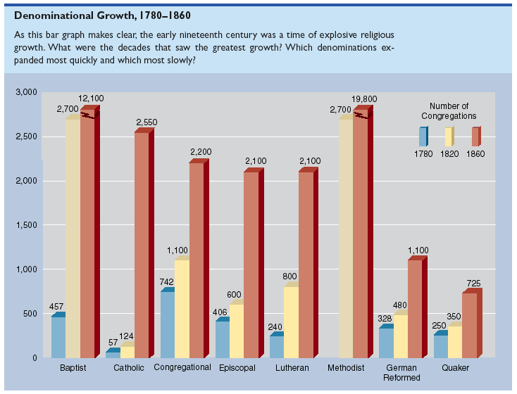
1816 → American Bible Society Founded
Notes:
Effects of the 2nd Great Awakening
hundreds of thousands became born again Christians
Shattered and reorganized churches and new sects
Fostered reform movements

Slide 10
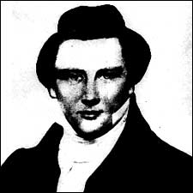
The Mormons (The Church of Jesus Christ of Latter-Day Saints)
Joseph Smith (1805-1844)
1823 --> Golden Tablets
1830 --> Book of Mormon
Notes:
Joseph Smith was visited by the angel Moroni and was told of a book written gold plates and buried on a hill outside Manchester NY (September 22, 1827 he found the plates)
Book was written in “reformed Egyptian”. Smith was provided with translating spectacles which he used to translate the language
Smith started gaining followers
Persecuted for his beliefs, mostly his belief in polygamy. He has 27 wives - claimed that there would be no salvation for women unless they were married. Every woman ought to be married and although it was a tough job, he felt up to the task

Slide 11
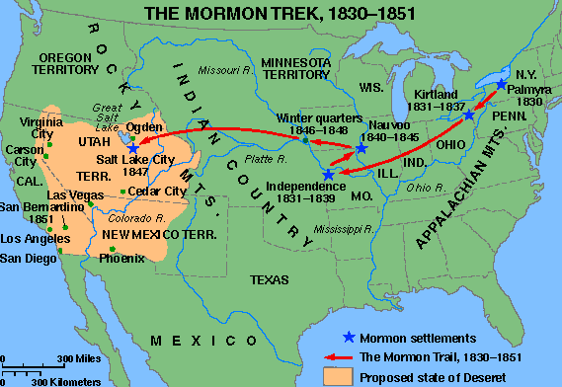
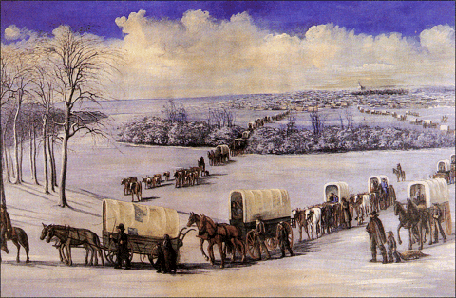
The Mormon “Trek”
Notes:
Smith and Co. left NY and went to Ohio
Then on to Nauvoo, Illinois.
1844 - While in Nauvoo, made many enemies and some of these had Smith arrested on treason charges. While in prison Smith was murdered.
Mormons then broke into 3 groups - one led by his first wife, who went to Independence, MO and rejected the practice of polygamy
Another group was led by James Strong to Beaver Island. Strong claimed to find brass plates with more of the true story on it and came to be know as King Jimmy the 1st.

Slide 12
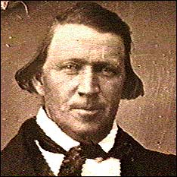
The Mormons (The Church of Jesus Christ of Latter-Day Saints)
Brigham Young (1801-1877)
Deseret community.
Salt Lake City, UT
Notes:
The last group was led by Brigham Young to Utah
Settled in Salt Lake area
Community became prosperous
Cultivated land by effective and cooperative means of irrigation
Utah will not be allowed to become a state until it bans polygamy in 1896

Slide 13
Millerites/Adventists
William Miller
Millenialists
Predicted 2nd Coming in March 1843, then October 1844
Notes:
1st said Jesus would come back March 1843
Gained followers who started giving away their belongings, put on white robes, and headed for the hills.
One man even painted his wagon white just in case Jesus wanted to ride in it
It didn’t happen and he recalculated date for Oct 22, 1844 - it didn’t happen again
Miller died in 1848
Some Millerites felt 2nd coming didn’t happen because they were celebrating the Sabbath on the wrong day - should be Saturday
7th Day Adventists

Slide 14
Age of Reforms
Abolition of Slavery (next unit) | Temperance | Women’s Rights | Education Reform
Mental Institutions | Prison Reform | Debtors Prisons | War

Slide 15
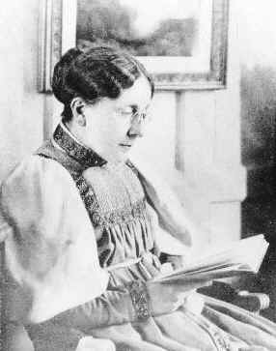
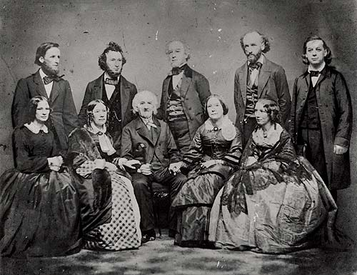
2. Temperance Movement
1826 - American Temperance Society “Demon Rum”!
Frances Willard
The Beecher Family
R1-6
Notes:
Alcohol abuse was rampant in 19th century America (Alcohol Republic)
Decreased the efficiency of labor while increasing injuries in the workplace
Family hindered by physical danger to women and children
Lyman Beecher helped found the American Temperance Society in 1826
Within a few years about 1000 groups emerged
Urged drinkers to give up alcohol

Slide 16
Annual Consumption of Alcohol

Slide 17
Maine
Dow Law, 1851
Prohibited manufacture and sale of liquor

Slide 18
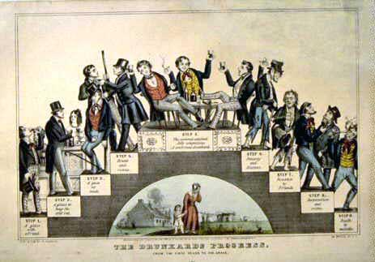
The Drunkard’s Progress
From the first glass to the grave, 1846

Slide 20
Notes:
Frank Slade, you have killed your own father
They are twining around my throat: take them off
Father oh father dear. Come home with me now. The steeple clock strikes one
God helping, I’ll never drink another drop of liquor as long as I live

Slide 22
Notes:
Results of the Temperance Movement
Much less drinking among women
Less per capita consumption of hard liquor

Slide 23
3. “Separate Spheres” Concept
“Cult of Domesticity”
A woman’s “sphere” was in the home (it was a refuge from the cruel world outside).
Her role was to “civilize” her husband and family.
An 1830s MA minister:
The power of woman is her dependence. A woman who gives up that dependence on man to become a reformer yields the power God has given her for her protection, and her character becomes unnatural!
Notes:
Gender lines more sharply drawn in 19th century due to Industrial revolution
Separated men and women into distinct economic roles
Women viewed emotionally and physically weak but also artistic and refines
Republican Motherhood - women seen as keepers of society’s conscience with special responsibility to raise children to become productive citizens

Slide 24
Early 19c Women
Unable to vote.
Legal status of a minor.
Single → could own her own property.
Married → no control over her property or her children.
Could not initiate divorce.
Couldn’t make wills, sign a contract, or bring suit in court without her husband’s permission.

Slide 25
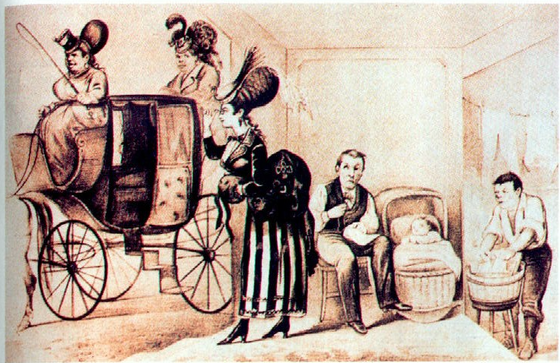
What It Would Be Like If Ladies Had Their Own Way!
R2-8

Slide 26
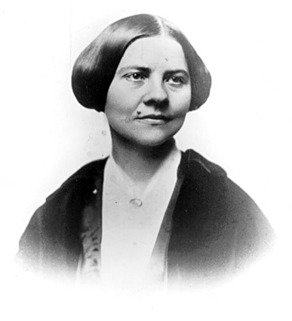
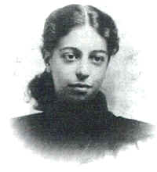
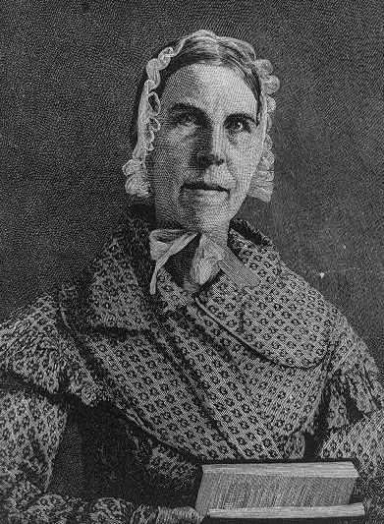
Cult of Domesticity = Slavery
The 2nd Great Awakening inspired women to improve society.
Lucy Stone
Angelina Grimké
Sarah Grimké
American Women’s Suffrage Assoc.
edited Woman’s Journal
Southern Abolitionists
R2-9
Notes:
Grimke sisters grew up in SC with slaves- moved North and joined abolitionist movement
Lucy Stone - abolitionist and women’s suffrage worker. Kept her last name after marrying and now women who do that are known as Lucy Stoners

Slide 27
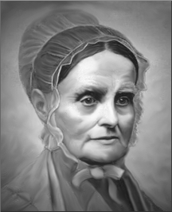
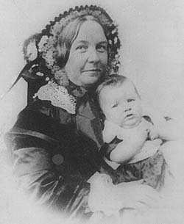
Women’s Rights
1840 --> split in the abolitionist movement over women’s role in it.
London --> World Anti-Slavery Convention
Lucretia Mott
Elizabeth Cady Stanton
1848 --> Seneca Falls Declaration of Sentiments
Notes:
Declaration of Sentiments - “… all men and women are created equal”
One resolution formally demanded women’s suffrage
Launched the modern woman’s rights movement

Slide 28
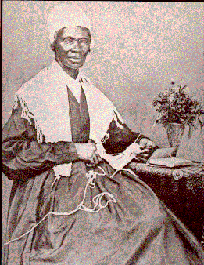
Sojourner Truth (1787-1883) or Isabella Baumfree
1850 --> The Narrative of Sojourner Truth
R2-10

Slide 29
4. Educational Reform
Religious Training → Secular Education
MA → always on the forefront of public educational reform * 1st state to establish tax support for local public schools.
By 1860 every state offered free public education to whites. * US had one of the highest literacy rates.

Slide 30
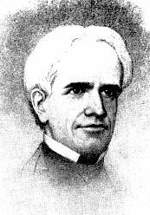
Horace Mann (1796-1859)
“Father of
American Education”
children were clay in the hands of teachers and school officials
children should be “molded” into a state of perfection
discouraged corporal punishment
established state teacher- training programs
R3-6

Slide 31
The McGuffey Eclectic Readers
Used religious parables to teach “American values.”
Teach middle class morality and respect for order.
Teach “3 Rs” + “Protestant ethic” (frugality, hard work, sobriety)
R3-8

Slide 33
Noah Webster
Helped standardize American English

Slide 34
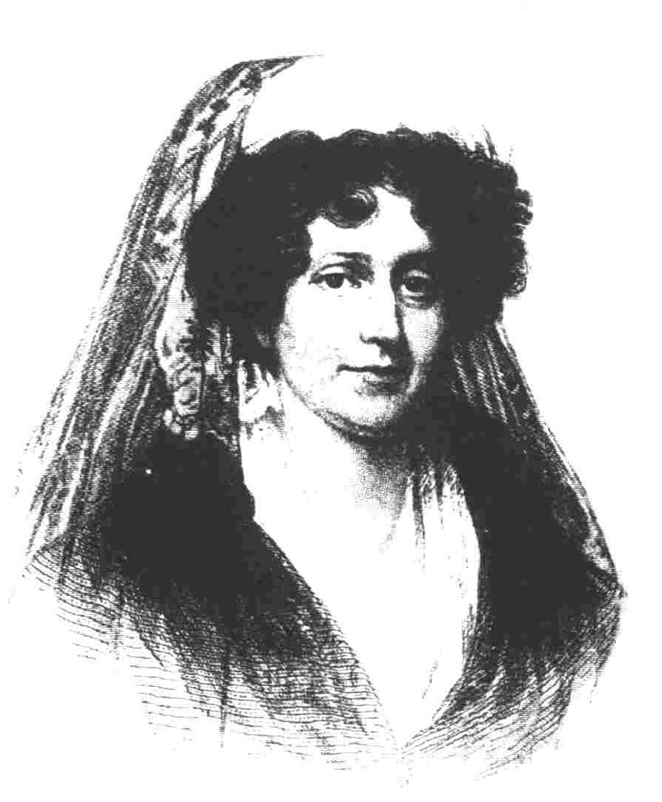
Women Educators
Troy, NY Female Seminary
curriculum: math, physics, history, geography.
train female teachers
Emma Willard (1787-1870)
1837 → she established Mt. Holyoke [So. Hadley, MA] as the first college for women.
Mary Lyons (1797-1849)
Notes:
Women’s schools gained respectability in 1820s
Oberlin College open to both women and men in 1837. Later also open to blacks

Slide 35
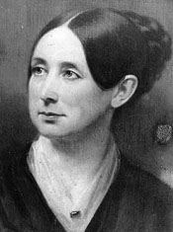
5. Penitentiary Reform
Dorothea Dix
(1802-1887)
1821 → first penitentiary founded in Auburn, NY
R1-5/7
Notes:
Reported on horrible conditions in poorhouses and basements where the insane were often kept in chains
Efforts resulted in improved conditions and influenced the view that the insane were not willfully perverse but mentally ill
Jails also started shifting from punishment to rehabilitation

Slide 36
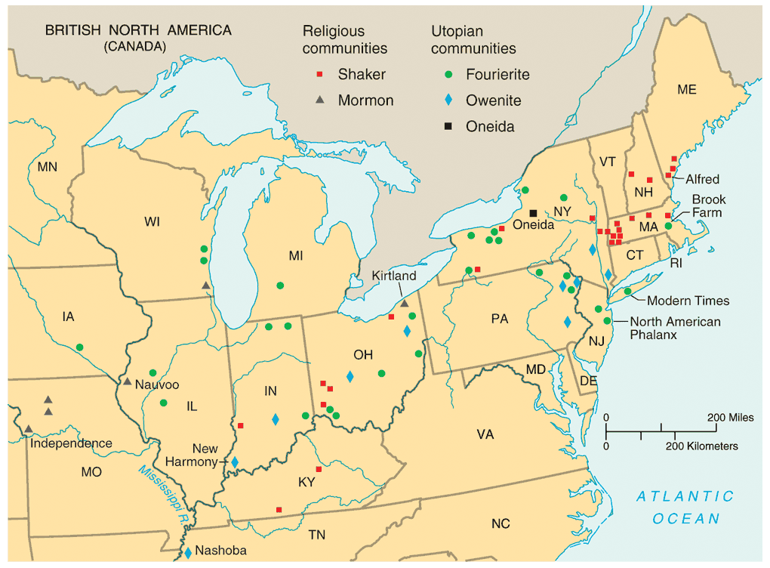
8. Utopian Communities

Slide 37
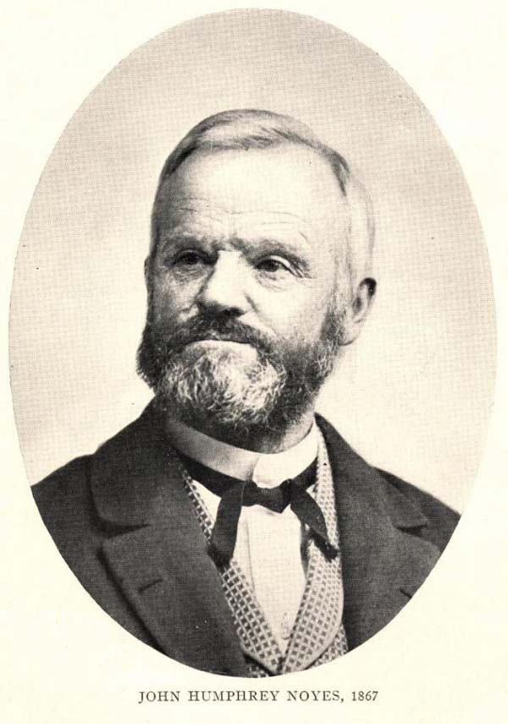
The Oneida Community New York, 1848
Millenarianism --> the 2nd coming of Christ had already occurred.
Humans were no longer obliged to follow the moral rules of the past.
all residents married to each other.
John Humphrey Noyes (1811-1886)
carefully regulated “free love.”

Slide 38
Mother Ann Lee (1736-1784)
The Shakers
If you will take up your crosses against the works of generations, and follow Christ in the regeneration, God will cleanse you from all unrighteousness.
Remember the cries of those who are in need and trouble, that when you are in trouble, God may hear your cries.
If you improve in one talent, God will give you more.

Slide 39
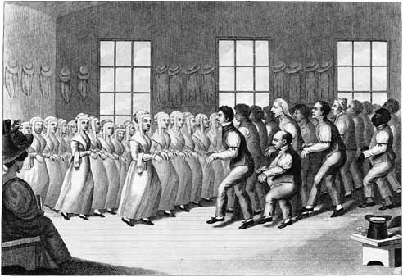
Shaker Meeting
Notes:
United Society of Believers in Christ’s 2nd Coming
Opposition to both marriage and free love led to their extinction
Believed in celibacy, equal spiritual value of men and women
New members were adopted as orphans or recruited through conversion

Slide 40
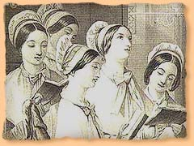
Shaker Hymn
'Tis the gift to be simple, 'Tis the gift to be free, 'Tis the gift to come down where you ought to be, And when we find ourselves in the place just right, 'Twill be in the valley of love and delight. When true simplicity is gained To bow and to bend we shan't be ashamed, To turn, turn will be our delight, 'Till by turning, turning we come round right.

Slide 41
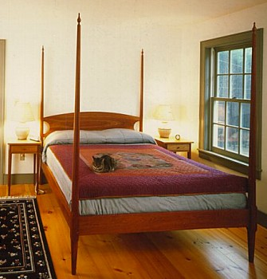
Shaker Simplicity & Utility

Slide 42
Secular Utopian Communities
Individual Freedom
Demands of Community Life
spontaneity
self-fulfillment
discipline
organizational hierarchy

Slide 43
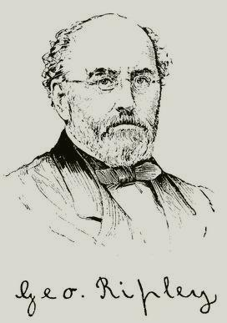
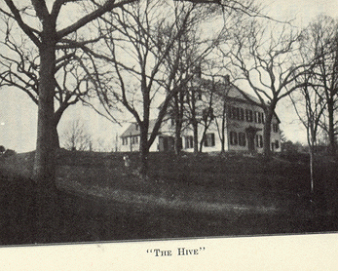
George Ripley (1802-1880)
Brook Farm West Roxbury, MA
Notes:
20 intellectuals
Lasted from 1841-1846
Nathaniel Hawthorne lived here
Plain living and high thinking

Slide 44
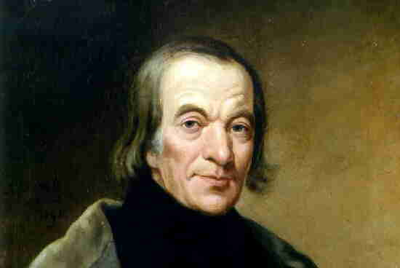
Robert Owen (1771-1858)
Utopian Socialist
“Village of Cooperation”

Slide 45
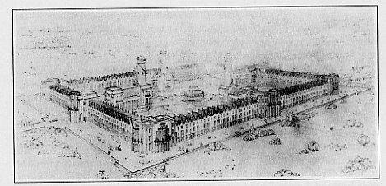
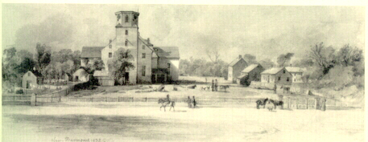
Original Plans for New Harmony, IN
New Harmony in 1832
Notes:
1,000 persons
Founded first American kindergarten, first free public school and first free public library

Slide 46
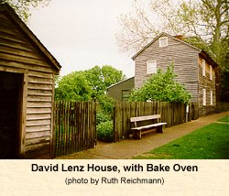
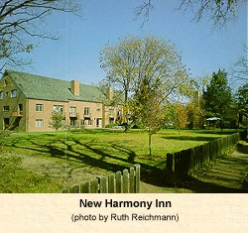
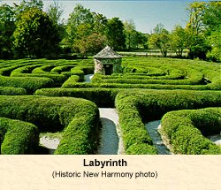
New Harmony, IN

Slide 47
9. Transcendentalism
(European Romanticism)
“Liberation from understanding and the cultivation of reasoning.”
“Transcend” the limits of intellect and allow the emotions, the SOUL, to create an original relationship with the Universe.

Slide 48
Transcendentalist Intellectuals/Writers Concord, MA
Ralph Waldo
Emerson
Henry David
Thoreau
Nature (1832)
Resistance to Civil Disobedience (1849)
Self-Reliance (1841)
Walden (1854)
“The American Scholar” (1837)
R3-1/3/4/5

Slide 49
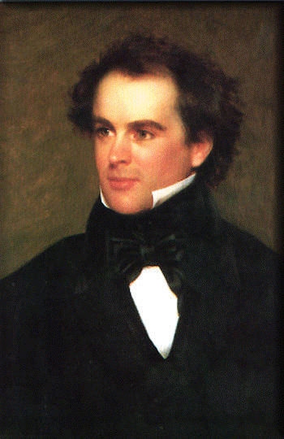
The Anti-Transcendentalist: Nathaniel Hawthorne (1804-1864)
pursuit of the ideal led to a distorted view of human nature and possibilities: * The Blithedale Romance
accept the world as an imperfect place: * Scarlet Letter * House of the Seven Gables

Slide 50
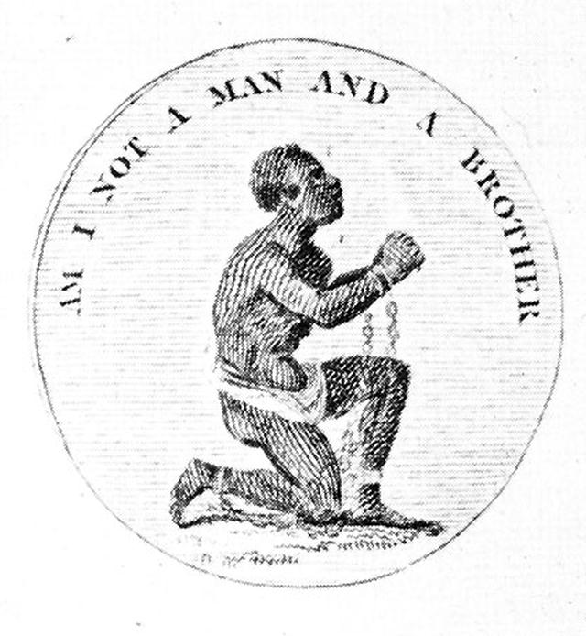
6. Abolitionist Movement
1816 → American Colonization Society created (gradual, voluntary emancipation.
British Colonization Society symbol

Slide 51
Abolitionist Movement
Create a free slave state in Liberia, West Africa.
No real anti-slavery sentiment in the North in the 1820s & 1830s.
Gradualists
Immediatists

Slide 52
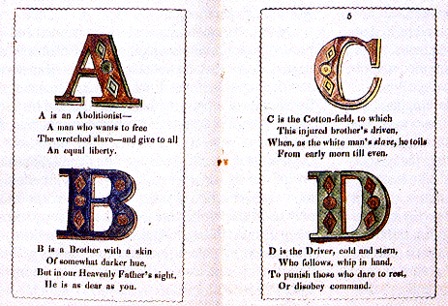
Anti-Slavery Alphabet

Slide 53
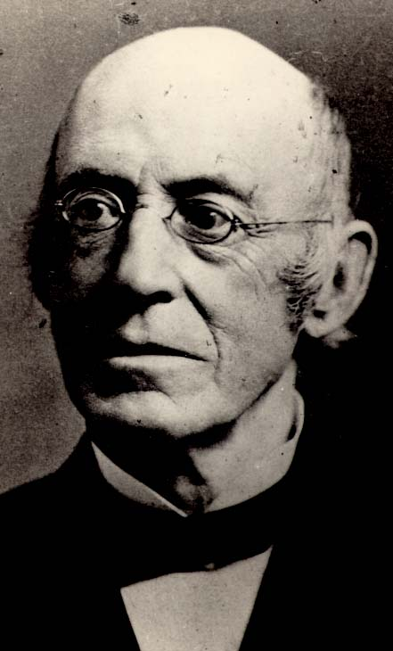
William Lloyd Garrison (1801-1879)
Slavery & Masonry undermined republican values.
Immediate emancipation with NO compensation.
Slavery was a moral, not an economic issue.
R2-4

Slide 54
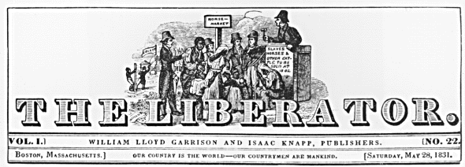
The Liberator
Premiere issue → January 1, 1831
R2-5

Slide 55
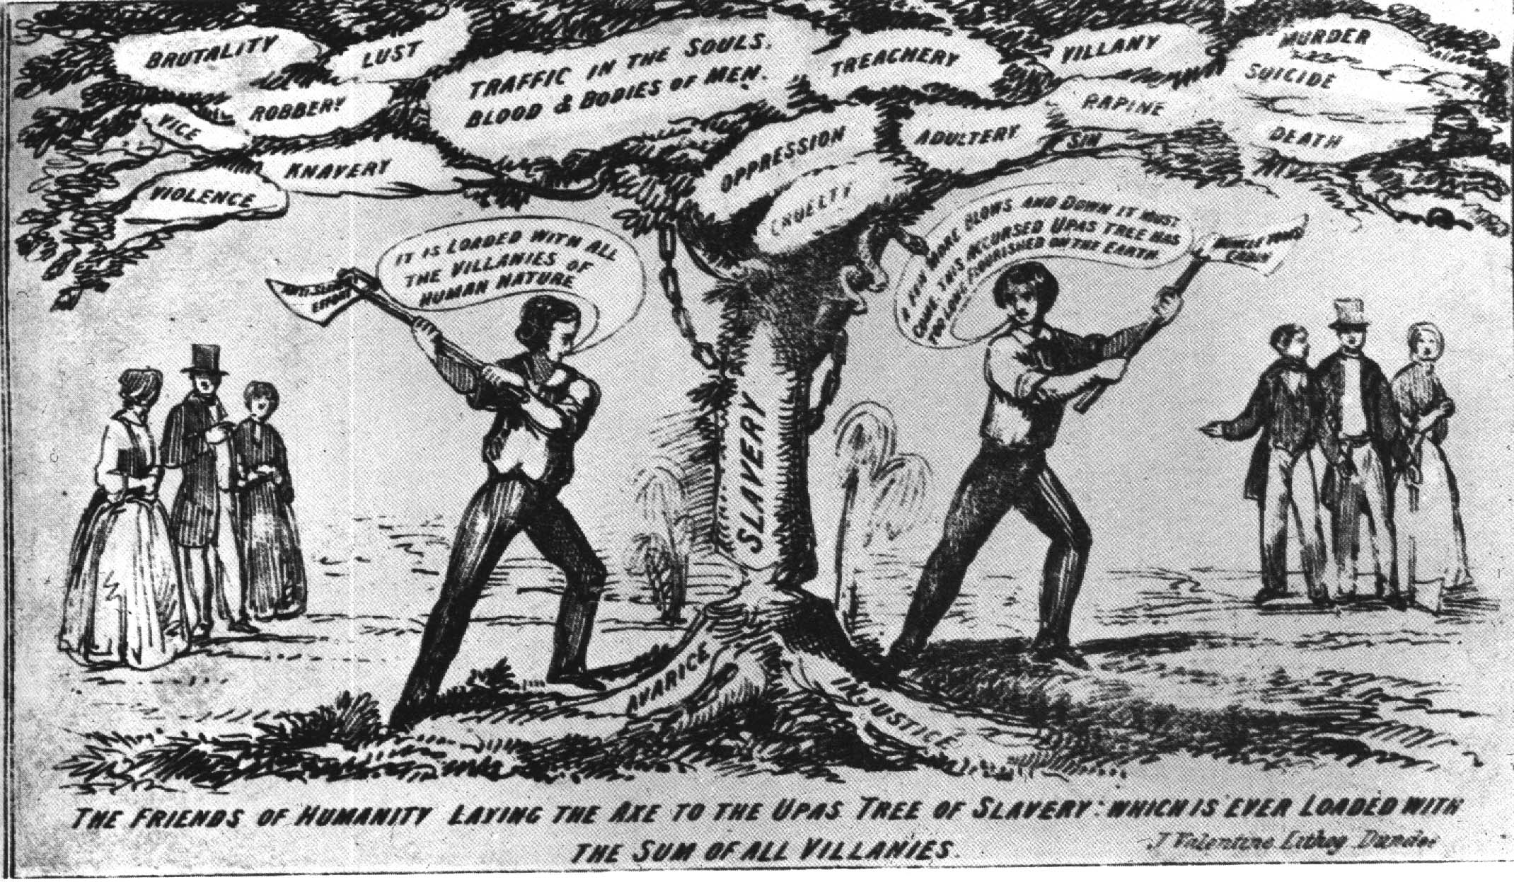
The Tree of Slavery—Loaded with the Sum of All Villanies!

Slide 56
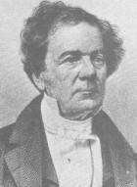
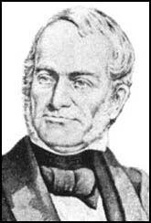
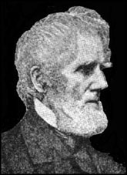
Other White Abolitionists
Lewis Tappan
James Birney
Liberty Party.
Ran for President in 1840 & 1844.
Arthur Tappan

Slide 57
Black Abolitionists
David Walker (1785-1830)
1829 --> Appeal to the Coloured Citizens of the World
Fight for freedom rather than wait to be set free by whites.

Slide 58
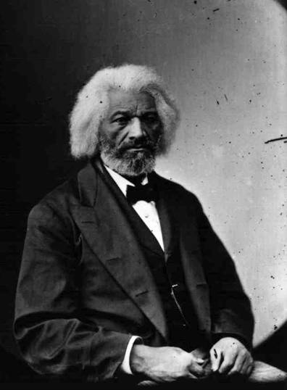
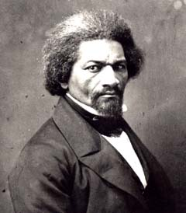
Frederick Douglass (1817-1895)
1845 → The Narrative of the Life Of Frederick Douglass
1847 → “The North Star”
R2-12

Slide 59
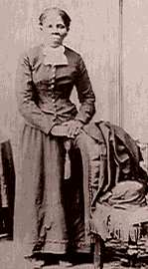
Harriet Tubman (1820-1913)
“Moses”
Helped over 300 slaves to freedom.
$40,000 bounty on her head.
Served as a Union spy during the Civil War.

Slide 60
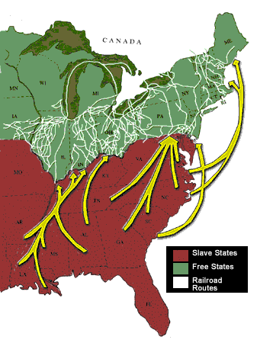
The Underground Railroad

Slide 61
The Underground Railroad
“Conductor” ==== leader of the escape
“Passengers” ==== escaping slaves
“Tracks” ==== routes
“Trains” ==== farm wagons transporting the escaping slaves
“Depots” ==== safe houses to rest/sleep

