Slide 1
The Articles of Confederation

Slide 2
The newly independent Americans didn’t want another tyrannical government.
They overcompensated by creating a government that couldn’t do much at all -
The Articles of Confederation

Slide 3
PROS:
-States were able to keep their power & independence
-No tyrannical government
-Citizens wanted protection - why?
CONS:
-Congress had no power to enforce its own laws
-Congress couldn’t collect taxes to pay for military
-Very difficult to get a unanimous vote - states had different needs & were different sizes

Slide 4
OVERALL:
The Articles of Confederation created a government that was TOO WEAK

Slide 5
Shays’ Rebellion highlighted major issues with the AOC
-Daniel Shays was a farmer who had fought in the Revolutionary War & couldn’t meet his financial demands
-He and thousands of others planned to overthrow the new government
-The last thing the new country needed was another revolution

Slide 6
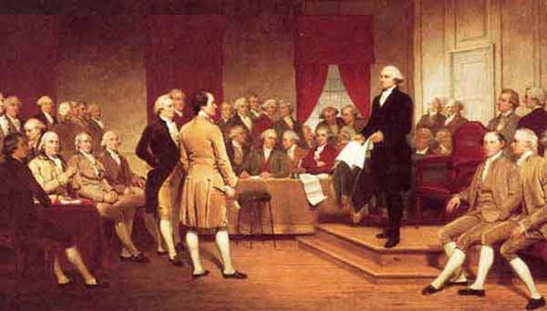
The Constitutional Convention

Slide 7
Leaders of the Convention
George Washington was asked to preside (lead) over the convention.
James Madison kept notes of the discussions and is often called “The Father of the Constitution.”
The men who wrote the Constitution are called the “Founding Fathers.”
All the participants in the Convention were wealthy, white, males.

Slide 8
The Virginia Plan
Called for a new national government. Threw out the Articles of Confederation
Three separate branches of government. – a legislative branch, executive branch, and judicial branch
Representation in the legislative branch based on population of state
Large states like the plan, small states don’t.

Slide 9
New Jersey Plan
Legislature would have one house (unicameral).
Each state gets one vote.
Small states like the plan, the large states hate it.
There would have to be a compromise.

Slide 10
The Great Compromise (Connecticut Compromise)
Legislature would have two houses (bicameral): House of Representatives and a Senate
House - based on the population of state
Senate - two senators per each state

Slide 11
Slavery
The Southern states refused to approve the Constitution unless slavery continued.
3/5 Compromise - Made each slave worth 3/5 of a vote in deciding numbers in House of Representatives

Slide 12
The Ratification Process
Article VII (7): “The ratification of the conventions of nine states shall be sufficient for the establishment of this Constitution between the States so ratifying the same”
RATIFY: to approve

Slide 13
The Ratification Process
Federalists (favored ratification) “Nationalists”
Stressed the weaknesses of the Articles of Confederation
Published a series of articles called the Federalist Papers to defend the Constitution
Anti-Federalists (opposed to ratification) “States Rights”
Feared the Constitution favored an elite minority
Constitution failed to protect individual freedoms and rights
National government would limit the power of the states

Slide 14
The Ratification Process
DEAL: Federalists promised to add a Bill of Rights to protect individual freedoms and state rights (First 10 Amendments)

