Slide 1
The Bill of Rights?
EQ: What are the Bill of Rights and how do they apply to my life?

Slide 2
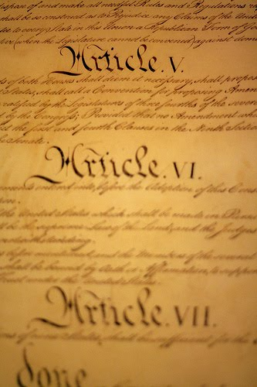
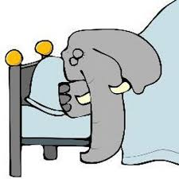
17L: Warm-up/transition
List the 7 Articles of the Constitution! Try not to use your notes!

Slide 3
7 Articles
Article I: Legislative Branch
Article II: Executive Branch
Article III: Judicial Branch
Article IV: Relations Among the States
Article V: Amendment Process
Article VI: National Supremacy
Article: VII: Ratification Process

Slide 4
Unit Goals
You will understand the factual knowledge of each Article and Amendment of the Constitution.
You will understand the historical context of why each amendment was added to the Constitution.
You will understand how each amendment applies to your life and the greater context of American society.

Slide 5
17R: The first 10 Amendments: The Bill of Rights
The first 10 amendments to the Constitution are collectively known as The Bill of Rights. They were added as a compromise to convince the Anti Federalists to sign the Constitution. They were added in 1791.

Slide 6
Amendment I
Congress shall make no law respecting an establishment of religion, or prohibiting the free exercise thereof; or abridging the freedom of speech, or of the press; or the right of the people peaceably to assemble, and to petition the Government for a redress of grievances.
R.A.P.P.S.

Slide 7
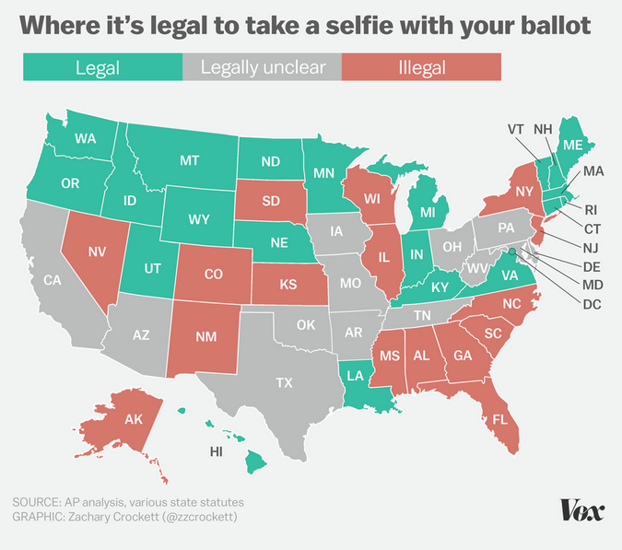
What do you think? Is it illegal to take a selfie with your ballot in N.C.? (14L)
How accurate was your prediction? What surprised you?
What patterns do you see in this data?
Do you personally believe that it should be illegal to take a selfie with your ballot? Explain.
What did the Framers of the Constitution write about Selfies in the 1st Amendment?
Okay, so this is sort of silly, but what does it tell us about federalism and elections?
Let's just say that the Supreme Court ruled on this, what is an argument someone in support of allowing ballot selfies could make:
Use the language of the Bill of Rights to write a 28th Amendment about Selfie Sticks in Voting Booths.
Notes:
Press Space Bar to see Map

Slide 8
Prohibited Speech
SLANDER or LIBEL
Speech that impugns a person's reputation resulting in demonstrable harm, especially (but not exclusively) financial harm. Penalties are civil rather than criminal.
INTENTIONAL INFLICTION OF EMOTIONAL DISTRESS
Extreme or outrageous speech intended specifically to cause an individual or group distress. Usually a civil rather than criminal matter.

Slide 9
Prohibited Speech
THREATS
Speech that is intended to intimidate. This would include bullying and specific believable threats of physical harm. An offhand angry remark like "I could kill her" would not count, but saying, "I will kill you" to someone who believes that you have the will and means to do so would count. This is usually a criminal matter.

Slide 10
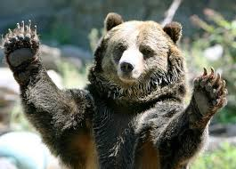
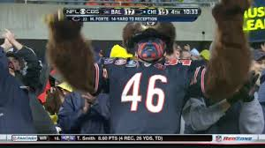
Amendment II
A well regulated militia being necessary to the security of a free state, the right of the people to keep and bear arms shall not be infringed.

Slide 11
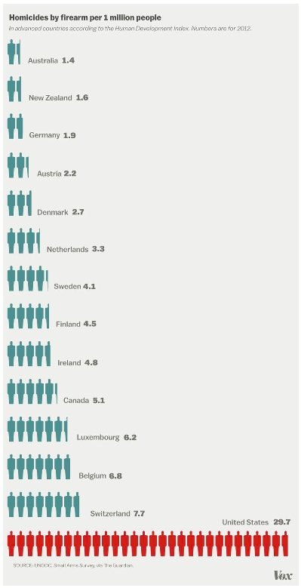
How does the US compare to other wealthy countries in the rate of homicides by firearm?
What is one consequence of the astronomically high homicide rate by firearm in the US?
What could the US do to reduce homicide rates?
What should the US do to reduce homicide rates?
If this chart were entitled and contained data on, "homicides by turtle attack", do you think we would ban turtle ownership or at least make turtles harder to get?
The US has considerably less stringent firearms laws than the other countries listed in the chart. Why do you think that is?
The Second Amendment reads: "A well regulated Militia, being necessary to the security of a free State, the right of the people to keep and bear Arms, shall not be infringed." In the comments section, based on this chart, write the Second Amendment as you would like it to be written today:
Notes:
Have students jot down answers and discuss with a partner

Slide 12
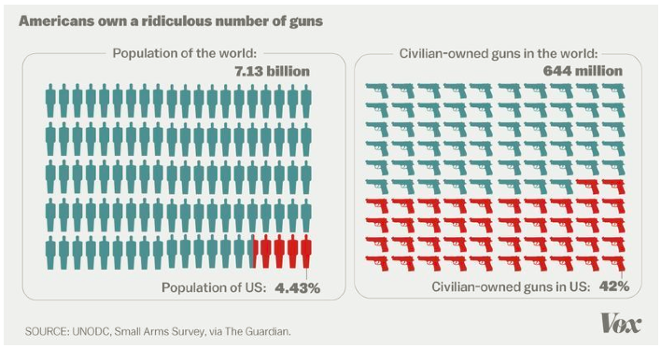
Bonus Chart!

Slide 13
Amendment III
No Soldier shall, in time of peace be quartered in any house, without the consent of the Owner, nor in time of war, but in a manner to be prescribed by law

Slide 14
Amendment IV
The right of the people to be secure in their persons, houses, papers, and effects, against unreasonable searches and seizures, shall not be violated, and no Warrants shall issue, but upon probable cause, supported by Oath or affirmation, and particularly describing the place to be searched, and the persons or things to be seized.

Slide 15
Amendment V
No person shall be held to answer for a capital, or otherwise infamous crime, unless on a presentment or indictment of a grand jury, except in cases arising in the land or naval forces, or in the militia, when in actual service in time of war or public danger; nor shall any person be subject for the same offense to be twice put in jeopardy of life or limb; nor shall be compelled in any criminal case to be a witness against himself, nor be deprived of life, liberty, or property, without due process of law; nor shall private property be taken for public use, without just compensation.

Slide 16
Amendment VI
In all criminal prosecutions, the accused shall enjoy the right to a speedy and public trial, by an impartial jury of the state and district wherein the crime shall have been committed, which district shall have been previously ascertained by law, and to be informed of the nature and cause of the accusation; to be confronted with the witnesses against him; to have compulsory process for obtaining witnesses in his favor, and to have the assistance of counsel for his defense.

Slide 17
Amendment VII
In suits at common law, where the value in controversy shall exceed twenty dollars, the right of trial by jury shall be preserved, and no fact tried by a jury, shall be otherwise reexamined in any court of the United States, than according to the rules of the common law.

Slide 18
Amendment VIII
Excessive bail shall not be required, nor excessive fines imposed, nor cruel and unusual punishments inflicted.

Slide 19
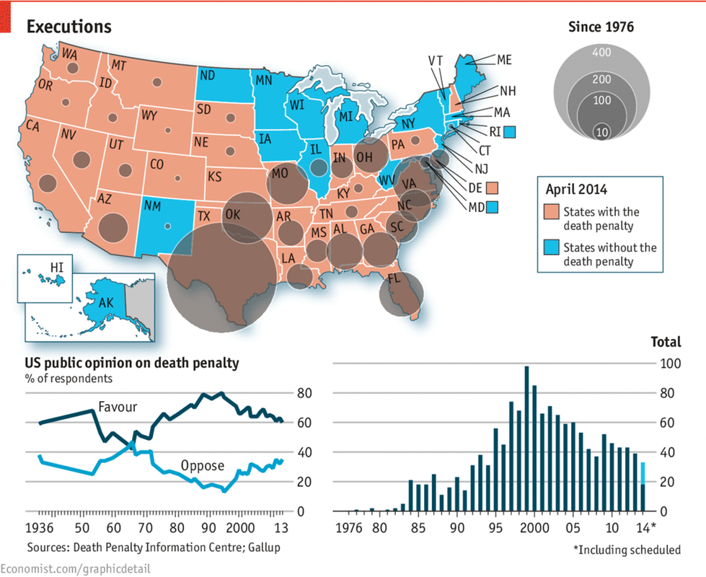
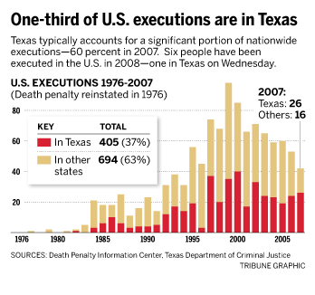
8th Amendment in Action

Slide 20
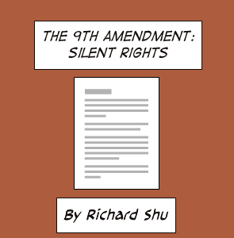
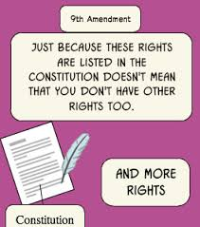
Amendment IX
The enumeration in the Constitution, of certain rights, shall not be construed to deny or disparage others retained by the people.

Slide 21
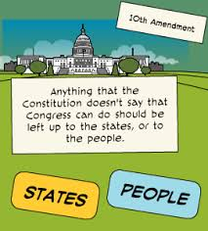
Amendment X
The powers not delegated to the United States by the Constitution, nor prohibited by it to the states, are reserved to the states respectively, or to the people.

Slide 22
Can you apply the Amendments?
Read Each of the scenarios
Decide if there is a violation or not and circle the correct answer
Justify your answer is the box using one of the bill of rights.
We will use fairness cards to go over….
Let’s do one together first:
A 20 year old college student starts his own newspaper, which often prints article making fun of the local mayor. The mayor is angry and gets his aids to take the papers off the stand before they can be distributed.
Violation | No Violation | Amendment Support:

Slide 23
Bill of Rights: hypothetical situations
--Read each scenario. Circle “violation” or “no violation” and then write the number of amendment and appropriate phrases from the amendment (see side #1) that relate to the situation.

