Slide 1
The Civil War
Chapter 11

Slide 2
The Civil War

Slide 3
Early Civil War Battle’s Chart
Pod’s will create an early Civil War chart. The chart will help students keep track of information on three major early battles of the Civil war (Fort Sumter, Bull Run, and Antietam).
Students should collect information on the dates of the battle, where the battle was located, who won the battle, major generals or commanders involved, 1 informative and interesting fact on the battle, an Illustration, and why the battle is significant.
Pod’s will use the class laptops, their own electronic devices, and textbook to find information to fill out their chart.

Slide 4
What happens after Fort Sumter?
Lincoln calls for 75,000 volunteers to serve for 3 months. Overwhelming response
Virginia Secedes: devastating for Union. Most populous and industrialized Southern State
In May Arkansas, Tennessee, and North Carolina Secede
Western Virginia counties secede from Virginia stay with the Union. These counties in 1863 get admitted into Union as West Virginia.

Slide 5
North vs. South in 1861
 | North | South
Advantages | ? | ?
Disadvantages | ? | ?

Slide 6
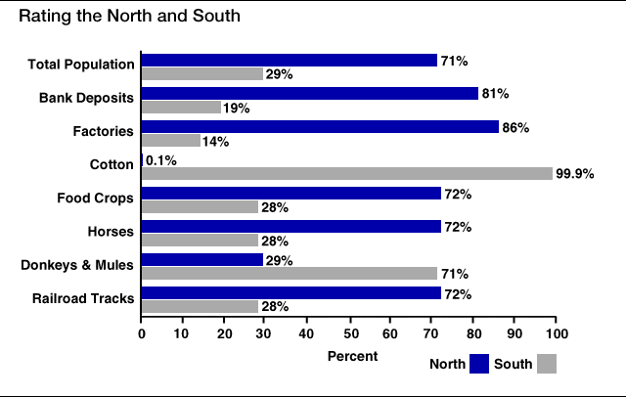
Rating the North & the South

Slide 7
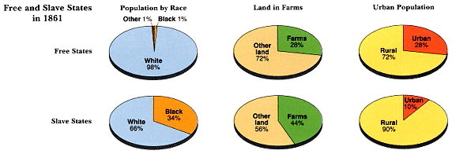
Slave/Free States Population, 1861

Slide 8
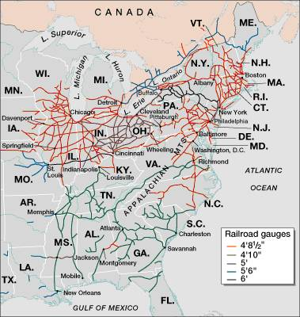
Railroad Lines, 1860

Slide 9
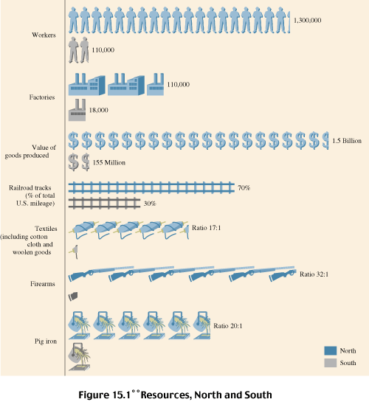
Resources: North & the South

Slide 10
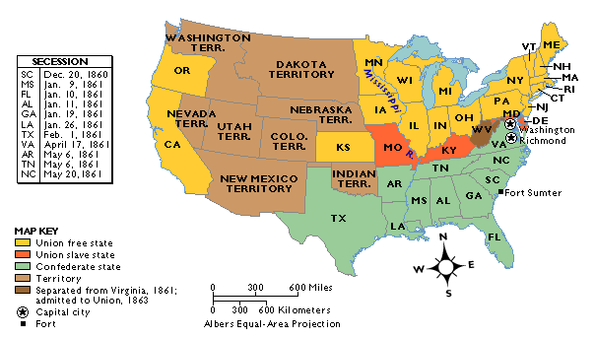
The Union & Confederacy in 1861

Slide 11
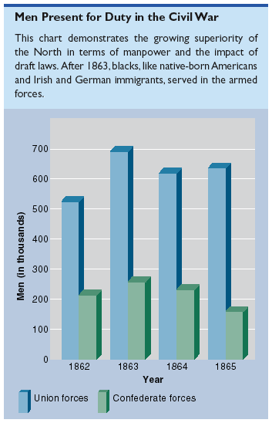
Men Present for Duty in the Civil War

Slide 12
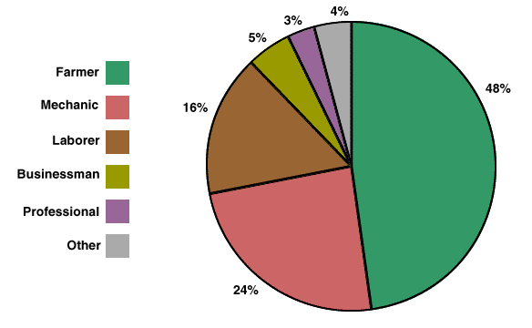
Soldiers’ Occupations: North/South Combined

Slide 13
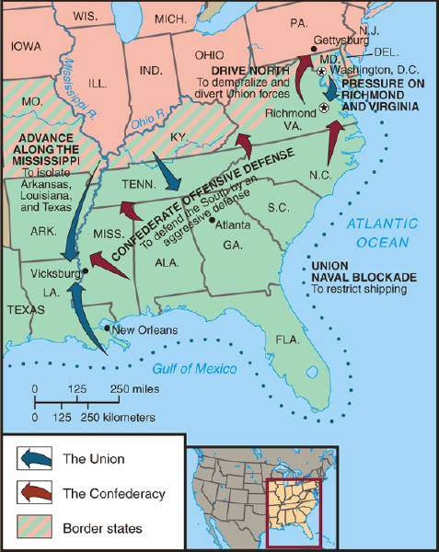
Overview of the North’s Civil War Strategy:
“Anaconda” Plan
Blockade the coast
Capture Confederate Capital---Richmond
Capture/Control the Mississippi River-thus splitting the Confederacy into two.

Slide 14
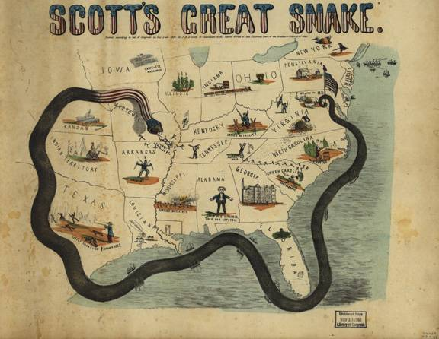
The “Anaconda” Plan

Slide 15
New Technologies in War
Invention of the rifle, deadly because it allowed soldiers to fire more quickly and with greater accuracy than old muskets.
Invention of the minie ball, a soft lead bullet that was more destructive than earlier bullets.
These two combined for mass destruction in frontal infantry attacks

Slide 16
Ironclad Ships
Could splinter wooden ships, withstand cannon fire, and resist burning.
Monitor (Union) vs Merrimack (Confederacy) first battle between ironclad ships changed the course of naval history.

Slide 17
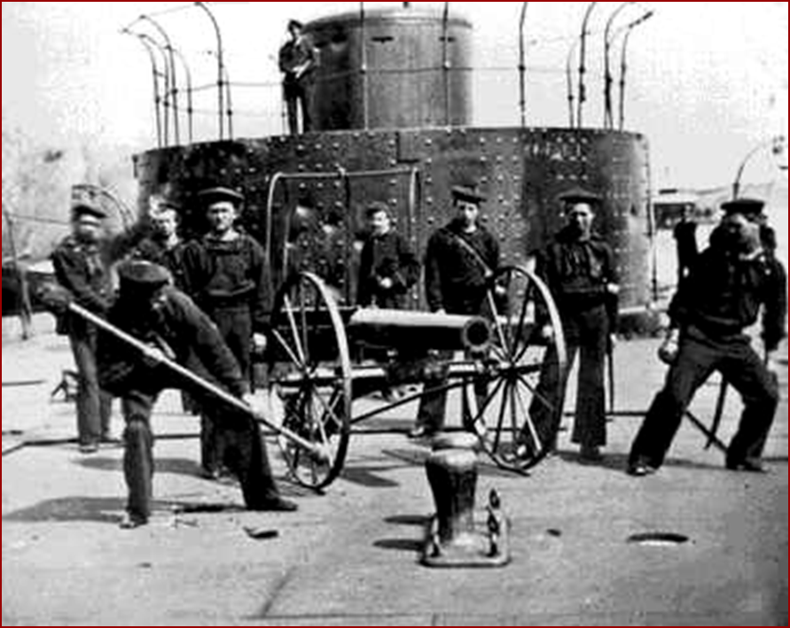
Merrimack v Monitor

Slide 18
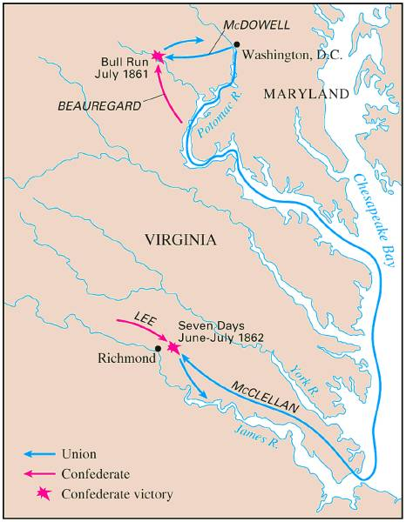
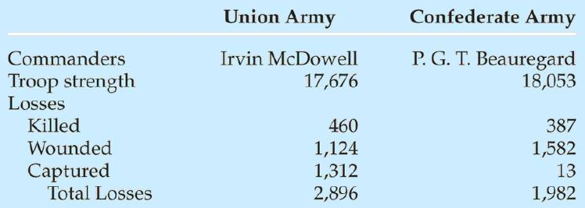
Battle of Bull Run (1st Manassas) July, 1861
1st Major Battle of the War
Both sides had to prepare for long war

Slide 19
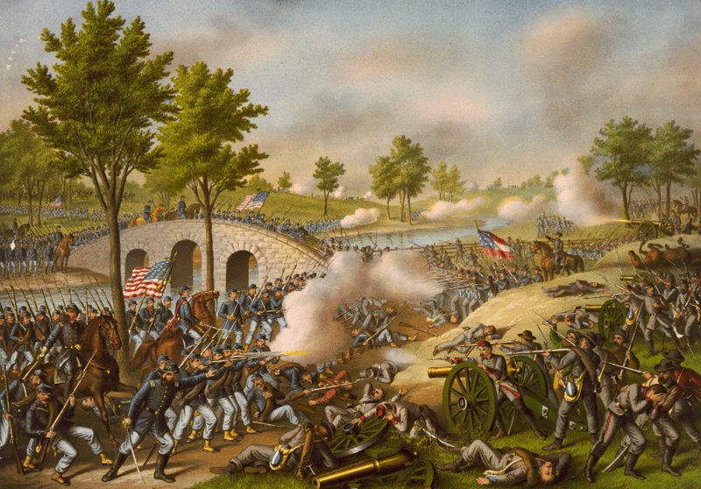
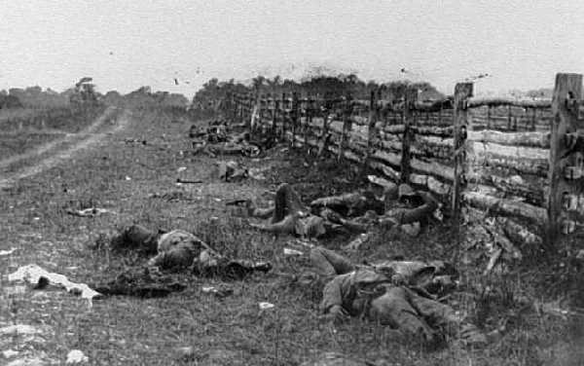
Battle of Antietam “Bloodiest Single Day of the War”
September 17, 1862
After this Battle, Lincoln issued the Emancipation Proclamation
23,000 casualties

Slide 20
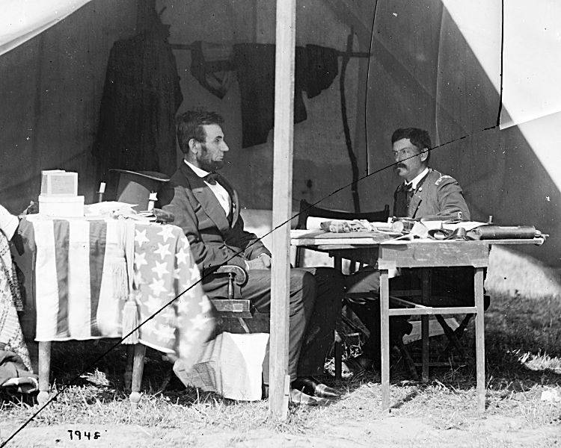
McClellan: I Can Do It All!

Slide 21
General George McClellan
Appointed to lead Union army after Union defeat at Bull Run.
Army of the Potomac
Extremely Cautious military tactician. After five months of training and army of 120,000 he insisted he could not move on Richmond till he commanded an army of 270,000.
Battle of Antietam: McClellan’s army against Lee’s in the bloodiest single day battle in United States history.
After the battle McClellan chose not to pursue Confederate army into their territory. President Lincoln would then fire McClellan over this overly cautious decision and failure to win the battle decisively

Slide 22
Diplomatic Relations with Great Britain
Britain no longer dependent on Southern Cotton. They were using Egyptian and Indian cotton. Did however become dependent on Northern Wheat and Corn.
Confederate govt sent two diplomats( John Slidell and James Mason) to Great Britain and France in attempt to gain support for their cause.
“The Trent Affair”: the two diplomats were on aboard the British merchant ship the Trent. It was stopped by an American warship and the two men were arrested.
Great Britain is outraged puts 8,000 troops on Canadian border. Lincoln orders the two men to be released. Crisis avoided.

Slide 23
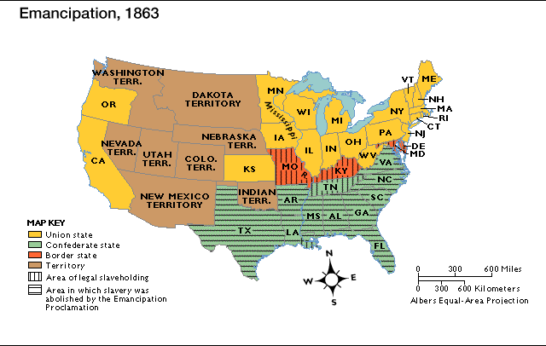
Emancipation Proclamation
Lincoln used his powers as commander-in-chief
Freed the slaves in the states that were still in rebellion
Keep France and Britain out of the War.

Slide 24
Emancipation Proclamation
Given January 1, 1863
Applied only to slaves in the Confederacy. (Not to slave states who had not seceded)
Not much of a practical effect, but had symbolic importance. Gave the war a moral purpose
Allowed for free blacks in the North to enlist in the Union army.

Slide 25
Reactions to Emancipation Proclamation
Not all in the North in favor of it.
Democrats claimed it would only prolong the war
Confederates reacted with outrage
Jefferson Davis called it “the most execrable measure recorded in the history of guilty man”
After the Emancipation Proclamation both sides knew there would be no compromise. If the Confederacy lost the slave holding society would perish.

Slide 26
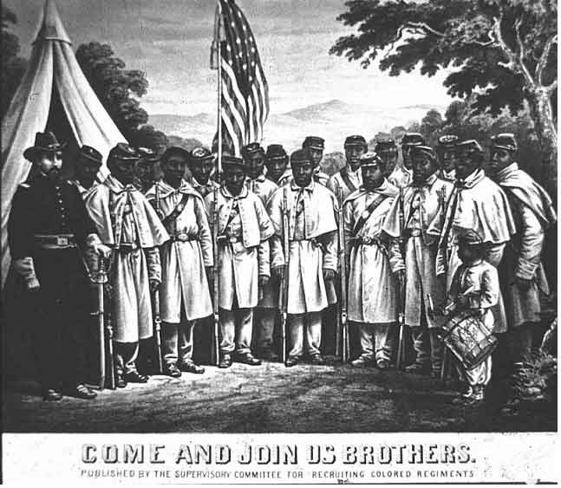
African-American Recruiting Poster

Slide 27
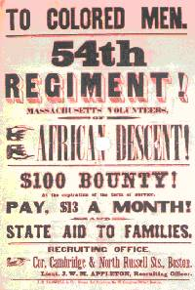
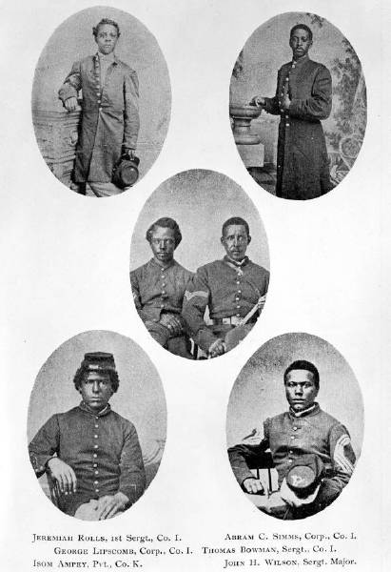
The Famous 54th Massachusetts
Most famous black regiment of the Civil War

Slide 28
Bellwork Review Questions
Describe the battles of Antietam, Fort Sumter, and Bull Run.
What was the Anaconda Plan? What were its three parts? Who created it?
What was the Trent Affair?
Describe the impact of the Emancipation Proclamation?

Slide 29
Political Problems in North and South
Sympathizers in both countries
Lincoln suspends habeas corpus in Maryland in response to a Baltimore mob attacking union soldiers. (he did this later in other border states)
13,000 confederate sympathizers arrested and held without trial
Chief Justice Taney declared Lincoln had gone beyond his constitutional powers. Lincoln ignored this ruling.
Lincoln’s wartime actions set precedent for future presidents

Slide 30
Political Problems in the North and South
Copperheads: Northern Democrats who advocated for peace with the Confederates.
Desertion of soldiers
Conscription: A draft law that would force certain members of both North and South to serve in their respective armies.
First Confederacy draft law was white men 18-35 (1864 law changed now 17-50).
The North’s draft law white men 20-45 (or pay $300 fee to avoid the draft)

Slide 31
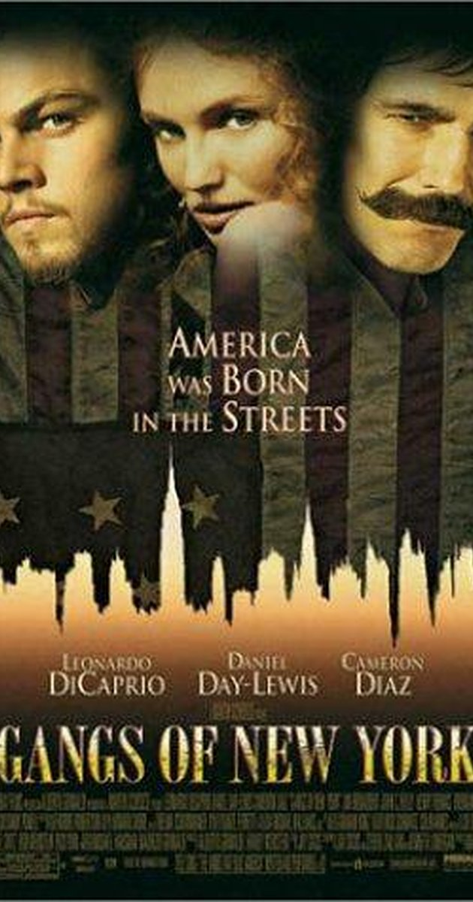
New York City Draft Riots 1863 July 13-16
Large poor and immigrant population
Feared Southern blacks would take their jobs
Attacked the wealthy and African Americans
100 dead by the time federal troops arrive

Slide 32
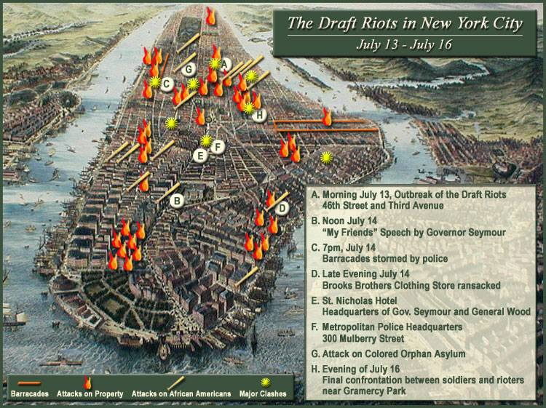
NYC Draft Riots, (July 13-16, 1863)

Slide 33
The war’s impact on the economy
In general the war expanded the North’s economy and shattered the South’s.
Confederacy faced food shortages
Confederacy faced heavy inflation
The Union saw an industrial boom as a result of military manufacturing
Union became more reliant on machinery to make up for lost man power.

Slide 34
Northern Economy
1863 Congress enacts first income tax law, a tax that take s a specified percentage of an individuals income.
Women replace men in the workforce, worked on farms even city and government jobs. Earned less money but many would remain workers after the war.

Slide 35
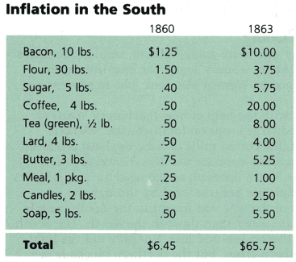
Inflation in the South
Gu4lOkcIG9hI3

Slide 36
Civil War Medicine
United States Sanitary Commission: Government agency set up to improve hygienic conditions of army camps and to recruit/train nurses.
Clara Barton “the angel of the battlefield”
Sanitary commission helped improve the death rate among Union wounded when compared to previous wars.

Slide 37
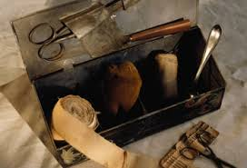
Civil War medicine

Slide 38
Prisoner of war camps
Limited shelter, terrible hygiene, overcrowded, and limited food.
Andersonville, Georgia: Largest Confederate prison. 1/3 of its prisoners died. Prisoners drank from same stream that served as their sewer.
In total 15% of Northern prisoners died in Confederate prisons, while 12% of Confederate Prisoners died in North Prisons.

Slide 39
Andersonville

Slide 40
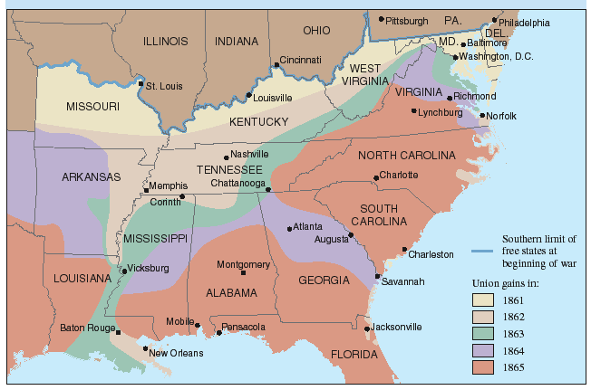
The Progress of War: 1861-1865

Slide 41
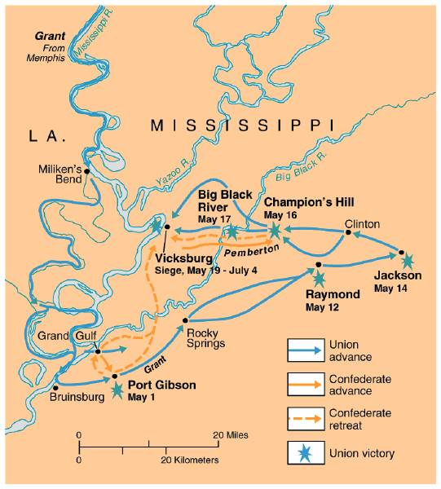
The War in the West, 1863:
Vicksburg
Turning point of the Western Theater.
Gave North Control of Miss. River

Slide 42
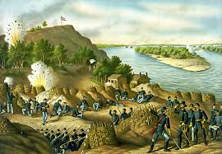
Siege of Vicksburg
City was shelled throughout the day
Ulysses S. Grant
Food supplies low in city, people ate dogs and mules
Forced CSA to surrender Vicksburg 7/4/1863 cut the country in two.

Slide 43
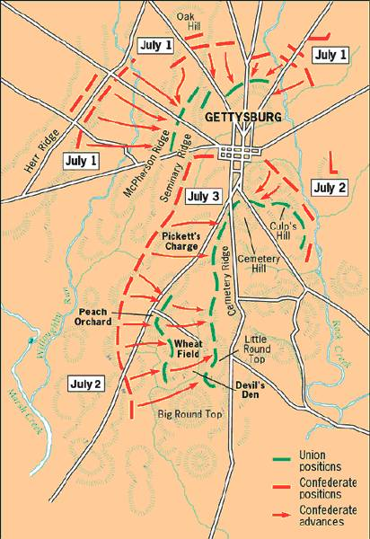
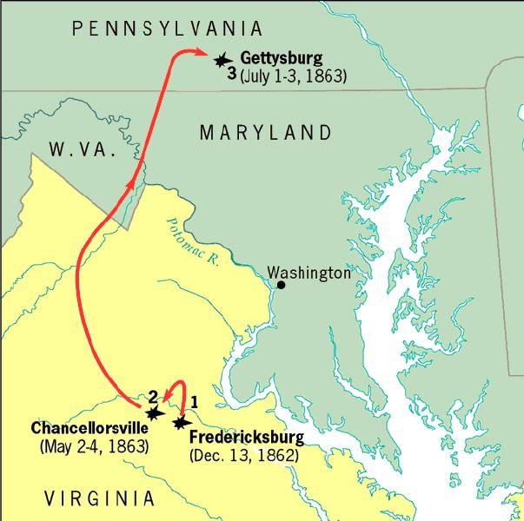
The Road to Gettysburg: 1863
Turning point in the Eastern Theater
The South never attacked the north again.

Slide 44
Battle of Gettysburg
Three day battle
Pickett’s Charge
Corpses everywhere, smell unbearable in July heat
General Lee took total responsibility for defeat at Gettysburg attempted to resign from his position of commander of CSA army.

Slide 45
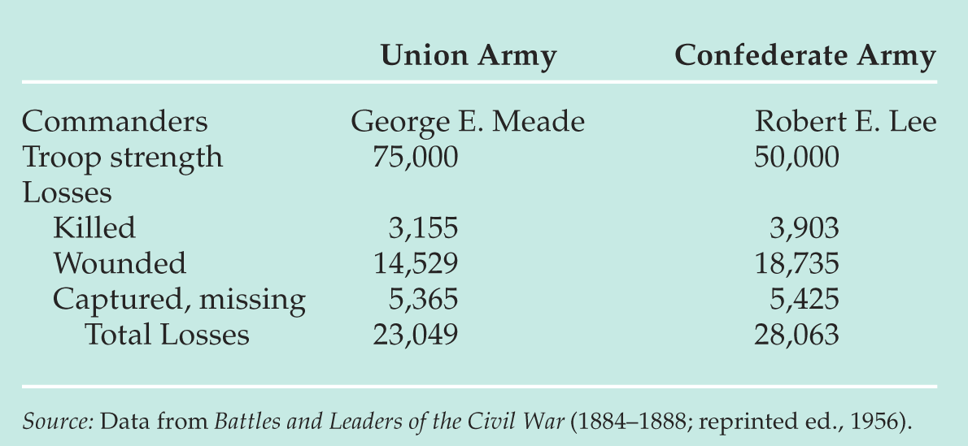
Gettysburg Casualties

Slide 46
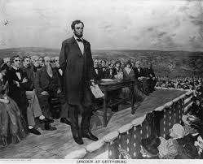
Gettysburg Address
November 19, 1863
Ceremony to dedicate national cemetery
Speech by Lincoln was 2 minutes long, remade America.
Restatement of American democratic ideas

Slide 47
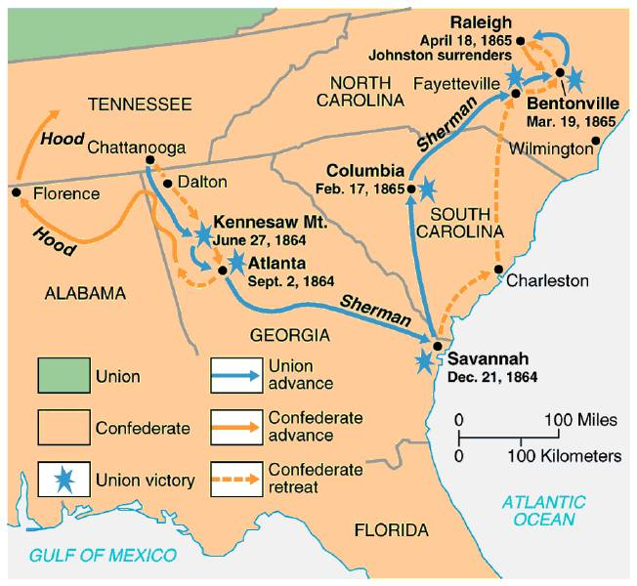
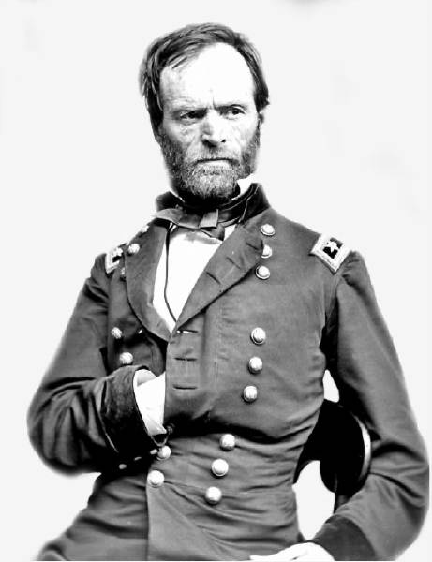
Sherman’s“ March to the Sea” through Georgia,1864
Implemented total warfare—making civilians feel the pain of war.
His burning of Atlanta helped Lincoln win reelection.

Slide 48
William Sherman
Union General- Proponent of total war in the South.
“The fields were trampled down and the road was lined with carcasses of horses, hogs, and cattle that the invaders, unable either to consume or to carry away with them, had wantonly shot down, to starve out the people and prevent them from making their crops. The dwellings that were standing all showed signs of pillage”- Southern Civilian’s perspective

Slide 49
Sherman’s March

Slide 50
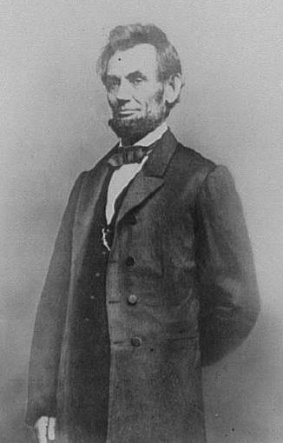
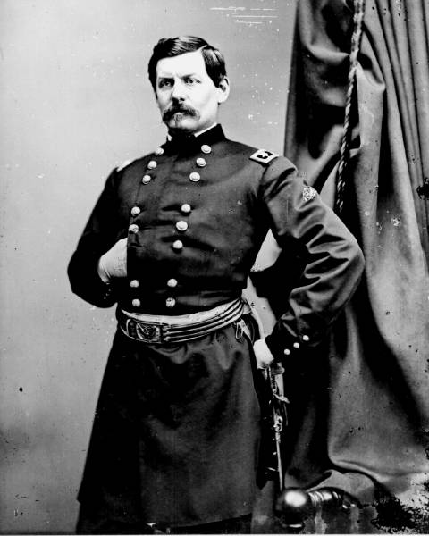
1864 Election
Pres. Lincoln (R)
George McClellan (D)

Slide 51
Election of 1864
Lincoln in August of 1864: “I am going to be beaten, and unless some great change takes place, badly beaten.”
Chose Andrew Johnson as VP ( a Democrat from Tennessee)
Union forces capture Mobile Bay in Alabama, Atlanta, and Northern Virginia.

Slide 52
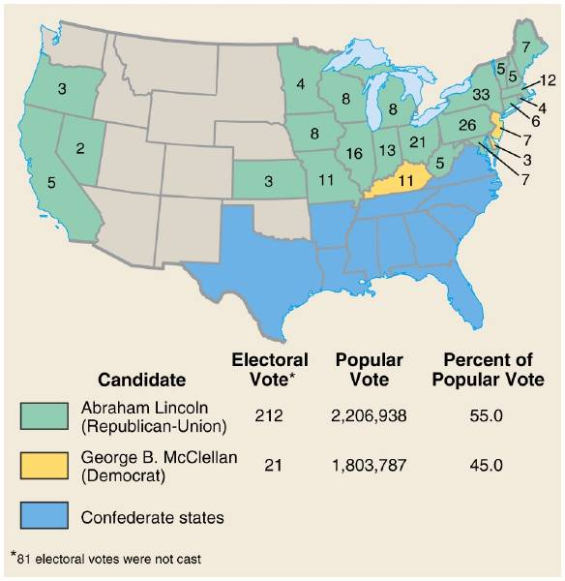
Presidential Election Results: 1864
Includes absentee ballots of Union soldiers.

Slide 53
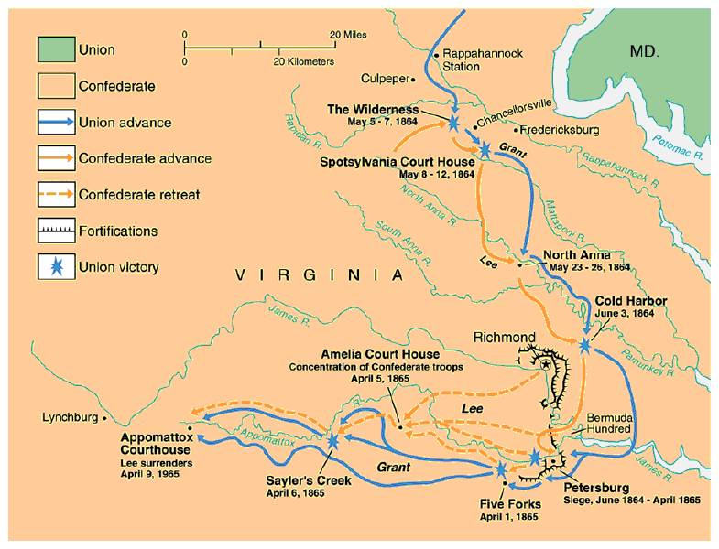
The Final Virginia Campaign: 1864-1865
April 2, 1865 Richmond is abandoned.

Slide 54
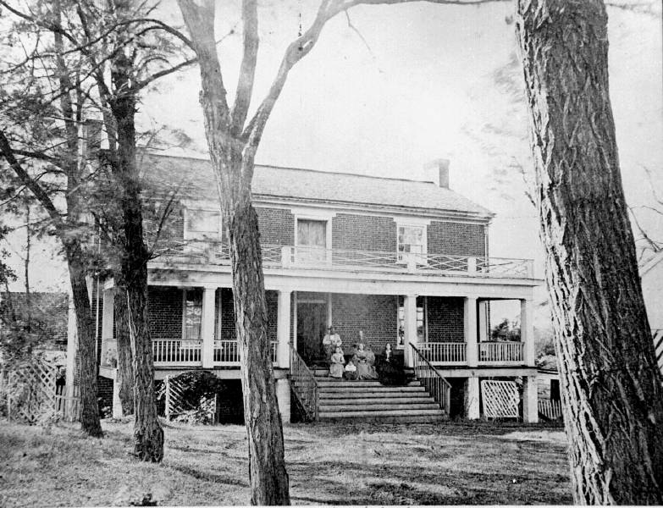
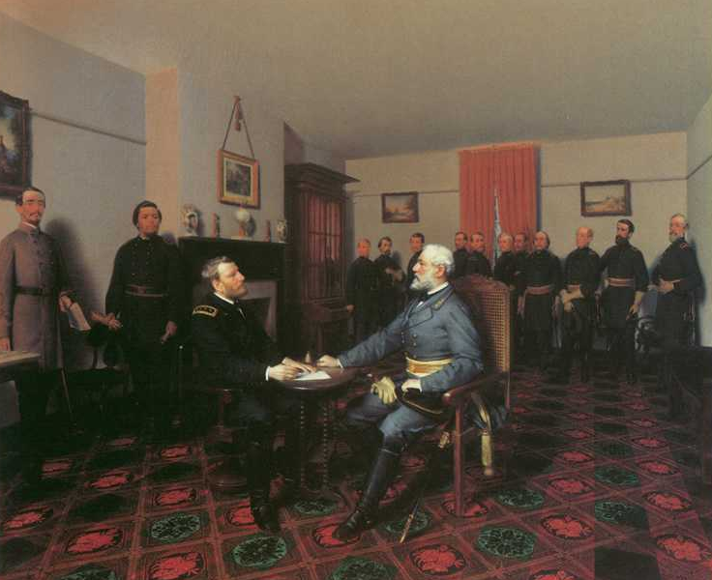
Surrender at Appomattox April 9, 1865
Generous terms for Lee and his men at Lincoln’s request.
Within two months all remaining Confederate forces collapsed

Slide 55
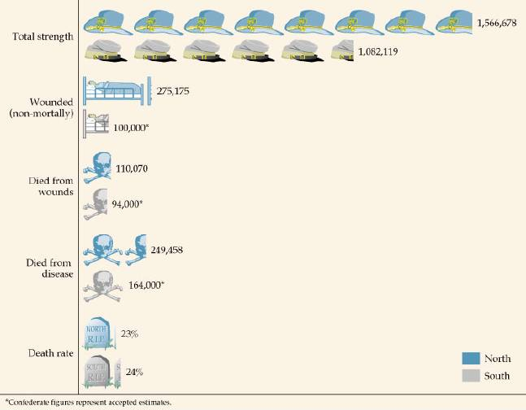
Casualties on Both Sides

