Slide 1
North vs. South in 1861
 | North | South
Advantages | ? | ?
Disadvantages | ? | ?

Slide 2
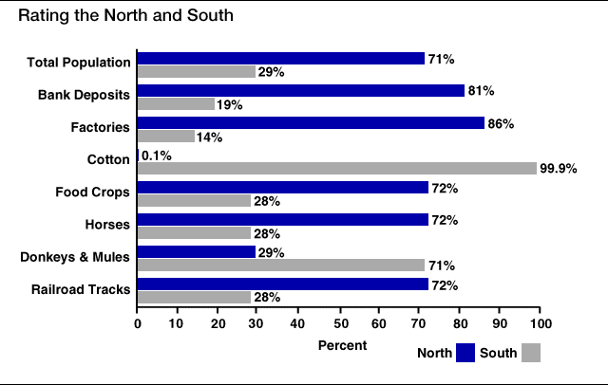
Rating the North & the South

Slide 3
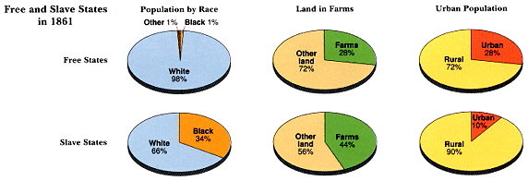
Slave/Free States Population, 1861

Slide 4
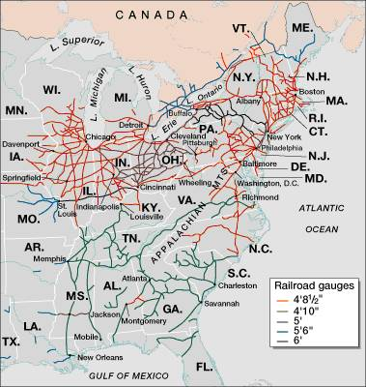
Railroad Lines, 1860

Slide 5
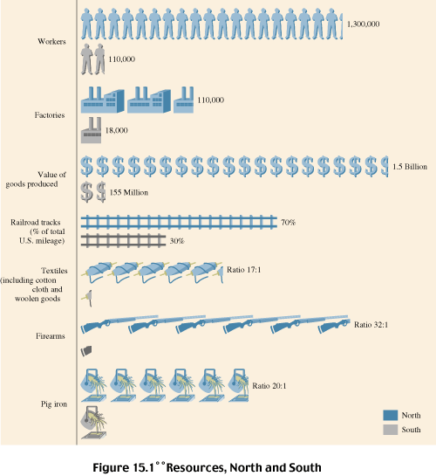
Resources: North & the South

Slide 6
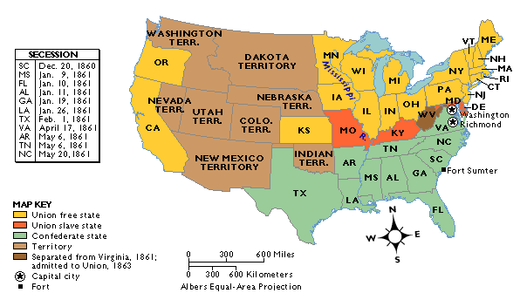
The Union & Confederacy in 1861

Slide 7
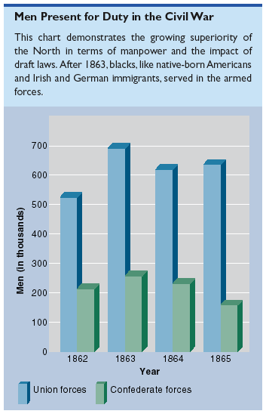
Men Present for Duty in the Civil War

Slide 8
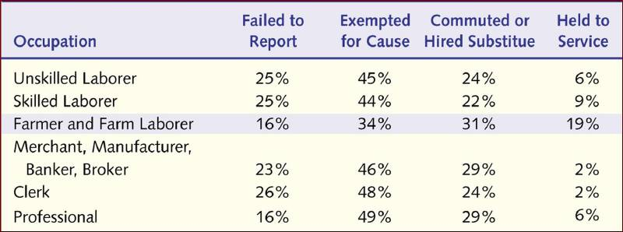
Ohio Military Service

Slide 9
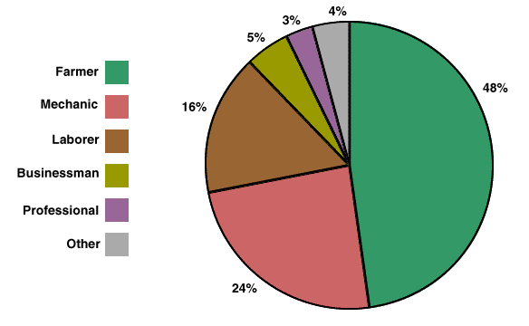
Soldiers’ Occupations: North/South Combined

Slide 10
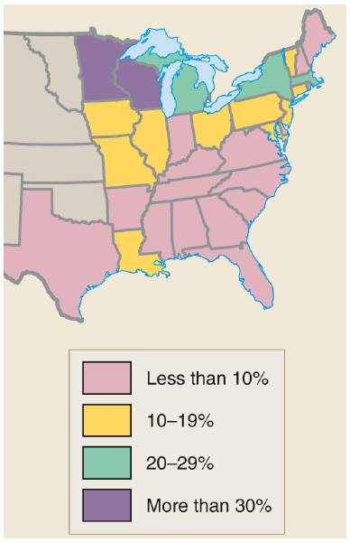
Immigrants as a % of a State’s Population in 1860

Slide 11
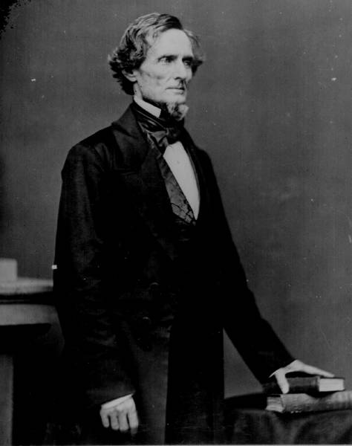
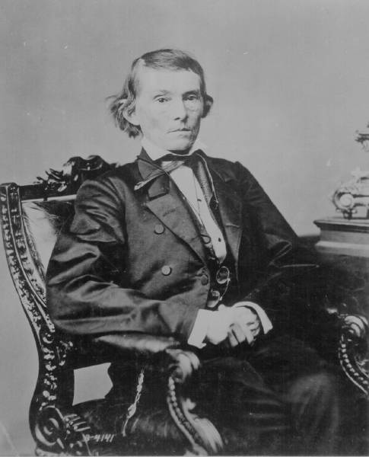
The Leaders of the Confederacy
Pres. Jefferson Davis
VP Alexander Stevens

Slide 12
The Confederate Seal
MOTTO → “With God As Our Vindicator”

Slide 13
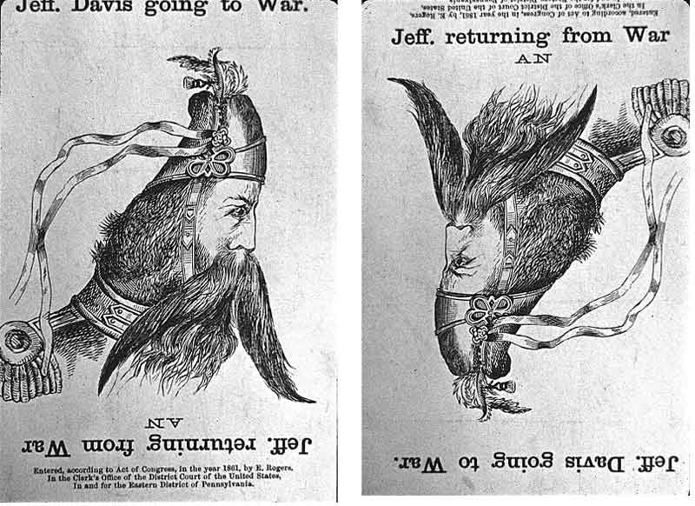
A Northern View of Jeff Davis

Slide 14
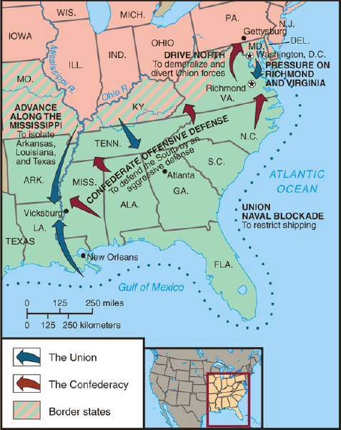
Overview of the North’s Civil War Strategy:
“Anaconda” Plan
Blockade the coast
Capture Confederate Capital---Richmond
Capture/Control the Mississippi River-thus splitting the Confederacy into two.

Slide 15
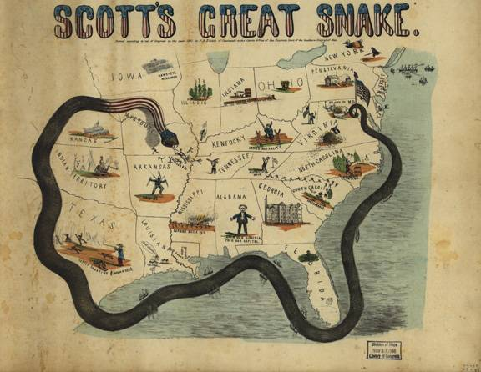
The “Anaconda” Plan

Slide 16
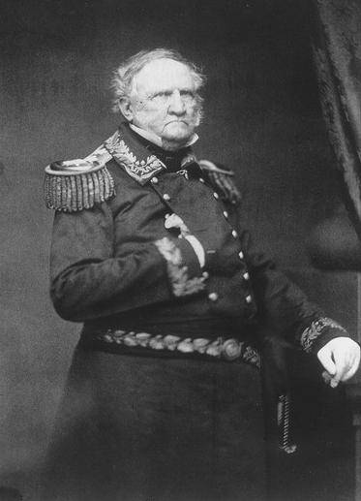
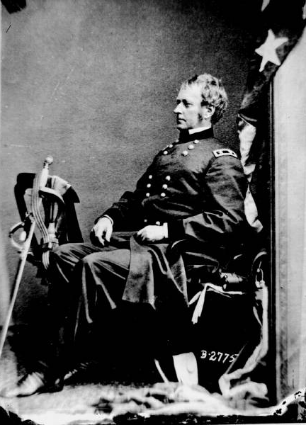
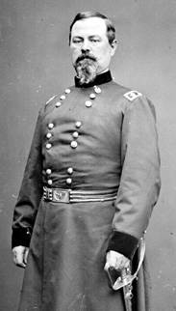
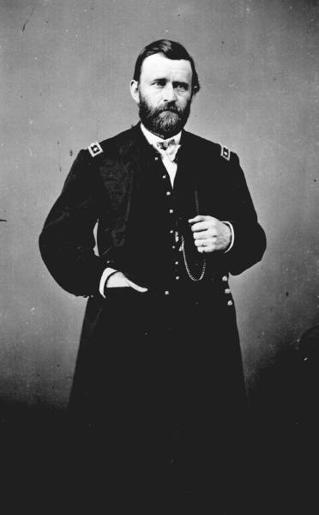
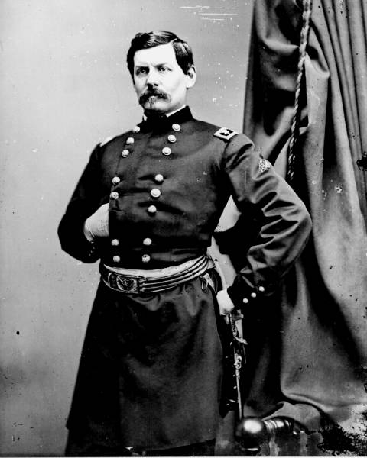
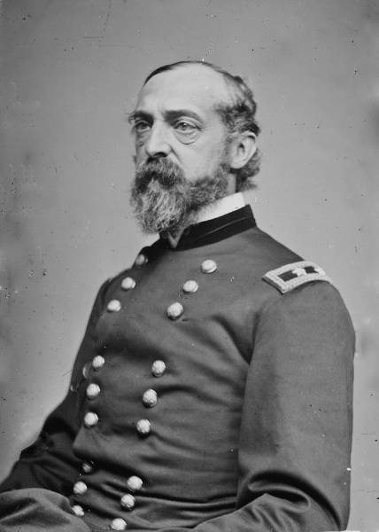
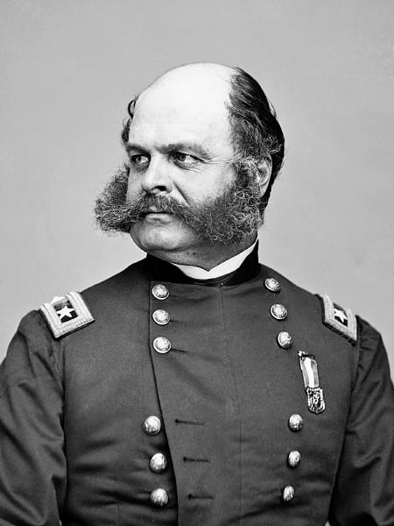
Lincoln’s Generals
Winfield Scott
Irwin McDowell
Joseph Hooker
Ulysses S. Grant—known as the butcher became commander of all Union forces after Vicksburg
George McClellan
George Meade
Ambrose Burnside
George McClellan, Again!

Slide 17
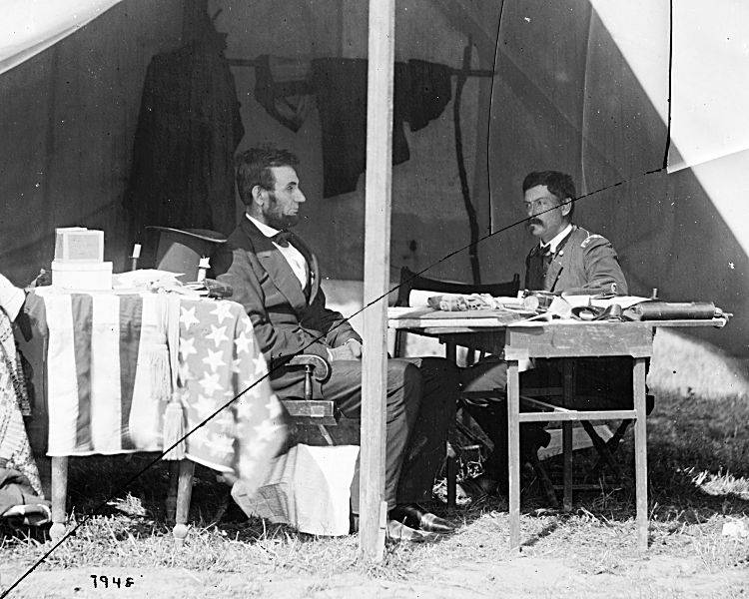
McClellan: I Can Do It All!

Slide 18
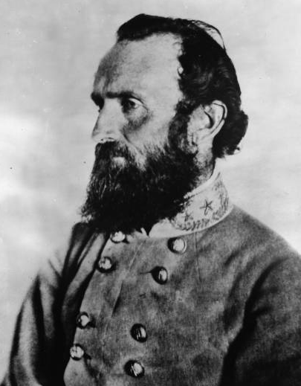
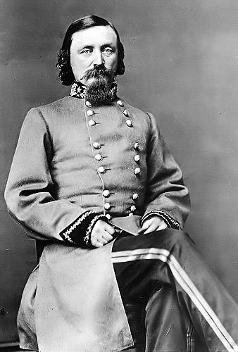
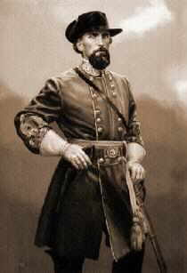
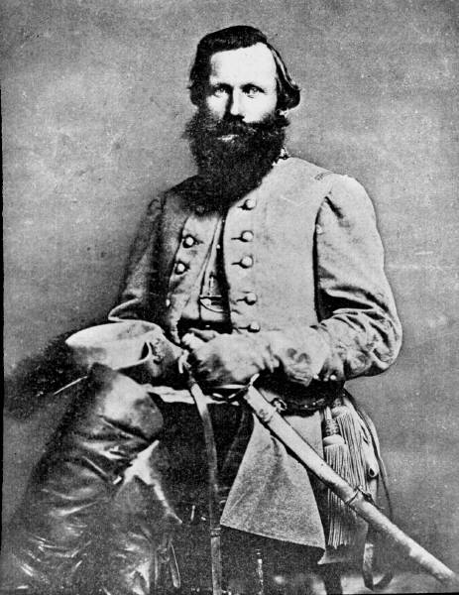
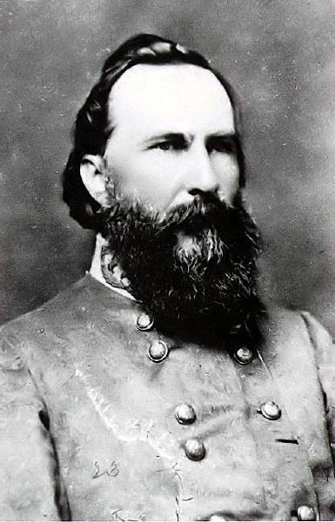
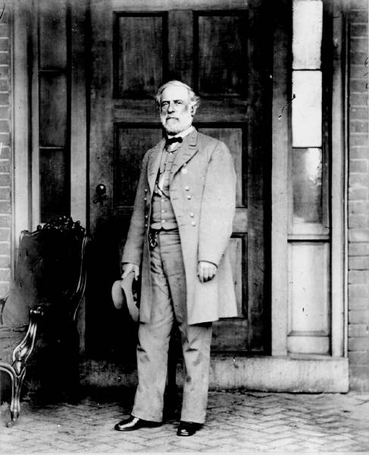
The Confederate Generals
“Stonewall” Jackson
Lee’s best general earned nickname at Bull Run and wounded by friendly fire at Chancellorsville
George Pickett
Nathan Bedford Forrest—founder of KKK
Jeb Stuart
James Longstreet
Robert E. Lee—commander of all Confederate forces

Slide 19
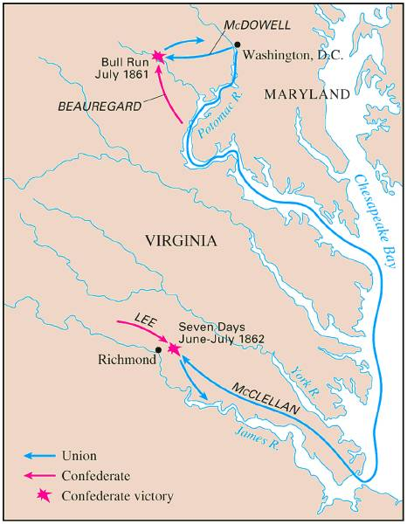
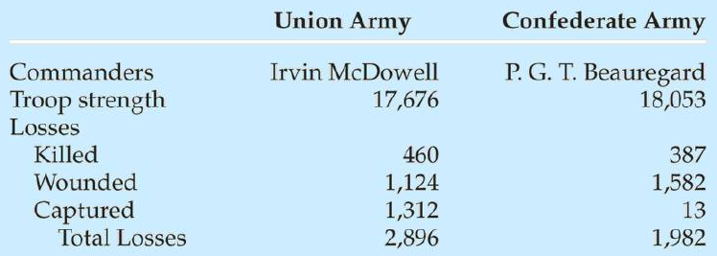
Battle of Bull Run (1st Manassas) July, 1861
1st Major Battle of the War
Both sides had to prepare for long war

Slide 20
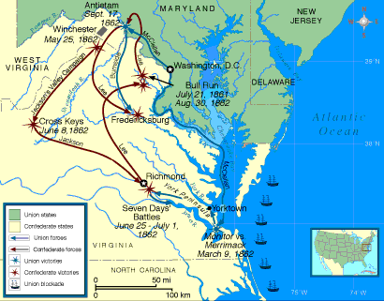
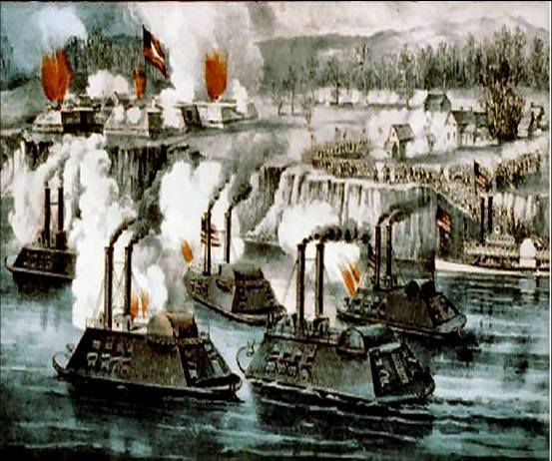
The Battle of the Ironclads, March, 1862
The Monitor vs. the Merrimac—Beginning of Steel Navies

Slide 21
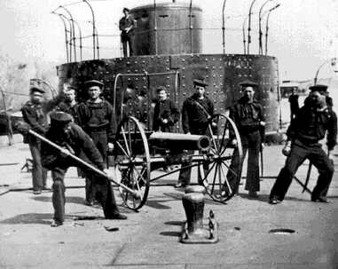
Damage on the Deck of the Monitor

Slide 22
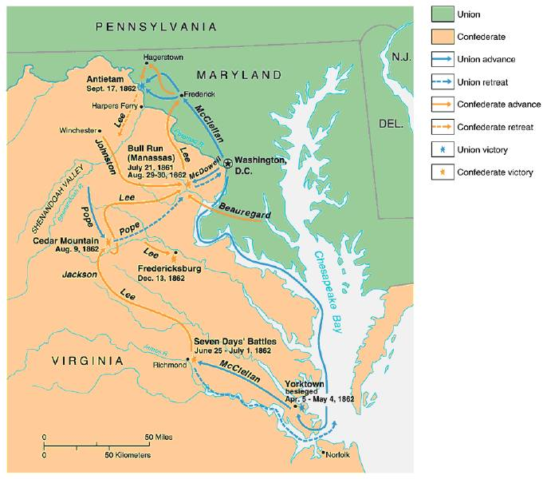
War in the East: 1861-1862

Slide 23
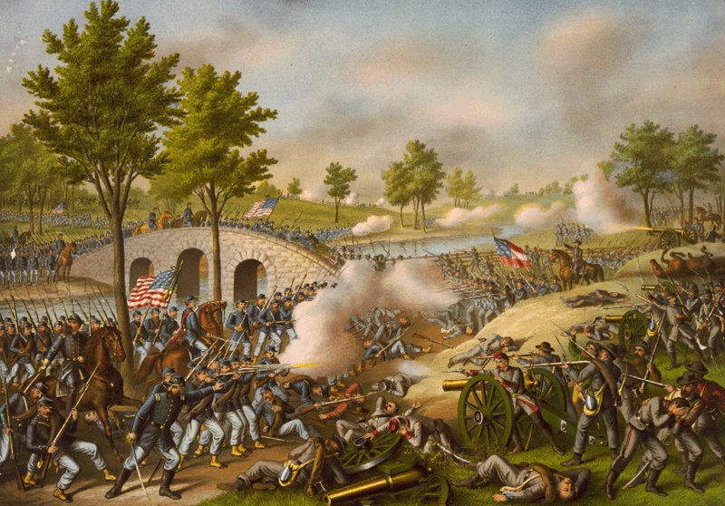
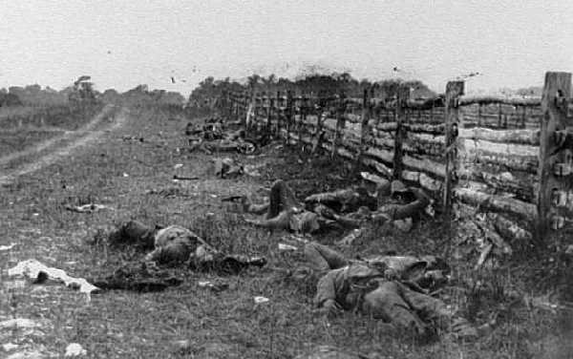
Battle of Antietam “Bloodiest Single Day of the War”
September 17, 1862
After this Battle, Lincoln issued the Emancipation Proclamation
23,000 casualties

Slide 24
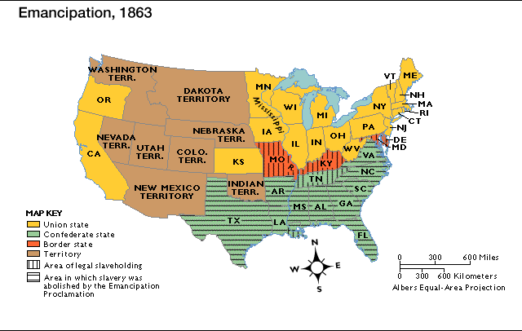
Emancipation Proclamation
Lincoln used his powers as commander-in-chief
Freed the slaves in the states that were still in rebellion
Keep France and Britain out of the War.

Slide 25
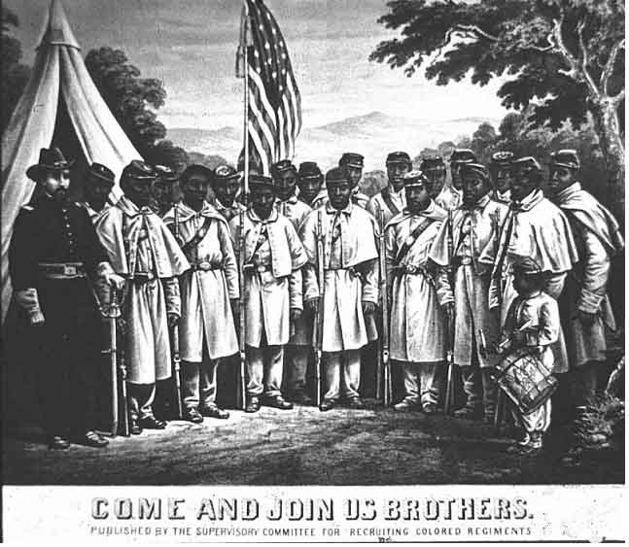
African-American Recruiting Poster

Slide 26
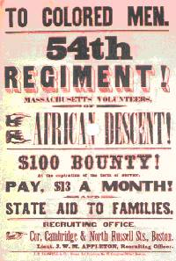
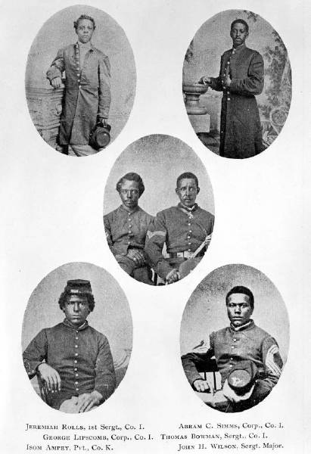
The Famous 54th Massachusetts
Most famous black regiment of the Civil War

Slide 27
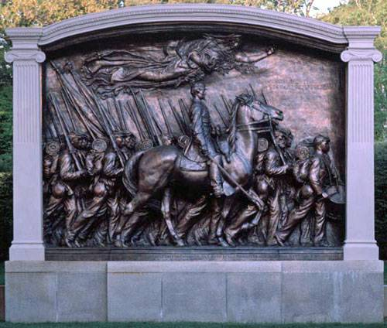
August Saint-Gaudens Memorial to Col. Robert Gould Shaw

Slide 28
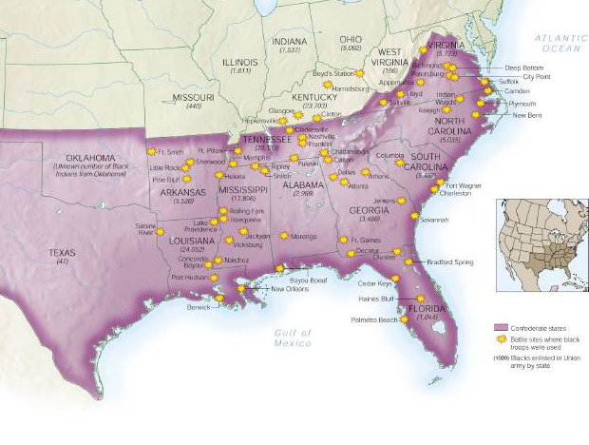
African-Americans in Civil War Battles

Slide 29
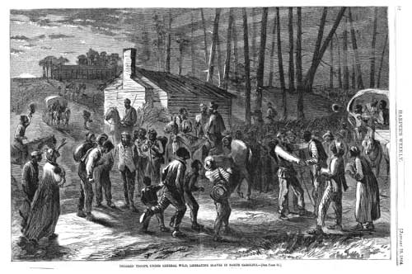
Black Troops Freeing Slaves

Slide 30
Actions of Congress and Lincoln during the Civil War
1861 – Suspended Habeas corpus—right to go before a judge and have the charges read.
1862 – Homestead Act—gave 160 acres of western land away to anyone who could make it profitable in 5 years.
1862 – Morrill Land Grant Act– gave states land to set up colleges
1862 – Emancipation Proclamation Effective (1/1/1863)

Slide 31
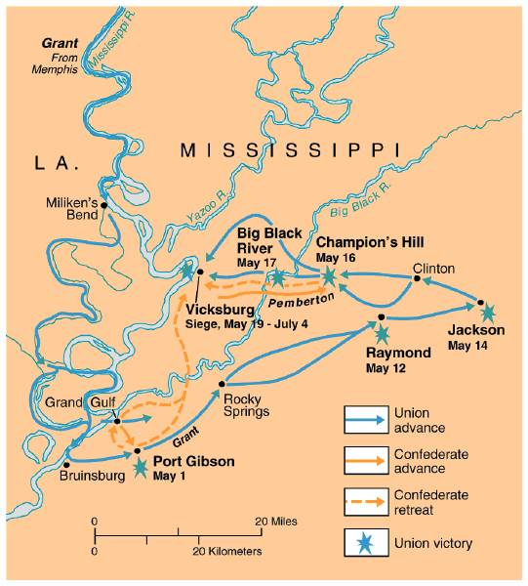
The War in the West, 1863:
Vicksburg
Turning point of the Western Theater.
Gave North Control of Miss. River

Slide 32
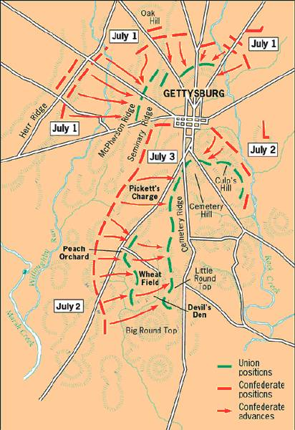
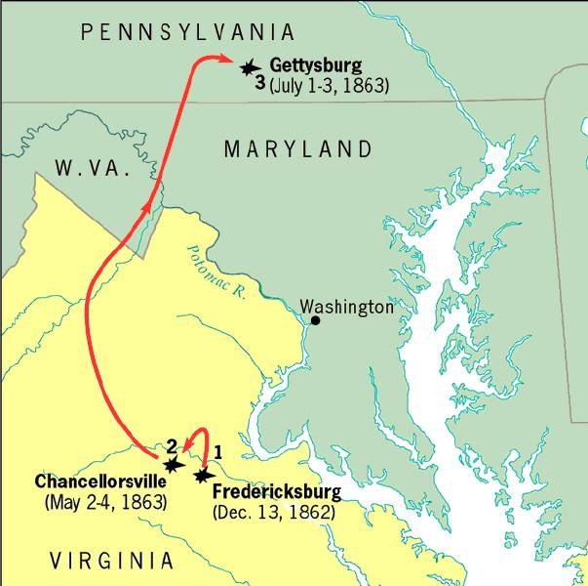
The Road to Gettysburg: 1863
Turning point in the Eastern Theater
The South never attacked the north again.

Slide 33
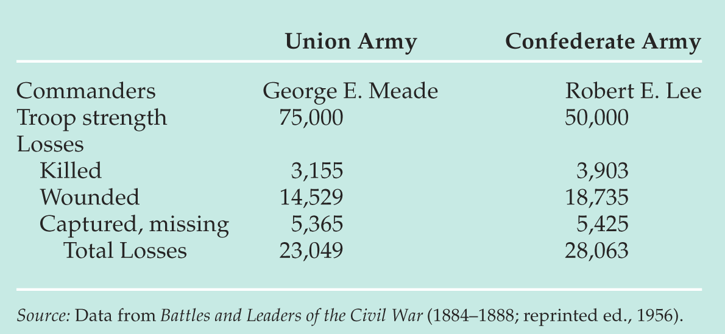
Gettysburg Casualties
& Gettysburg Address

Slide 34
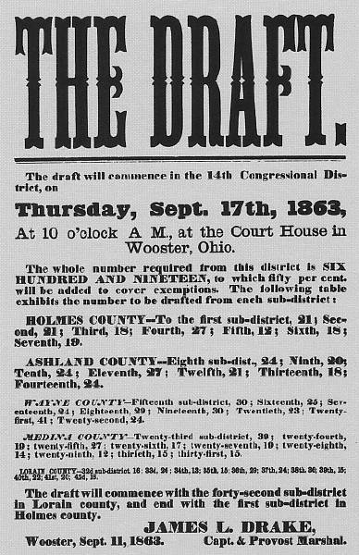
The North Initiates the Draft, 1863

Slide 35
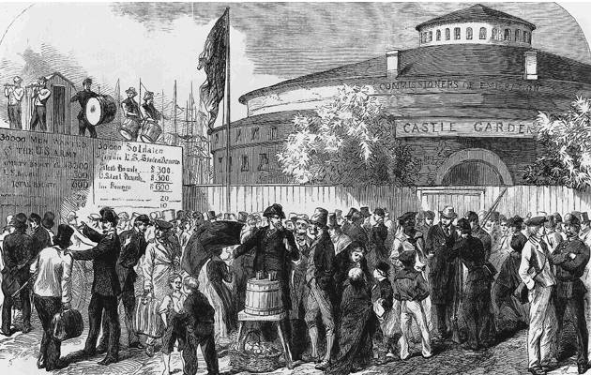
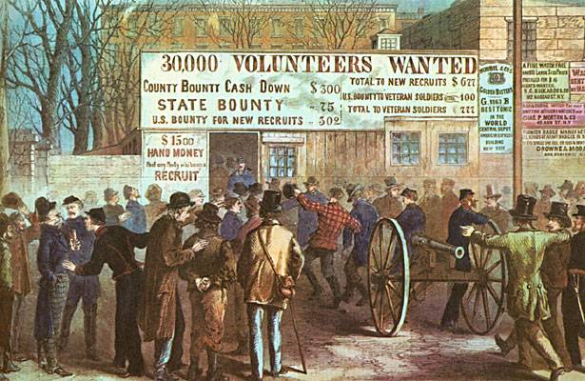
Recruiting Irish Immigrants in NYC

Slide 36
Recruiting Blacks in NYC

Slide 37
NYC Draft Riots, (July 13-16, 1863)

Slide 38
NYC Draft Riots, (July 13-16, 1863)

Slide 39
A “Pogrom” Against Blacks

Slide 40
Inflation in the South

Slide 41
The Progress of War: 1861-1865

Slide 42
Sherman’s“ March to the Sea” through Georgia,1864
Implemented total warfare—making civilians feel the pain of war.
His burning of Atlanta helped Lincoln win reelection.

Slide 43
1864 Election
Pres. Lincoln (R)
George McClellan (D)

Slide 44
Presidential Election Results: 1864

Slide 45
The Final Virginia Campaign: 1864-1865

Slide 46
Surrender at Appomattox April 9, 1865

Slide 47
Casualties on Both Sides

Slide 48
Civil War Casualties in Comparison to Other Wars

Slide 49
Ford’s Theater (April 14, 1865)

Slide 50
The Assassin
John Wilkes Booth

Slide 51
The Assassination

Slide 52
WANTED~~!!

Slide 53
Now He Belongs to the Ages!

Slide 54
The Execution

