Slide 1
John Locke
The most important Enlightenment philosopher in the design of the government of the United States.
Natural Rights: purpose of government is to protect the natural rights of citizens; these rights are “life, liberty, and property”
Social Contract: people in a society agree to give up some of their freedom in exchange for protection of their natural rights by a government

Slide 2
Montesquieu and Rousseau
Baron de Montesquieu: Separation of Power → powers of government should be divided into branches
Jean-Jacques Rousseau: “All Men Are Created Equal”

Slide 3
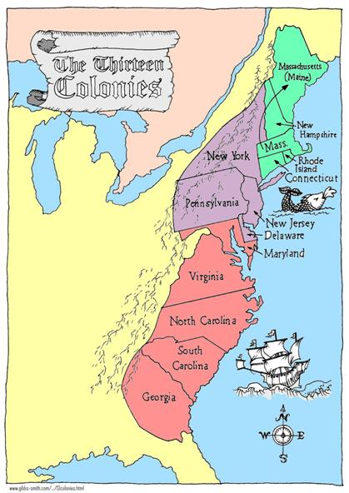
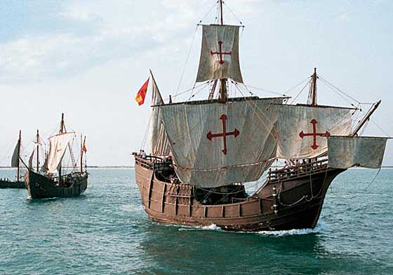
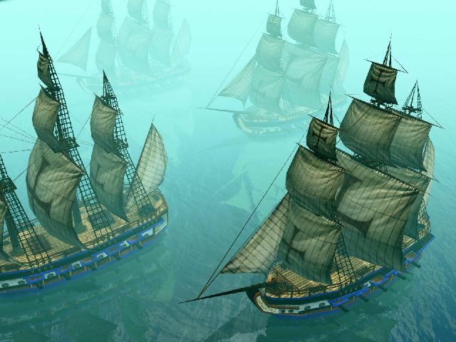
Original 13 Colonies

Slide 4
Vocabulary
Colony:
A settlement in a new area.
The first colonies in North America
were along the eastern coast.
Settler:
A person that moves to an area, usually to colonize. .

Slide 5
Reasons Why
Some people didn’t like, or agree with, the Church of England. They wanted the Church to be more pure. These people were called Puritans.
Wealth & resources; get out of debt
New beginning; create a new life for themselves
3 G’s??

Slide 6
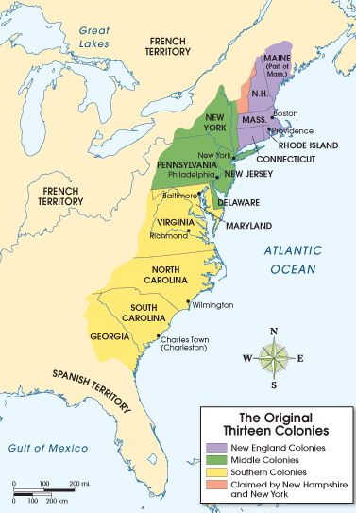
The Colonies
Each colony was unique in its characteristics. However, they are grouped together based on location, reasons they were founded, and what types of industries they had.
New England Colonies
Rhode Island
Connecticut
Massachusetts
New Hampshire
Middle Colonies
Delaware
Pennsylvania
New York
New Jersey
Southern Colonies
Maryland
Virginia
North Carolina
South Carolina
Georgia

Slide 7
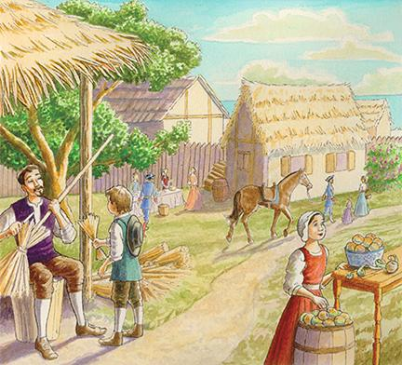
New England Colonies

Slide 8
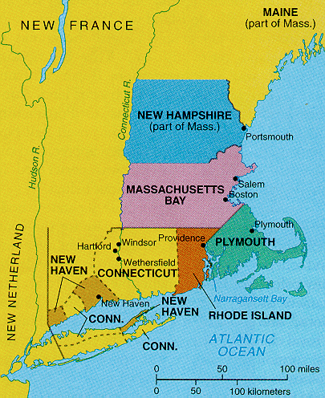
New England Colonies
The settlers here wanted to keep their family together and practice their own religions.
They were used to doing many things themselves and not depending on other people for much.
Some were looking for economic opportunities. Some starting fishing settlements

Slide 9
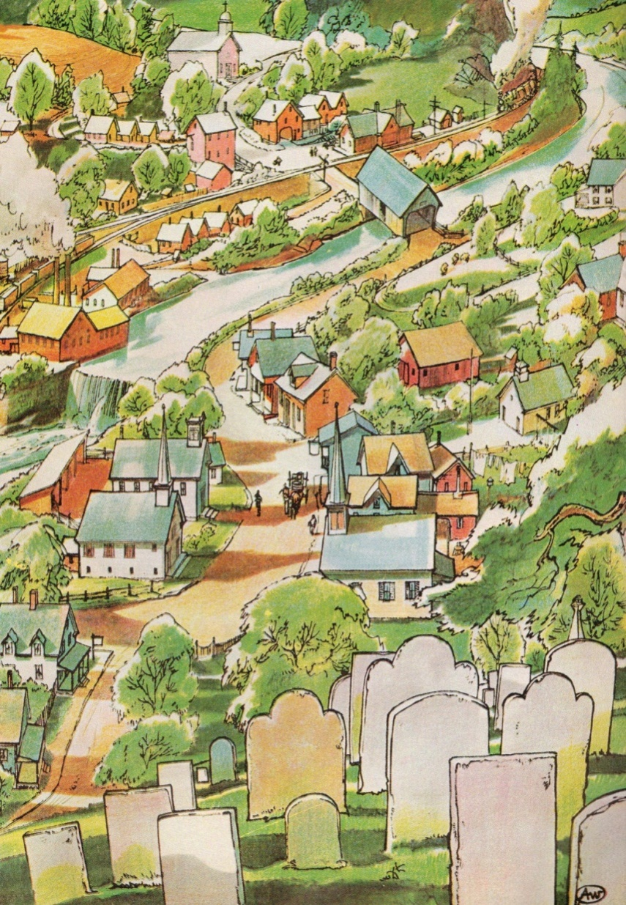
New England Colonies
People in New England towns lived, worked, and worshiped close together.
People used a barter system instead of money. This means to trade goods.
The meetinghouse was the most important building in the town – direct democracy.

Slide 10
New England Colonies
Economy
-manufacturing, fishing & trading
-Boston was the major New England port.

Slide 11
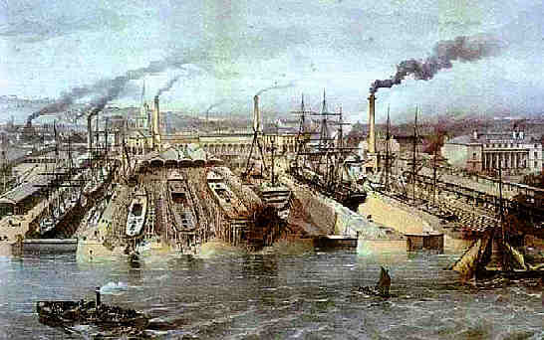
New England Colonies
By 1750, busy cities cropped up around the New England colonies.
Some colonists lived in small towns surrounded by farm land outside of the big cities.

Slide 12
Middle Colonies

Slide 13
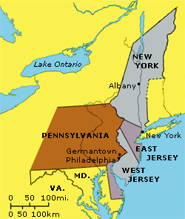
Middle Colonies
The settlers here were looking to practice their own religion or to make money.
Colonies were a mix of direct democracy & representative democracy.

Slide 14
Middle Colonies
Economy
-These Colonies were part agriculture, part industrial
-Wheat and other grains were grown
-Factories produced iron, paper and textiles
-Trading goods with England was common

Slide 15
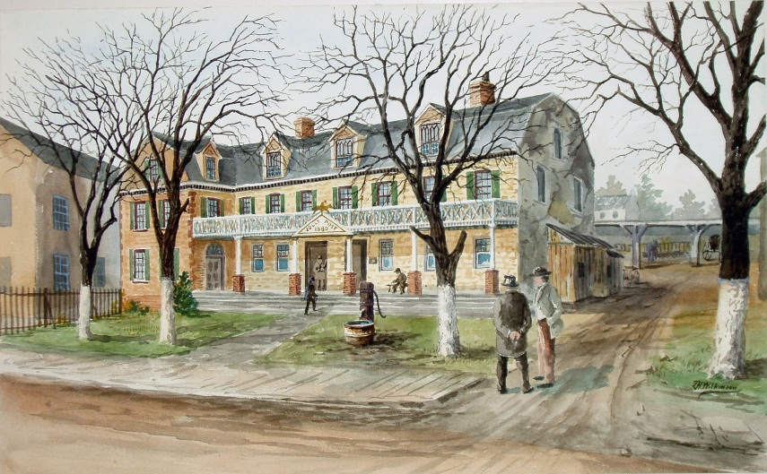
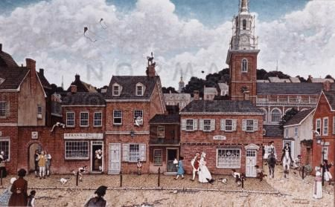
Middle Colonies
-Settlers that lived here came from many different places and backgrounds.
-Dutch, Swedish, French, Belgian, English, and more! Many lived in Philadelphia
-Founded on the principles of living peacefully together.

Slide 16
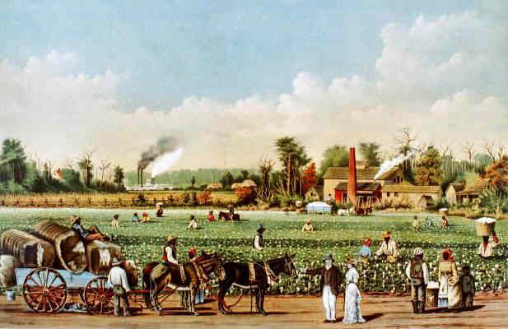
Southern Colonies

Slide 17
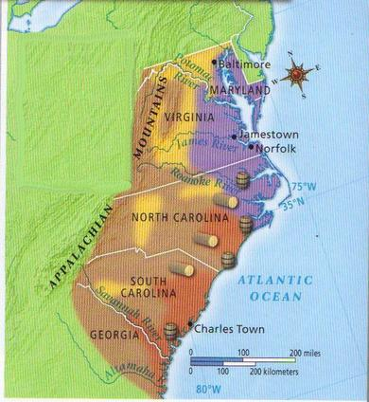
Southern Colonies
The settlers here, for the most part, wanted to make money.
They brought their families and they kept their them together on the plantations.
The large plantations were spaced far apart & people would live miles away from their nearest neighbors
What kind of government would make sense??

Slide 18
Southern Colonies
Economy
-almost entirely agricultural
-plantations were abundant
-a large part of the workforce was African slaves
-plantations grew tobacco, rice, and indigo

