Slide 1
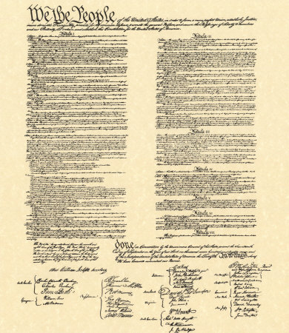
The United States
Constitution
Basics & Structure

Slide 2
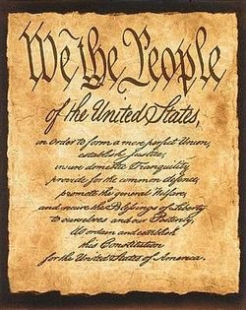
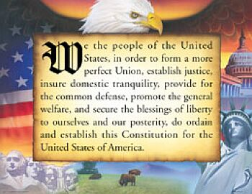
“The Preamble”
- The Introduction to the Constitution
“We the People” (Popular Sovereignty!)
Lists 6 Goals of the Constitution

Slide 3
6 Goals Listed in the Preamble
1) Form a more perfect union (better, more unified nation)
2) Establish Justice (fairness)
3) Ensure domestic tranquility (peace within the country)
4) Provide for the common defense (protect the nation)
5) Promote the General Welfare (the people live well)
6) Secure the Blessings of Liberty to Ourselves and our Posterity (freedom to us and future generations)

Slide 4
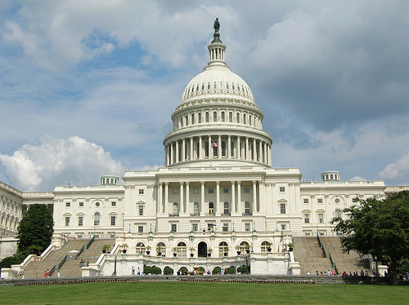
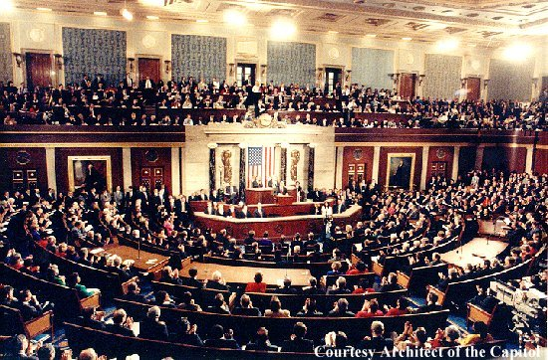
Article I
Legislative
Information about the ___________ Branch
Qualifications to run for each house
Term Lengths
Powers of Congress as a whole
Powers denied to Congress
Powers of each House
Powers of Congress besides
Necessary and Proper Clause: ____________________ _____________________________________________
just the ones listed (if needed); Also called the “Elastic Clause”

Slide 5
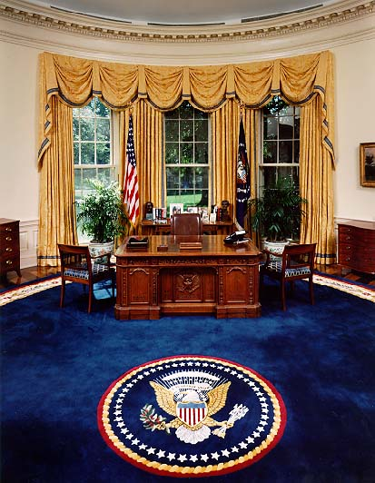
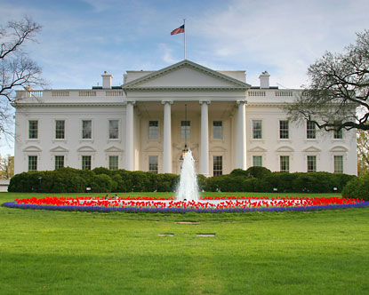
Article II
Executive
Information about the ___________ Branch
Qualifications to run
Powers of the President
Responsibilities of the President
Presidential Oath of Office

Slide 6
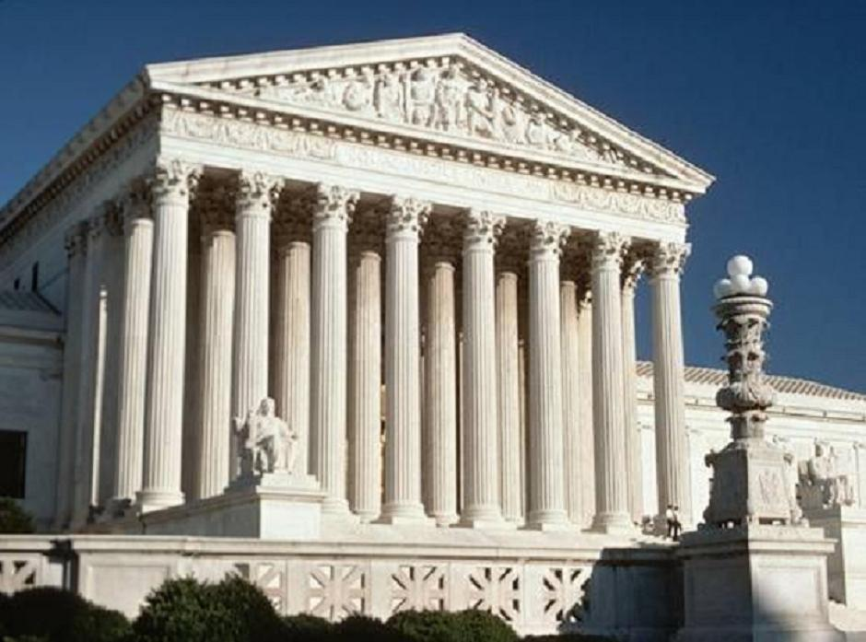
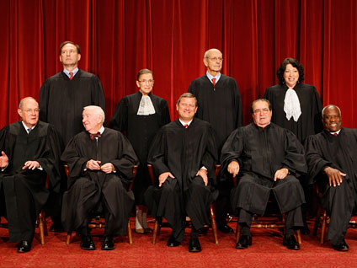
Article III
Judicial
Information about the ___________ Branch
Establishes Supreme Court and any
lower courts made by Congress
Term Length (life tenure)
Federal Jurisdiction

Slide 7
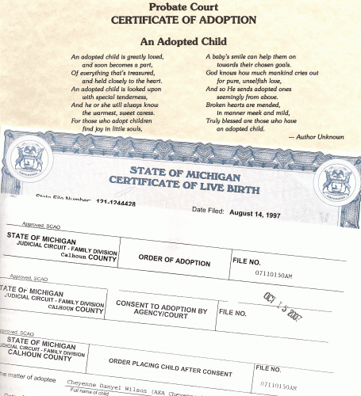
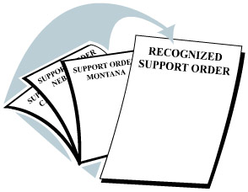
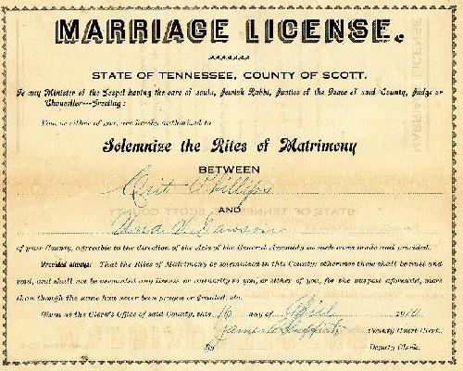
Article IV
Defines the relationship between states
“Full Faith and Credit Clause”: __________ ___________________________________
States will
honor each others’ laws and contracts

Slide 8
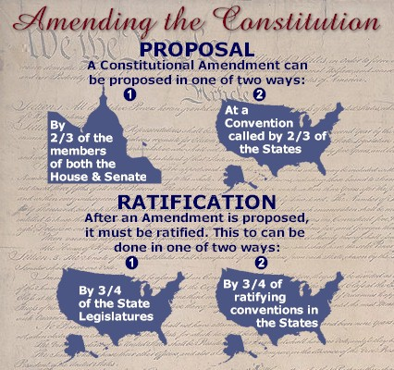
Article V
amendment
Defines how to make an ___________ to the Constitution
Propose the amendment
STEP 1: _____________________
Ratify the amendment
STEP 2: ___________________

Slide 9
“Informal” Amendments
Custom: Tradition
(Ex. The Cabinet – not in Constitution but made by George Washington, and every president since has had one
Court Rulings: Set Precedent
(Ex: Early court cases, such as Plessy v. Ferguson, legalizing segregation were frequently upheld in future cases that are similar)
Presidential Actions: Defines his own powers
(Ex: Gulf of Tonkin Resolution during Vietnam - LBJ used his power as Commander-in-Chief to send as many troops as he thought necessary – eventually Congress passed the War Powers Act to prevent this in the future)

Slide 10
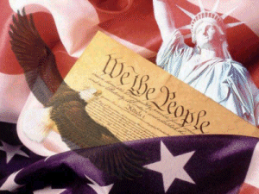
Article VI
Defines the power of the Federal Government
“Supremacy Clause”: _________________ ______________________________________________________________________
The Constitution is the
“Supreme Law of the Land.” If a state law and a Federal law conflict, the Federal law is supreme.

Slide 11
Article VII
Ratification Process for the Constitution
9 States Needed to take effect

Slide 12
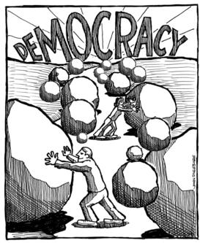
Popular Sovereignty
Rule by the people
“We the People”

Slide 13
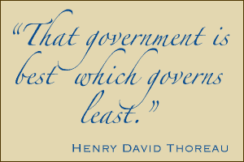
Limited Government
**Government is not all-powerful**
Freedoms are protected
Power is divided between levels
and branches of government

Slide 14
Judicial Review
The Supreme Court can declare laws unconstitutional
- Established by court case Marbury v. Madison

Slide 15
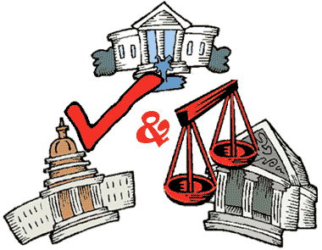
Checks and Balances
Each Branch of Government prevents the others from abusing their powers

Slide 16
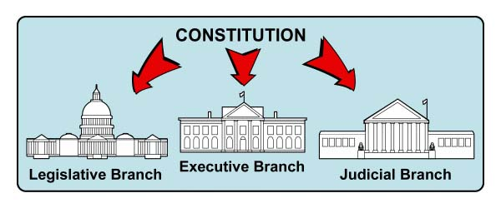
Separation of Powers
Federal power is divided between three branches of government
Makes the Laws
Enforces the Laws
Interprets the Laws

Slide 17
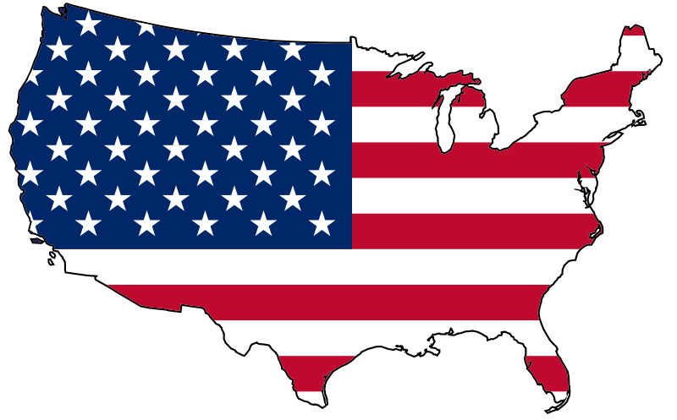
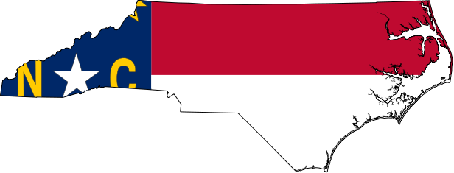
Federalism
Power is divided between state and federal levels of government
Enumerated
Reserved
Concurrent

Slide 18
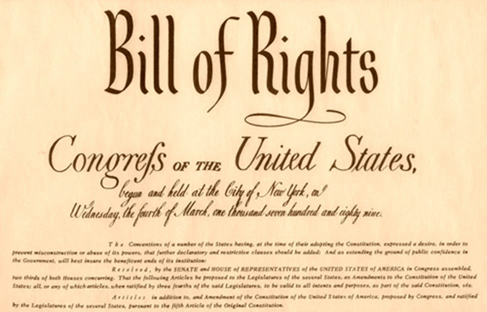
Bill of Rights
First ten amendments to the Constitution

