Slide 1
Contact and Exploration
Day 2

Slide 2
Review—Answer as soon as you enter the room
Why did individual countries start exploring in the late 1400s?
Name specific reasons why explorers went to the new world!
How did the Pope prevent conflict between Spain and Portugal?

Slide 3
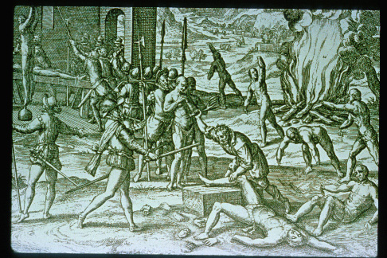
Columbus (2)
Coumbus and Indians as envisioned in “the Black Legend” told by rival English
1493 Columbus returned to found a colony, that would serve as base of further exploration, and gain wealth (gold, furs, sugar, slaves)
War of Conquest – using horses, canon, steel and trained dogs
Inspiration for other Spanish and European conquerors.

Slide 4
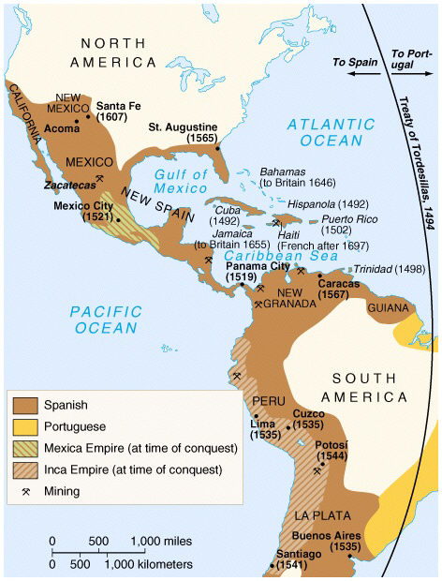
The Spanish empire
Conquests:
The Caribbean, Mexico, western South America, Florida, California and the Southwest!

Slide 5
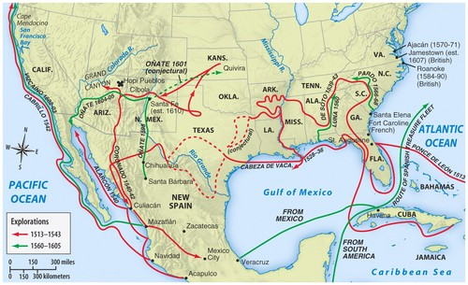
The Spanish in North America – mostly looking for gold or riches
Ponce de Leon: Florida (1513 – 1521)
First Permanent Settlement in America – St. Augustine – 1565

Slide 6
The Spanish Conquest and Columbian Exchange
Columbian Exchange = the interchange of diseases, plants and human cultures between the New and Old Worlds after 1492
Completely remade North American environment!
Introduction of new crops (sugar), new animals (horses, sheep, cattle and pigs), and new pathogens.

Slide 7
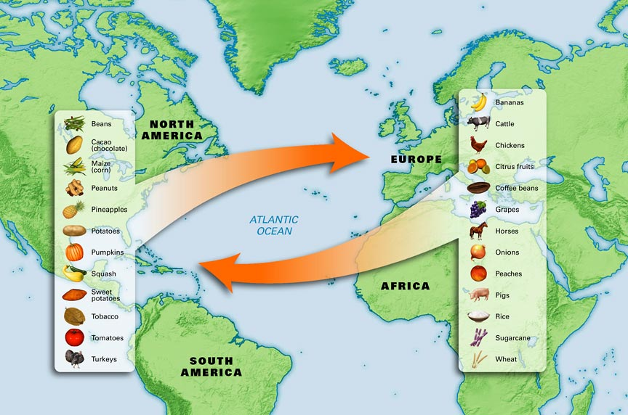
Columbian Exchange

Slide 9
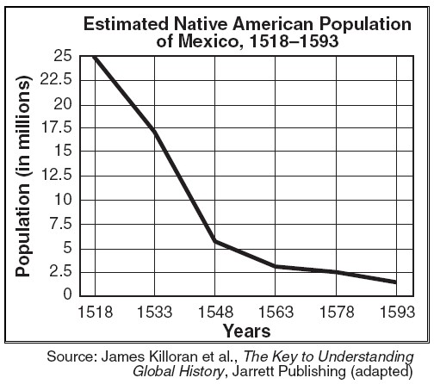
Columbian Exchange in the New World: Epidemics → A Holocaust
Diseases spread rapidly in the population that had no immunities and was overworked by conquerors
GENERALLY POST CONTACT POPULATION THROUGHOUT THE AMERICAS WITHIN 50 YEARS WAS 10% OF PRE CONTACT POPULATION
Large tracts of land now open to European settlement. In many cases like New England already cleared!

