Slide 1
The Electoral Process

Slide 2
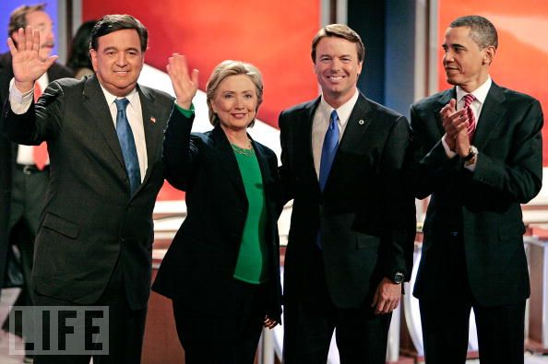
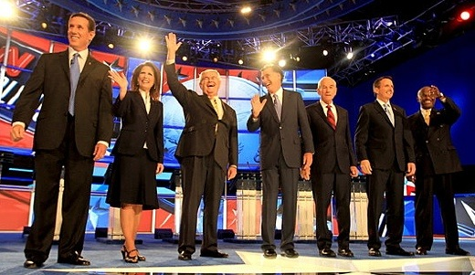
Choosing the Candidates
List of possible candidates (collect petition signatures to get on the slate)
Primary
Candidate

Slide 3
Choosing the Candidates
Donald Trump
Mike Pence
National Convention
Ticket

Slide 4
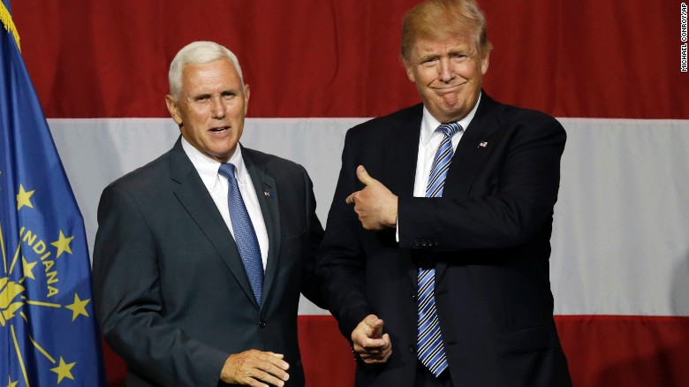
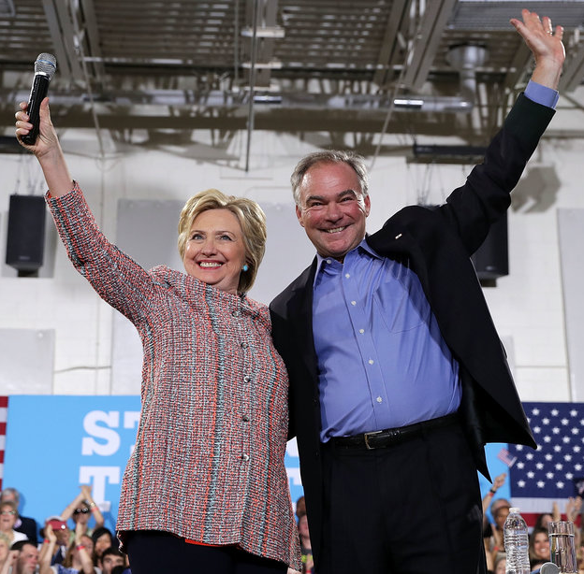
2016 Tickets
Republican Ticket
Democratic Ticket

Slide 5
The Election
General
1st Tues after 1st Mon of Nov.
Polling Place (in precinct)
Exit Polls

Slide 6
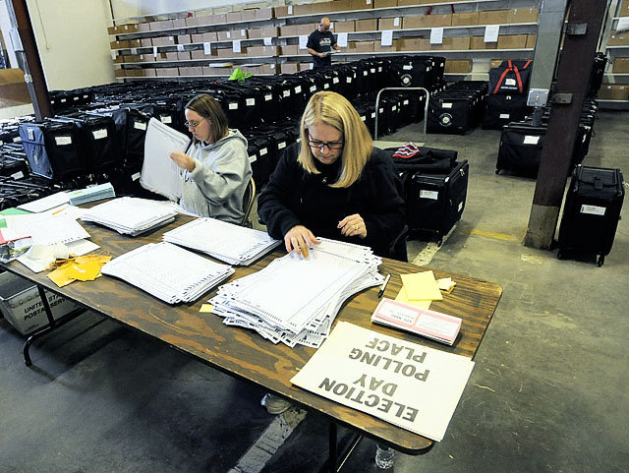
The Election
When the polling places close, each precinct will tabulate results (called “returns”) and report to the state election board
“Returns”

Slide 7
Who Won??
Popular Vote: Actual # of votes cast by voters – in all elections except the presidency, the winner of the majority of popular votes wins the election
Electoral Vote: Votes cast by each state’s electors – used for presidential election only
How many electors does a state have?
How many total EC votes are there?
How many are needed to win?
# of House Reps + 2 Senators (minimum of 3)
538 (includes 3 for Washington, DC)
270 (if no majority, House of Reps chooses)

Slide 8
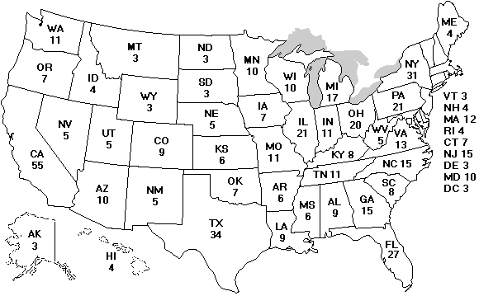
The Electoral College
NC 15
President must win at least 270 votes

Slide 9
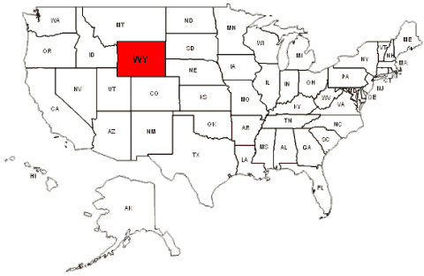
The Electoral College – WHY??
Wyoming Population: 544,270
US Population: 307,006,550
WY % of Overall Pop: 0.017%
Wyoming Electoral Votes: 3
US Total Electoral Votes: 535
WY % of Overall EC Votes: 0.56%
WY: 1 EC Vote per 181,000 people
US: 1 EC Vote per 573,844 people
Small states like it because it gives them more power – otherwise, elections would be dominated by urban centers (most populated) and rural areas would be disregarded.

Slide 10
Popular v. Electoral Votes
Candidates who won the popular vote but did not win the electoral vote:
- Andrew Jackson (1824)
- Samuel Tilden (1876)
- Grover Cleveland (1888)
- Al Gore (2000)
- Hillary Clinton (2016)
How does this happen??

Slide 11
Who Won??
Winner-Take-All System: Whoever wins the majority of the popular votes in a state gets ALL that state’s electoral votes (doesn’t matter how close the two candidates were)
Green: 90%
Orange: 10%
Popular Vote:
Green: 90,000
Orange: 10,000
EC Votes:
Green gets 10 EC votes
Green: 52%
Orange: 48%
Popular Vote:
Green: 52,000
Orange: 48,000
EC Votes:
Green gets EC 10 votes

Slide 12
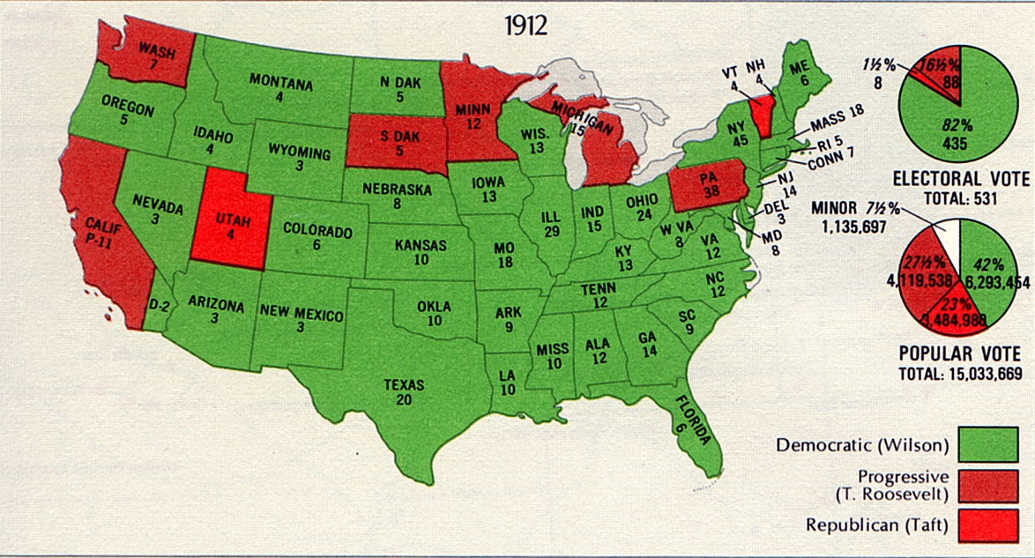
Winner Takes All - 1912

Slide 13
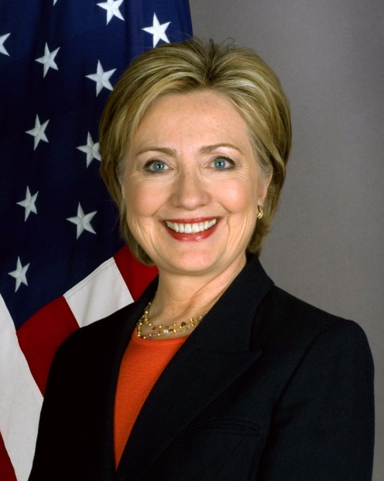
2016 Election
Nominee | Donald Trump | Hillary Clinton
Party | Republican | Democratic
Running mate | Mike Pence | Tim Kaine
Electoral vote | 306 | 232
States carried | 30 | 20 + DC
Popular vote | 62,984,825 | 65,853,516
Percentage | 46.1% | 48.2%

Slide 14
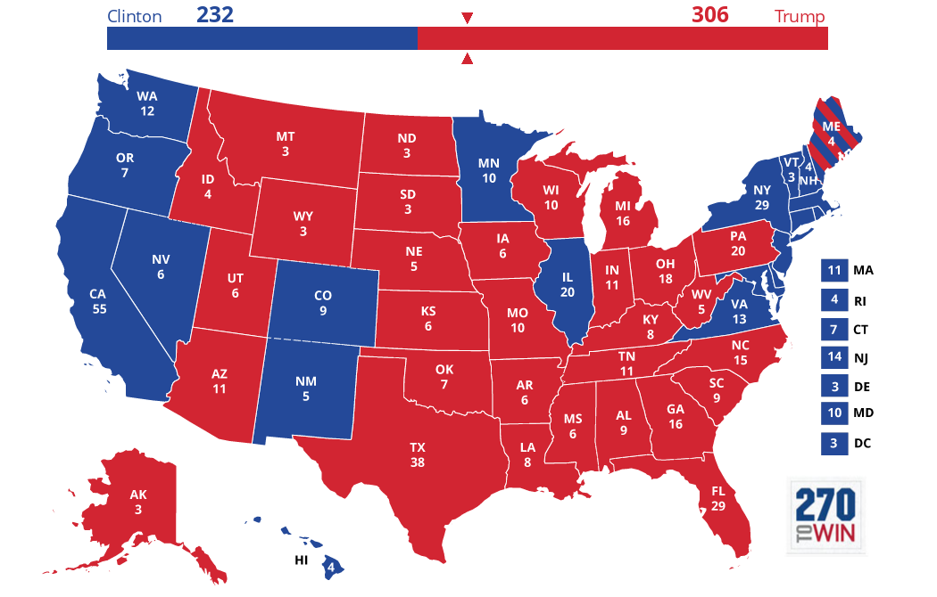
2016 Election – Electoral Map

Slide 15
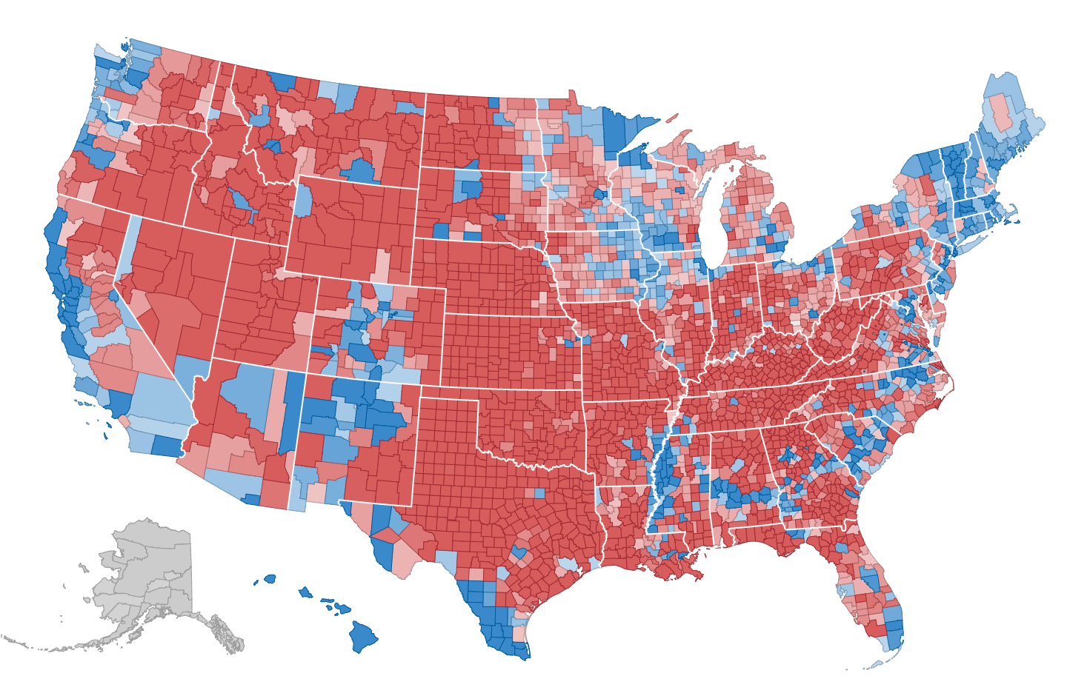

Slide 16
