Slide 1
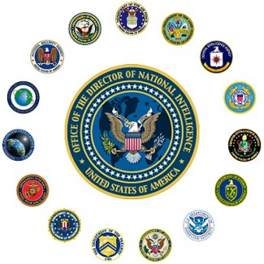
Executive Branch
Independent Agencies & Cabinet Departments

Slide 2
Agencies
enforce
Help the Executive Branch _________ the laws
Leaders appointed by the __________ and approved by the ___________
President
Senate

Slide 3
Executive Agencies
NASA: National Aeronautics and Space Administrations; research/exploration of _____
EPA: _____________________________
CIA: ______________________________: collects __________ on __________________
space
Environmental Protection Agency
Central Intelligence Agency
information
Foreign governments

Slide 4
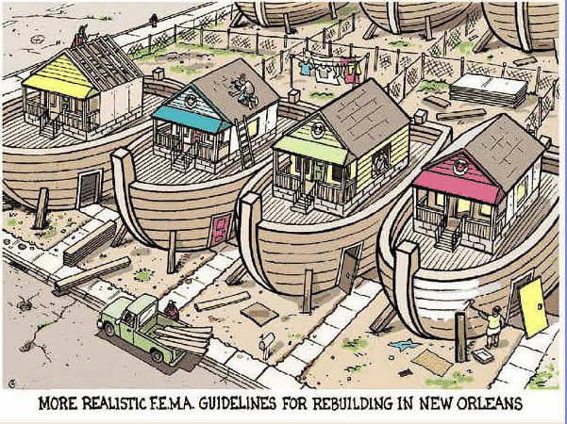
Executive Agencies
SSA: Social Security Administration:
helps ___________ and _____________
FEMA: Federal Emergency Management Agency: helps with
______________
elderly
Handicapped
disaster relief

Slide 5
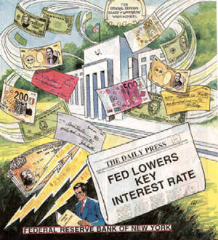
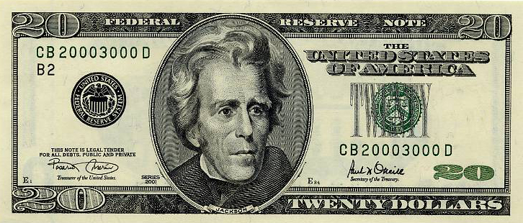
Regulatory Commissions
Set regulations on __________ to protect ___________________
FCC: _________________________________: regulates the __________
Federal Reserve: regulates supply
of ________
industry
Consumers/workers
Federal Communications Commission
media
money

Slide 6
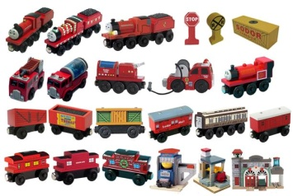
Regulatory Commissions
EEOC: Equal Employment Opportunities Commission: no _____________ in hiring
SEC: _________________________________: regulates the _______________
CPSC: Consumer Product Safety Commission: makes sure products are ______; issues recalls
discrimination
Securities and Exchange Commission
Stock market
safe

Slide 7
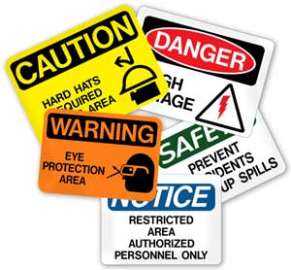
Regulatory Commissions
OSHA: Occupational Safety and Health Administration: Standards in the _____________
workplace

Slide 8
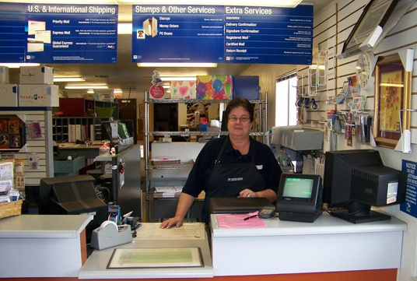
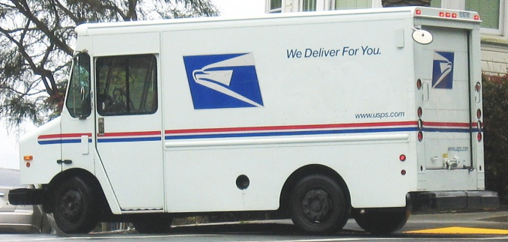
Government Corporations
Runs like a private company but operated by the government
US Postal Service: ________________
Delivers mail

Slide 9
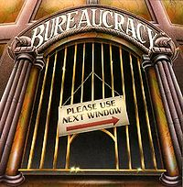
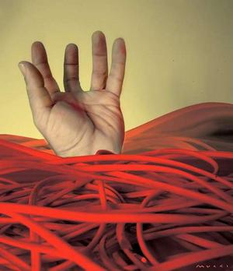
Bureaucracy
Complex system of agencies and departments that make up the government; specialized jobs and standards
Problem: “_____________” – too many
rules and paperwork → inefficiency
(hard to get things done)
RED TAPE

Slide 10
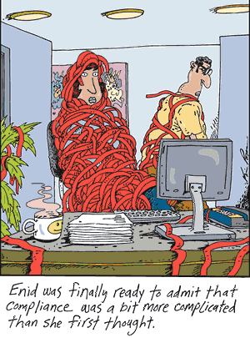
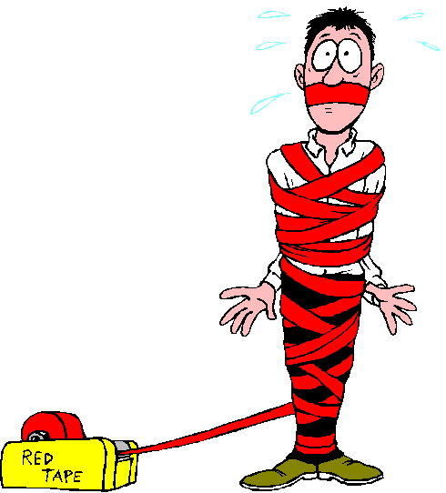

Slide 11
Civil Service Reform
Civil Servant: ___________________________
How did they get their job? ________________
If President chooses his friends/supporters, this is called ___________ or the _______________
Someone who works in a government agency or department (except military)
Appointed by President
(some)
patronage
“spoils system”

Slide 12
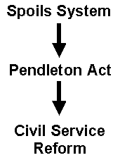
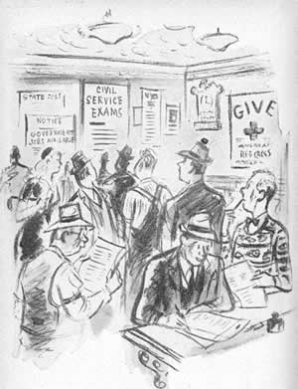
Civil Service Reform
Pendleton Civil Service Act:
_______________: Must pass a
test and be qualified for the job
Hatch Act – Promotions also be
based on merit → Civil servants
cannot work on ____________
or in political parties
Merit system
campaigns

Slide 13
Department of State
Handles the foreign policy of the nation
Staffs embassies
Analyzes data about American interests in other nations
Speaks for the U.S. at the United Nations

Slide 14
Department of the Treasury
Serves as the financial division of the government
Manages public debt
Collects taxes
Manufactures coins and currency
Administers explosive and firearm laws
Regulates the production and distribution of alcohol and tobacco

Slide 15
Department of Justice
Oversees the nation’s legal affairs
Supervises the agencies that serve as the nation’s police and prison system
Enforces antitrust laws

Slide 16
Department of Defense
Protects the security of the United States
Oversees the armed forces through the Joint Chiefs of Staff
Until 1949 was called the Department of War

Slide 17
Department of Interior
Protects the public lands and natural resources throughout the U.S.
Oversees relationships with Native Americans

Slide 18
Department of Agriculture
Helps farmers improve incomes and production for home and abroad
Develops conservation programs
Safeguards the nation’s food supply

Slide 19
Department of Commerce
Promotes and protects the industrial and commercial parts of the economy
Carries out the census

Slide 20
Department of Labor
Ensures safe working conditions
Oversees minimum wages and protects pensions
Collects and analyzes data on employment

Slide 21
Department of Health and Human Services
Oversees programs concerned with health and social services of the American people
Manages federal medicare and medicaid

Slide 22
Department of Housing and Urban Development
Works to assist communities in the nation
Ensures equal housing opportunities

Slide 23
Department of Transportation
Regulates America’s transportation needs, policies and planning
Works to ensure safe, efficient, and convenient land and air transportation

Slide 24
Department of Energy
Plans energy policy
Researches and develops energy technology

Slide 25
Department of Education
Coordinates federal assistance programs for public and private schools
Develops programs to help students with limited English proficiency and physically challenged students

Slide 26
Department of Veterans Affairs
Oversees medical care for veterans and families
Manages educational programs for veterans

Slide 27
Department of Homeland Security
Charged with protecting the security of America’s borders, shores, land and the safety of its people
Newest department created in 2002 after September 11, 2001

