Slide 1
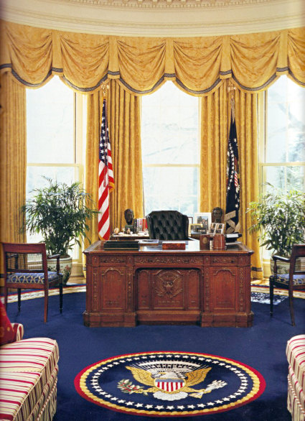
Executive Branch

Slide 2
Article __ of Constitution
II
President Requirements:
35 Years old
Natural Born US Citizen
Lived in US for 14 years

Slide 3
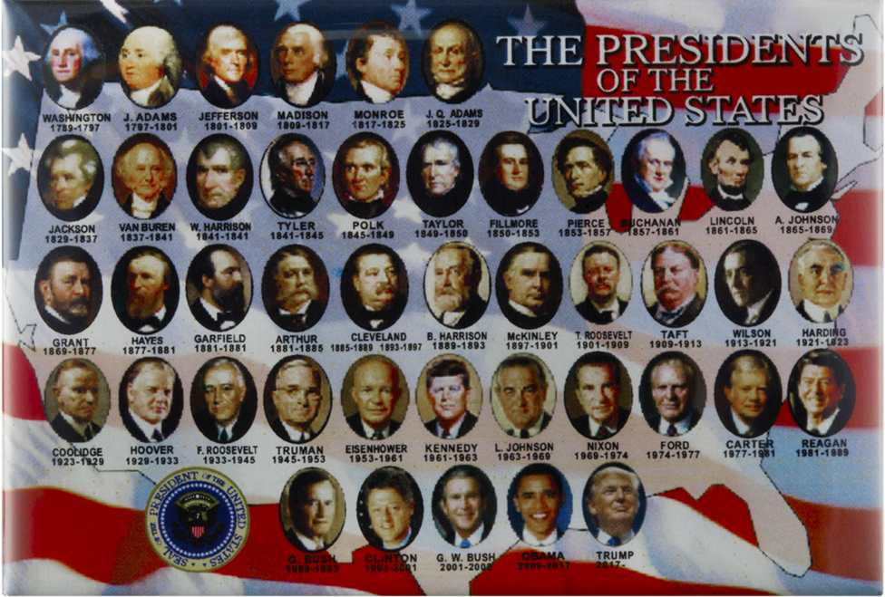

Slide 4
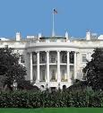
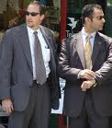
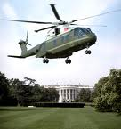
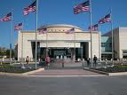
Benefits:
$400,000 salary
White House
Secret Service Protection
Air Force One, Marine One
Camp David
Health Care
Office (Oval Office), Staff
Pension, Funding for Presidential Library

Slide 5
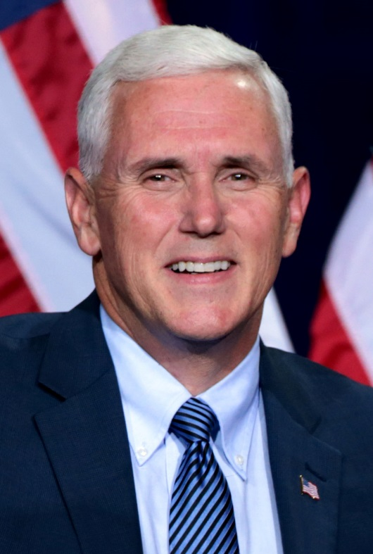
Vice President
Requirements:
Jobs:
Same as President
(in case he becomes President)
Take over if President dies, resigns, or cannot fulfill his duties
President of the Senate (break ties)

Slide 6
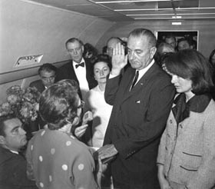
Presidential Succession
Vice President
Appoints new VP
(Senate approves)
Speaker of House
25th Amendment
Pres Pro Tempore
Secretary of State
Sec of Treasury
Sec of Defense
(each cabinet secretary in order of the department’s creation)

Slide 7
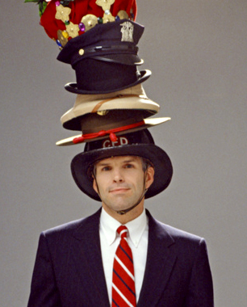
The President’s Many “Hats”
The President of the US has many different jobs to perform. As leader of the Executive Branch and the United States, he fulfills many duties both inside the country and abroad.

Slide 8
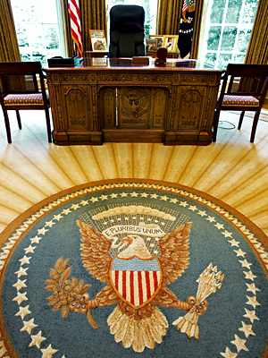
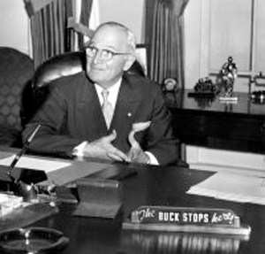
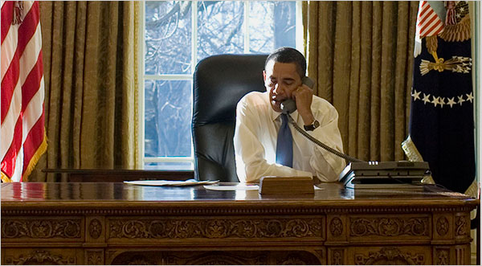
Chief Executive
- Leader of Executive Branch
Appoints officials
Oversees the Federal Bureaucracy
(complex system of
offices/agencies/etc)
Issues Executive Orders
(President’s order, has the force of
law, must be followed)

Slide 9
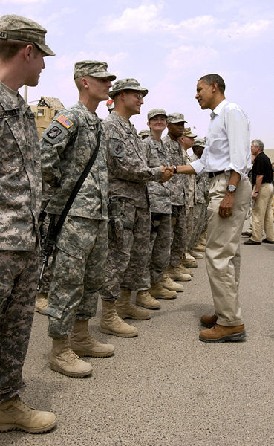
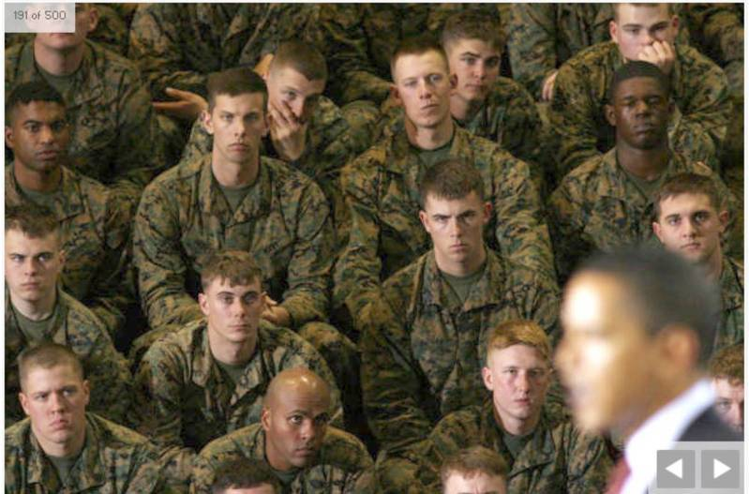
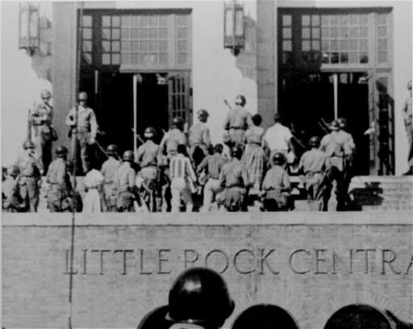
Commander-in-Chief
Overall leader of the armed forces
Can send troops around the world or
to enforce law inside the US
War Powers Act: Limits the President’s
ability to wage war to 90 days without
Congress’ approval

Slide 10
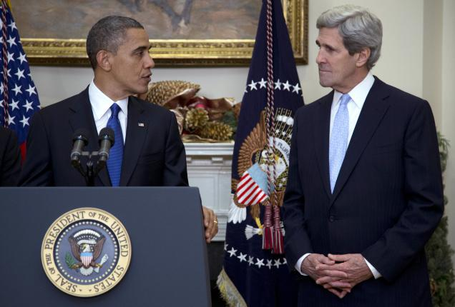
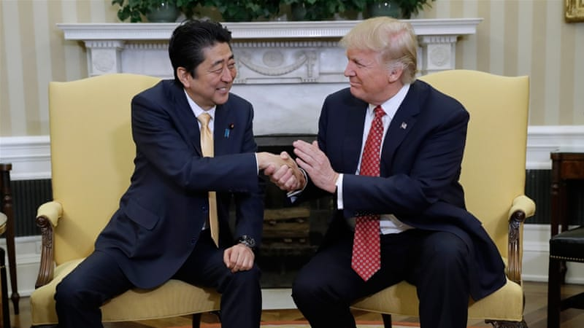
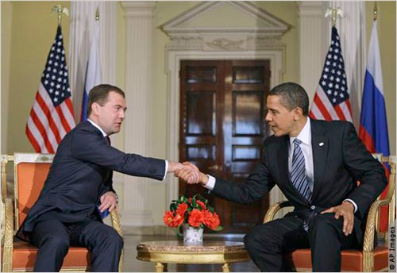
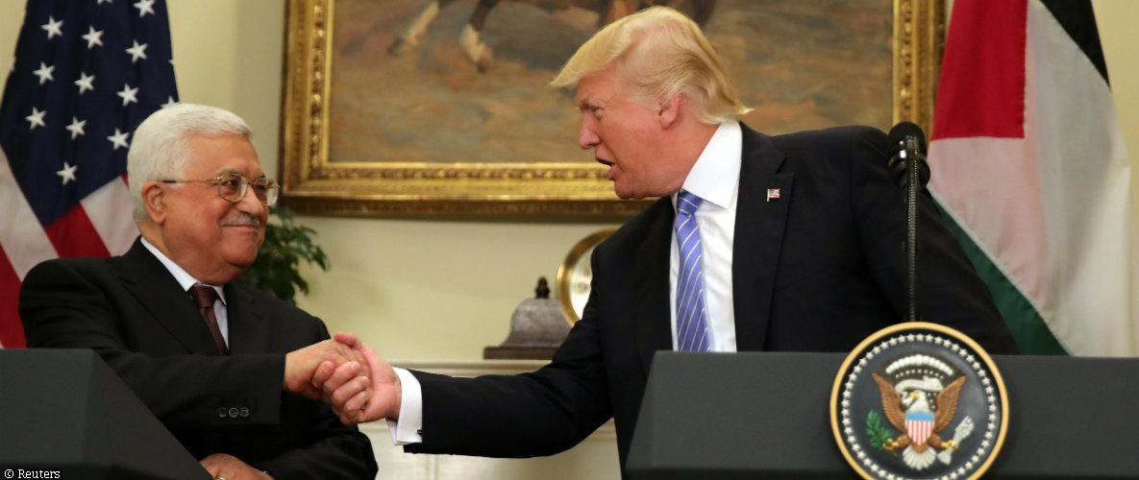
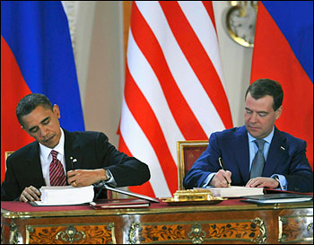
Chief Diplomat
Travels to other countries to build international relations
Meets with leaders of foreign nations
Appoints US Ambassadors
Makes treaties: Formal agreements with other countries (ratified by Senate)

Slide 11
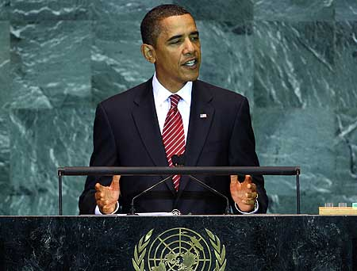
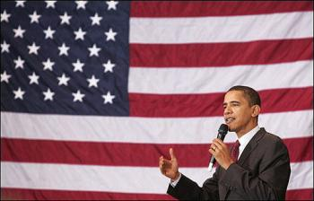
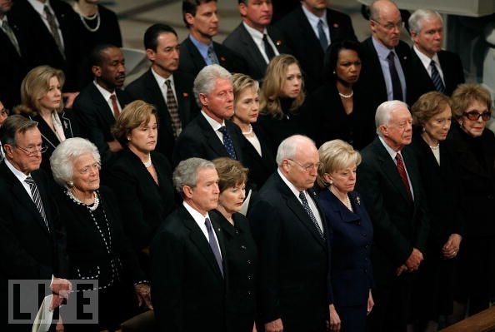
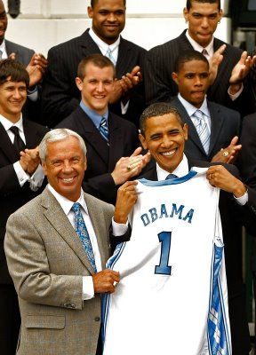
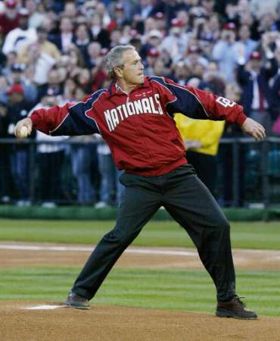
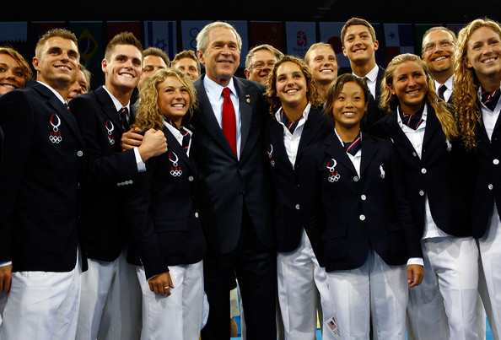
Chief of State
Represents the US – Face of government and symbol of US around the world
Symbolic/Ceremonial Acts (throws out 1st pitch, attends funerals, meets heroes, etc)

Slide 12
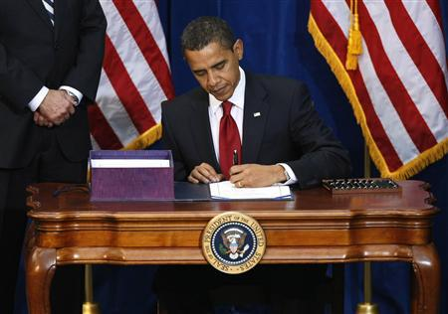
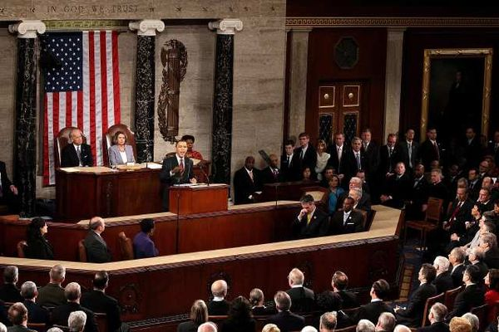
Legislative Leader
Signs/Vetoes Bills
Calls Special Sessions of Congress
Recommends Legislation (Gives “State of the Union Address” to joint session of Congress every year stating what he would like to see happen)
Makes the budget (Congress approves)

Slide 13
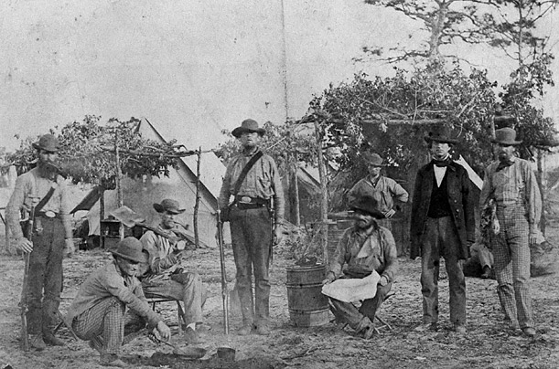
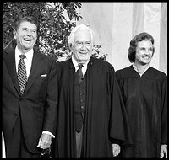
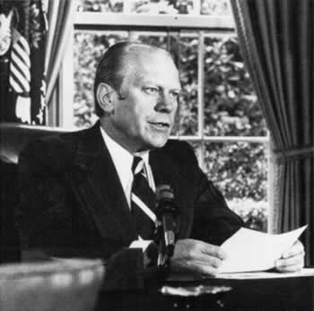
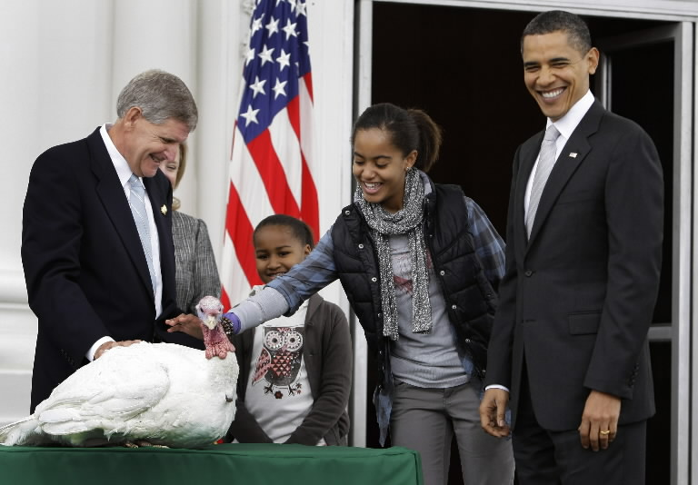
Judicial Leader
Appoints Judges
Grants Pardons – forgiveness for crimes
Grants Amnesty – pardon to a group
Grants Reprieves – delays punishment until another trial

Slide 14
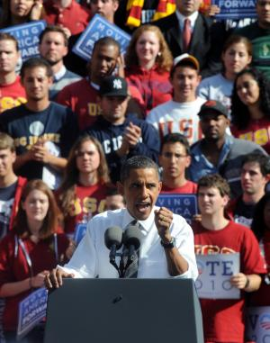
Political Party Leader
Most recognized member of his party
Party’s spokesman on the national level
Appoint loyal party members to jobs in government (patronage)
Endorse and campaign for party’s candidates

