Slide 1
Influences and Foundations of American Democracy

Slide 2
Recap: Government!
Levels of government?
Types of government?
Need for government? (What does government do?)
Branches of Government?

Slide 3
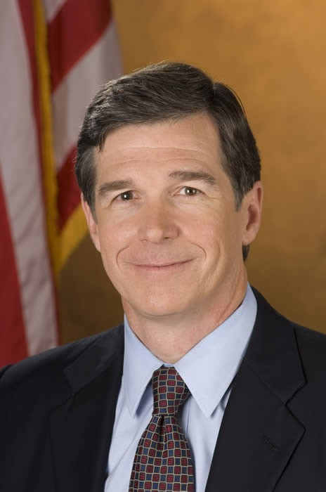
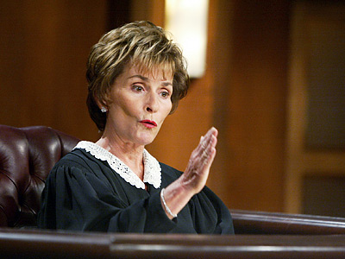
Branches of Government
Legislative: Makes laws
-Ex: US Congress, NC General Assembly
Executive: Enforces laws
- President Donald Trump, Governor Roy Cooper
Judicial: Interprets laws
- Courts

Slide 4
English Political Traditions
What aspects of the English government do we use in the US today?

Slide 5
The Enlightenment
Cultural & intellectual movement of the 1600-1700s
Developed in Germany, France, Britain & spread throughout much of Europe
Spread the idea that reason and science could improve society
Our founders were products of Enlightenment and believed in Enlightenment ideals

Slide 6
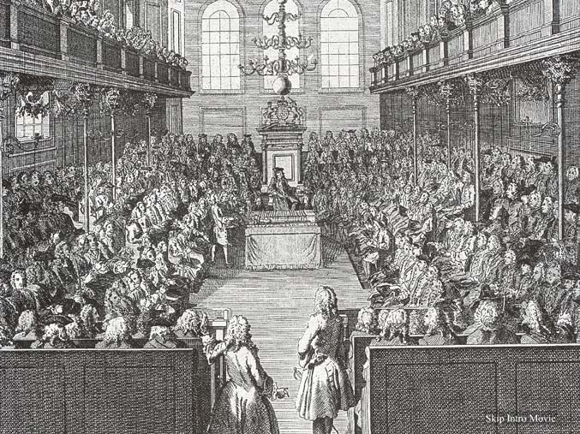
Parliament
Main Ideas | Influence on US Gov’t
Lawmaking body Stronger than king | Powerful legislature

Slide 7
Magna Carta “Great Charter” (1215)
Main Ideas | Influence on US Gov’t
King’s power limited | Rule of law Common law No taxation without representation

Slide 8
English Bill of Rights (1689)
Main Ideas | Influence on US Gov’t
Statement of rights citizens should have | Ended divine right Fair trial No cruel/unusual punishment Free elections

Slide 9
Common Law
Main Ideas | Influence on US Gov’t
Rests on court decisions (precedent) | Still have today! Means not all “laws” that we follow come out of Congress or other law-making bodies.

Slide 10
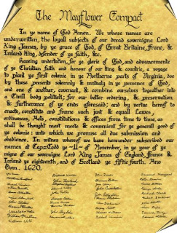
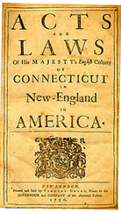
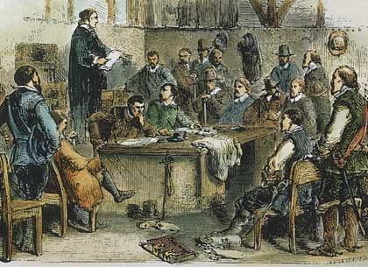
Colonial Traditions
Mayflower Compact: Pilgrims agreed to obey gov’t authority → self-rule, democracy, social contract (1620)
Virginia House of Burgesses: est. by VA colony as first representative assembly in English colonies → beginning of self-government (1621)
Fundamental Orders of Connecticut: Pilgrims left MA for CT, wrote Orders for new gov’t → first written constitution in US (1639)

Slide 11
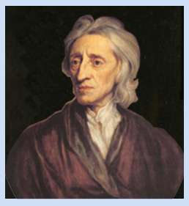
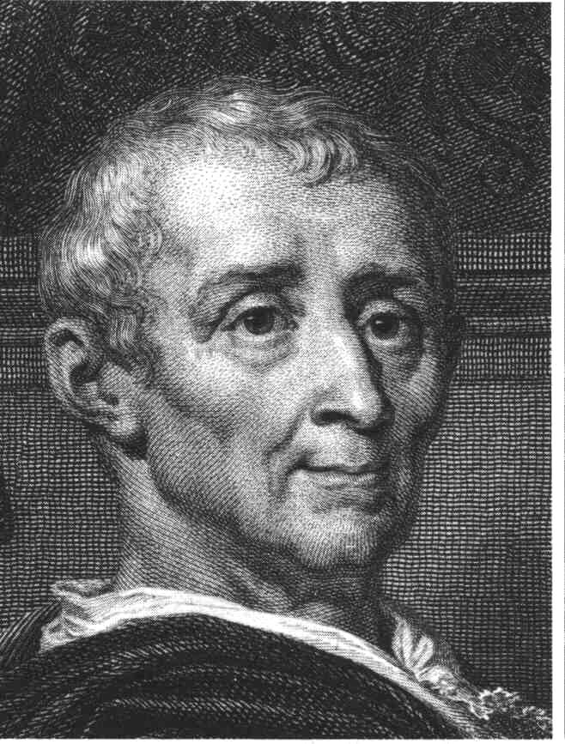
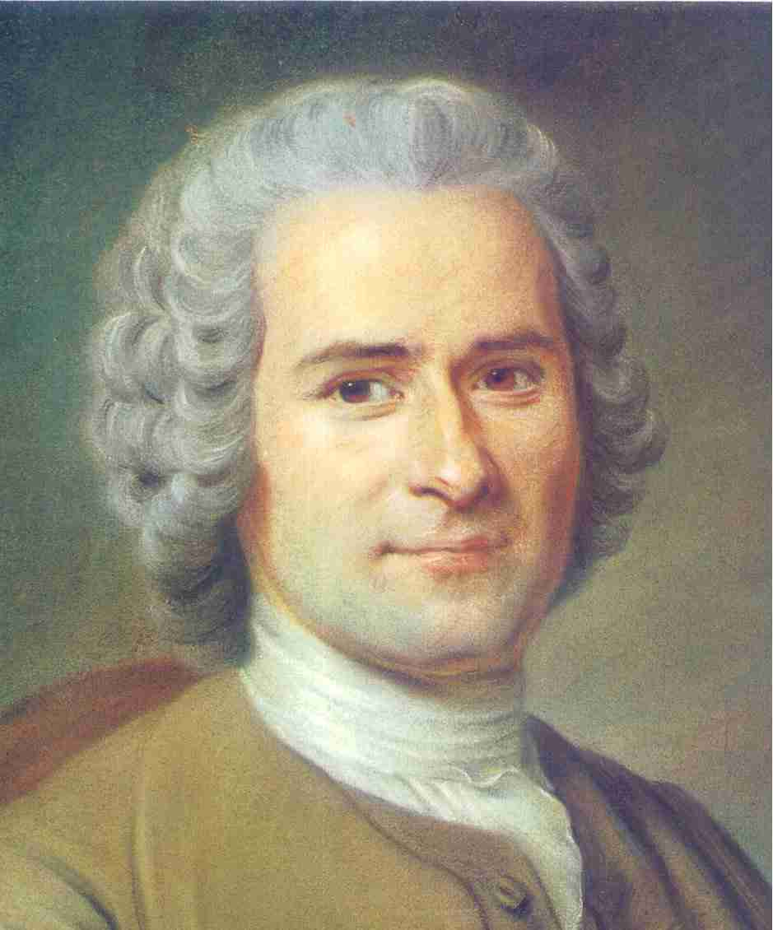
Enlightenment Philosophy
Enlightenment was a time when people in Europe began to question traditional ideas about gov’t & power and came up with new ideas about who should be involved in gov’t
Several important writers of 1700s helped pave the way for the American Revolution…..

