Slide 1
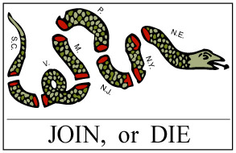
What do you see What does it mean
1.
2.
3.

Slide 2
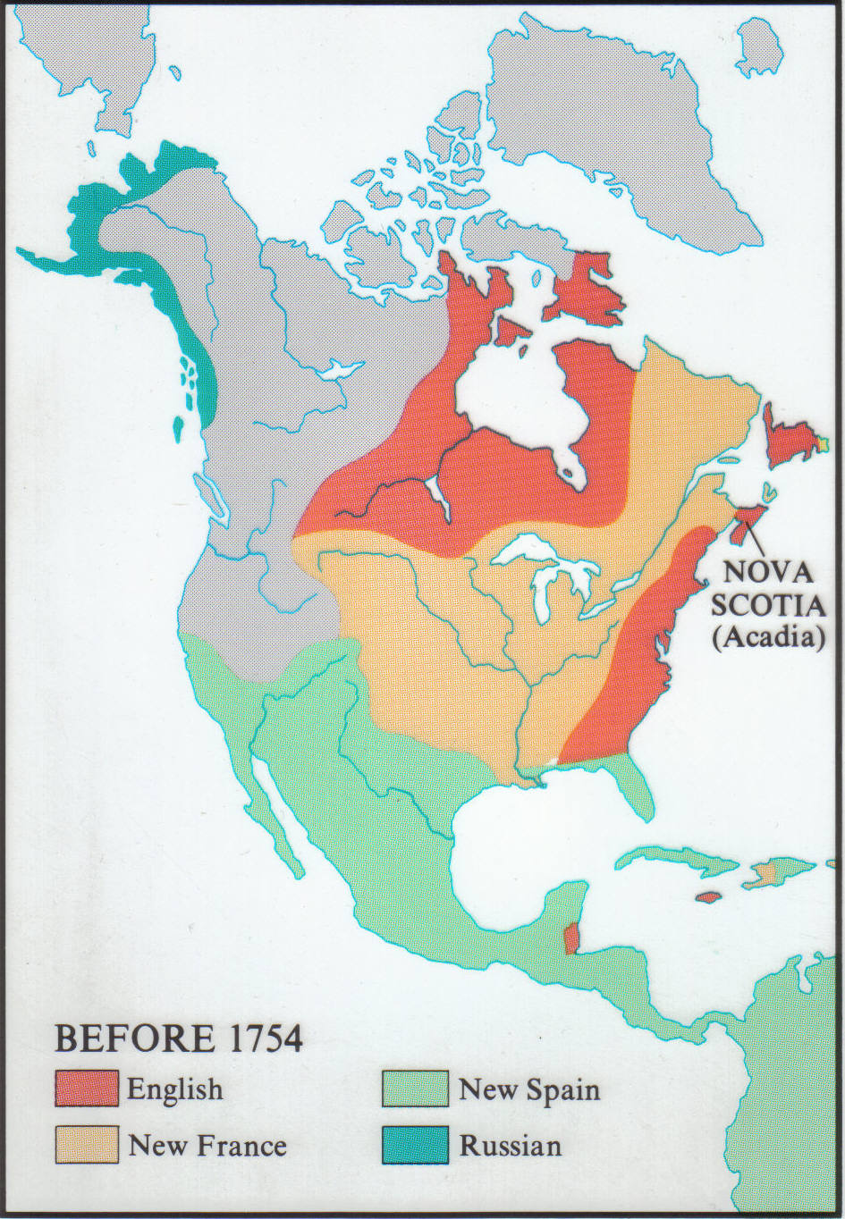
French and Indian War
1754-1763

Slide 3
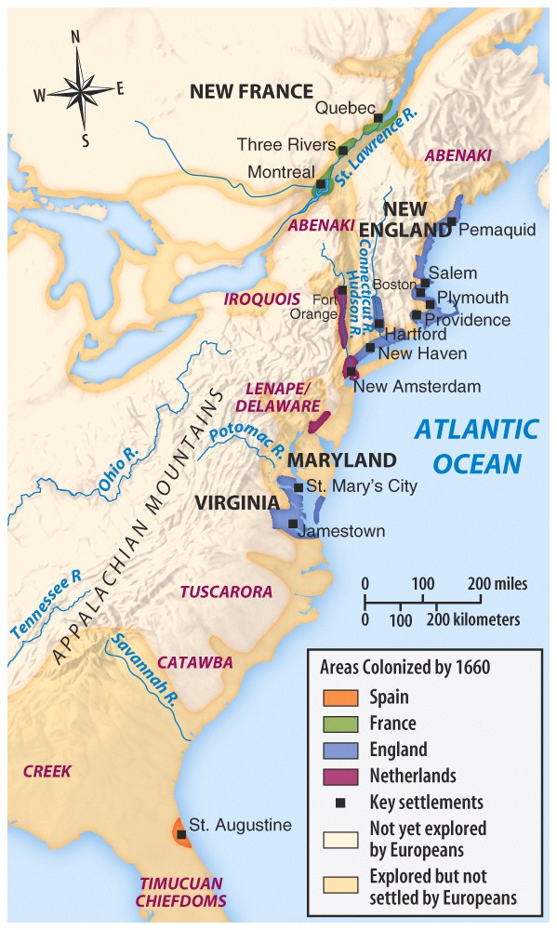
French were not here take over the land and colonize as were the British.
They set trading posts for the fur trade and developed working relationships with the Indian tribes unlike the British.

Slide 4
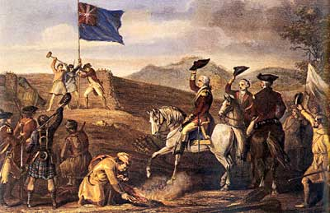
FRENCH AND INDIAN WAR OR SEVEN YEARS OF WAR
CAUSES
CAUSES
England and the 13 Colonies fight together to defend their empire.
English-French rivalry worldwide would erupt into a world war.
Against the French, Indian allies and Spanish
War begins over land disputes in the Ohio Valley
FOUGHT FOR THE CONTROL OF NORTH AMERICA
British want part of fur trade and the 2 openings into North America
George Washington starts this war

Slide 5
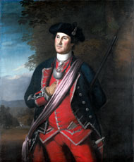
GEORGE WASHINGTON
British concerned about French forts in Virginia territory.
Send Washington, a major in the Virginia militia, to the Allegheny River Valley.
Washington leads 300 men against the French at Fort Duquesne and kills over a 100 French.
Along the way, Washington builds Fort Necessity. The fort falls to the French in a skirmish that will lead to the French and Indian War.
A British statesman later wrote about Washington’s first skirmish: “The volley fired by a young Virginian in the backwoods of America set the world on fire.”

Slide 6
Albany Plan
The Albany Plan
1754: Albany Congress – convened by British, led by Franklin ~ 1st attempt at colonial unity ~ only 7 of 13 colonies there
Purpose: keep Iroquois loyal, bolster defense against France through colonial unity
Franklin sponsored plan for colonial home rule, unanimously adopted by delegates
  Colonies rejected: not enough independence
  London rejected: too much independence

Slide 7
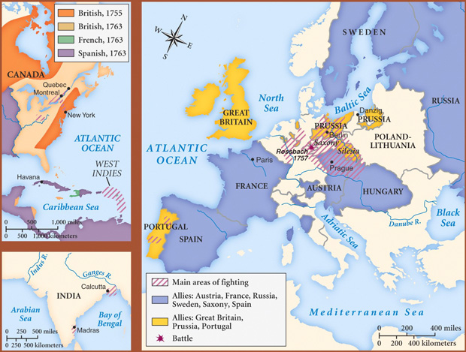
French and Indian War
Seven Years of War

Slide 8
Time line Answer
1753 | The French expand into the Ohio Valley region and George Washington is to ask them to leave. The French fortify their area with additional forts. Governor Dinwiddie has colonists build a fort.
1754 | The French build Fort Duquesne and Washington is asked to make them leave. Washington attacks French on a diplomatic mission to ask the English to leave. Washington retreats and builds Fort Necessity. Washington’s fort is attacked; he surrenders and is allowed to leave.
1755 | The British lay an attack plan. 1) General Braddock will capture Fort Duquesne 2) British will fortify Fort Oswego then capture Fort Niagara 3) capture Fort Frederic 4) capture Fort Beausejour Braddock carries out part one of attack but is attacked severely by Native Americans and his troops retreat in fear, he is killed. Washington gets out surviving soldiers.

Slide 9
French and Indian War Timeline
1756 | British Fort Oswego is captured.
1757 | British Fort William Henry is captured by the French and the French let them walk away. The Native Americans have different plans and slaughter them which is in the Last of the Mohicans.
1758 | British defeated at Fort Carillon. British put in a blockade and are able to take Louisburg. The British take French Fort Frontenac and Fort Duquesne. The British call fort Duquesne, for Pitt and it will become present-day Pittsburgh.

Slide 10
French and Indian War Time line
1759 | French Fort Niagara is taken. The British head to Quebec. French General Montcalm has 15000 soldiers defending Quebec and British General Wolfe has 8500 soldiers. In July Wolfe bombards Quebec for 68 days but Montcalm holds. Montcalm waits for winter. The British move to the west of Quebec and climb cliffs for an attack which Montcalm thinks is impossible so he doesn’t house many soldiers there. The seasoned British attack the young French. Montcalm and Wolfe will be killed.
1760 | The French fail to take back Quebec. The British lay siege to Montreal in three directions, the French governor surrenders.
1762 | France invades Newfoundland but British troops quickly recover it.
1763 | Treaty of Paris is signed.

Slide 11
FRENCH AND INDIAN WAR OR SEVEN YEARS OF WAR
EFFECTS
EFFECTS
French lose war and all land in North America
Colonists realize British are not invincible seek independence.
English inherit vast new land holdings in North America
England sees responsibility to defend empire in North America
FOUGHT FOR THE CONTROL OF NORTH AMERICA
Great Britain accumulates huge war debts
King George and Parliament tax the Colonies

Slide 12
1763 → Treaty of Paris
France --> lost her Canadian possessions, most of her empire in India, and claims
to lands east of the Mississippi River.
Spain --> got all French lands west of the Mississippi River, New Orleans, but lost Florida to England.
Native Americans-→ continued to loose land to the settlers.
England --> got all French lands in Canada, exclusive rights to Caribbean slave trade, and commercial dominance
in India.

Slide 13
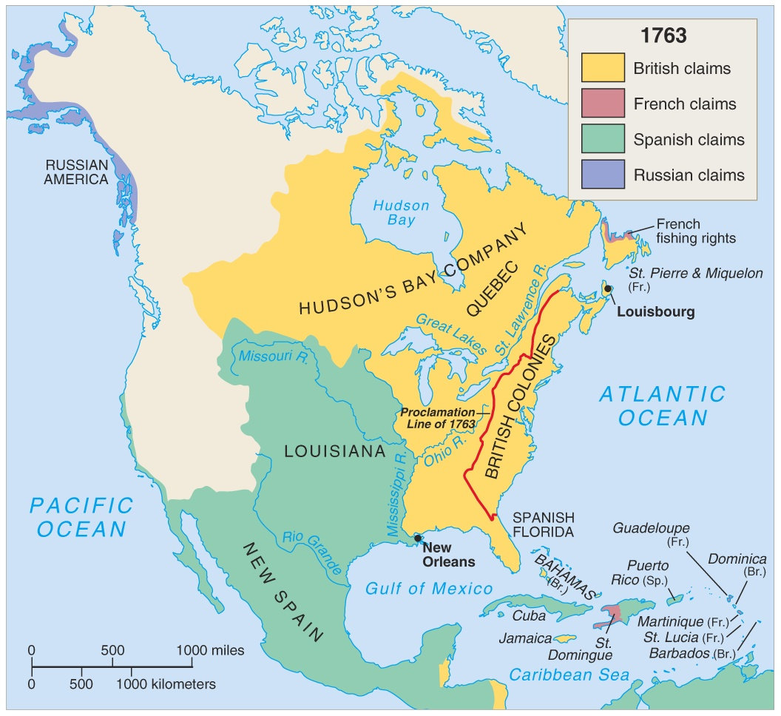
F/I War 1763
Treaty of Paris 1763
England gains French land from Canada to Florida and Appalachians to the Mississippi River.
England gains Florida from Spain.

Slide 14
Effects of the War
on Britain?
1. It increased her colonial empire in
the Americas.
2. It greatly enlarged England’s debt.
3. Britain’s contempt for the colonials
created bitter feelings.
Therefore, England felt that a
major reorganization of her
American Empire was necessary!

Slide 15
Effects of the War on the American Colonials
1. It united them against a
common enemy for the first
time.
2. It created a socializing
experience for all the
colonials who participated.
3. It created bitter feelings
towards the British that
would only intensify.

Slide 16
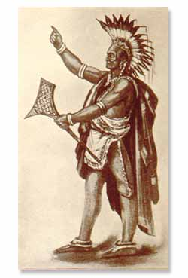
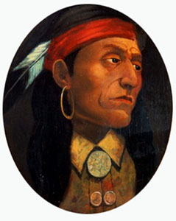
Pontiac
Pontiac's Rebellion
Chief Pontiac was an influential Ottawa leader who encouraged his people not to make peace with white settlers.
He was murdered by those who opposed his political views.

Slide 17
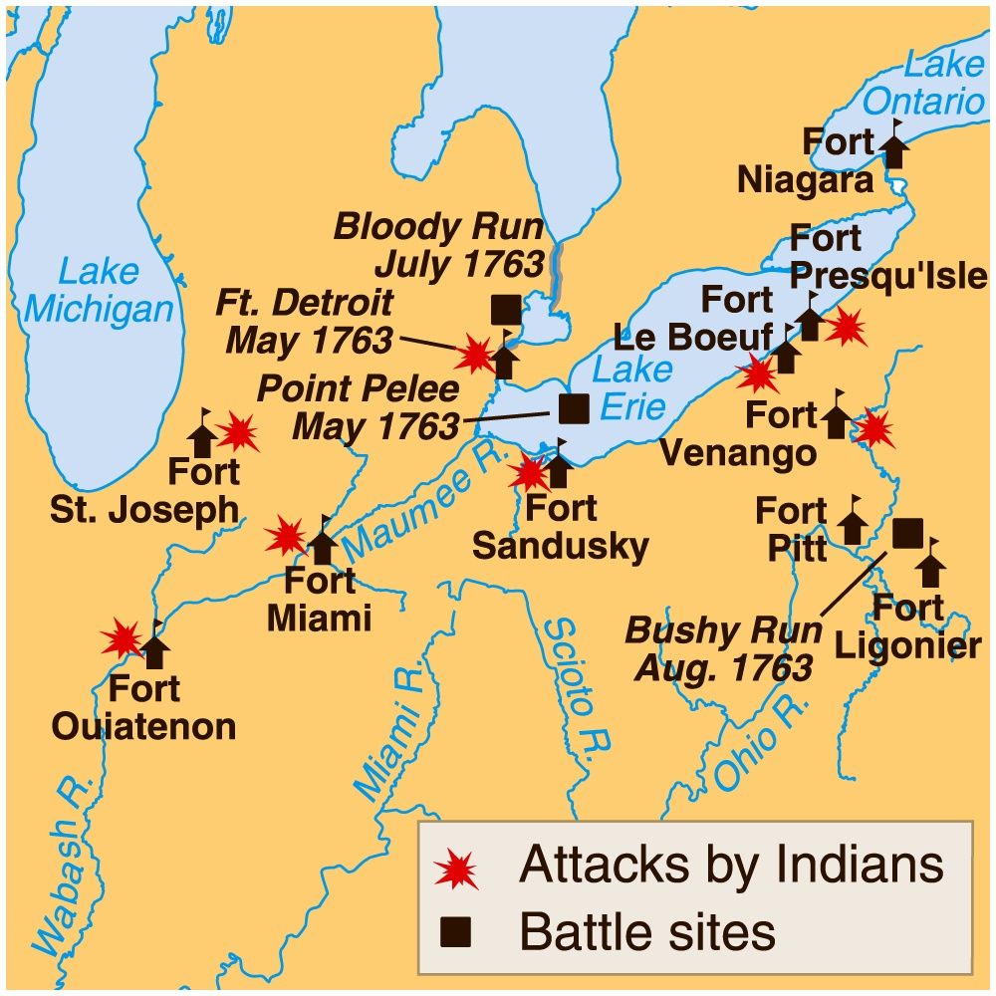
Pontiac
Pontiac's Rebellion
Colonists moved into this new territory causing Indian attacks on their settlements.
Great Britain would prohibit the Colonists from moving westward.

Slide 18
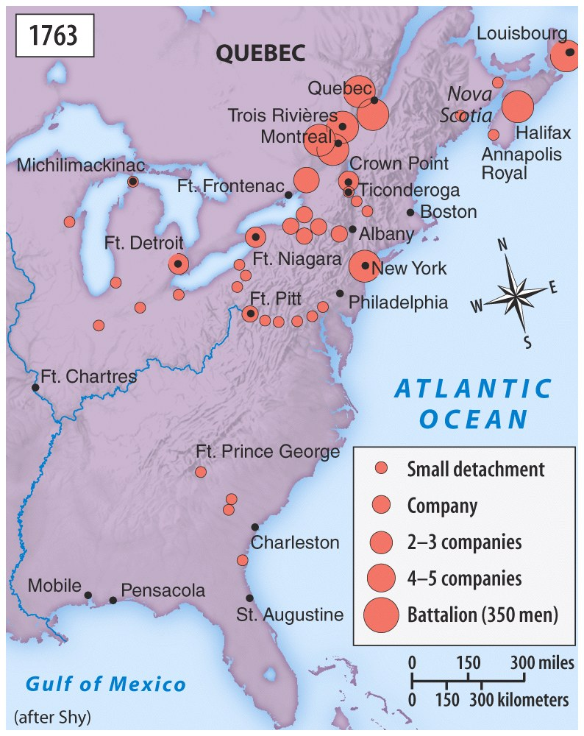
Troops1
British Troop Movements in response to Chief Pontiac’s resistance to negotiate.

Slide 19
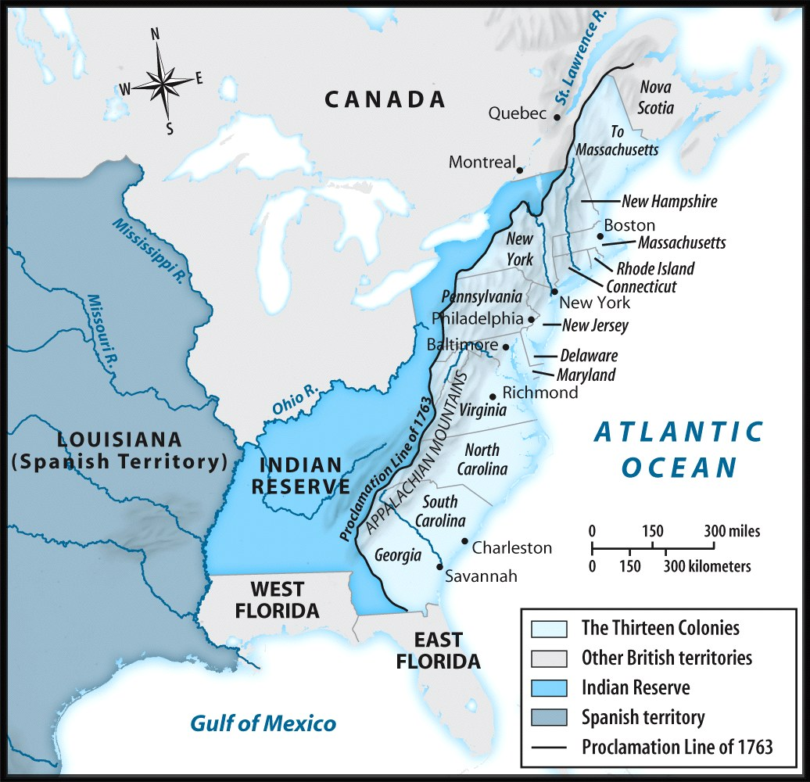
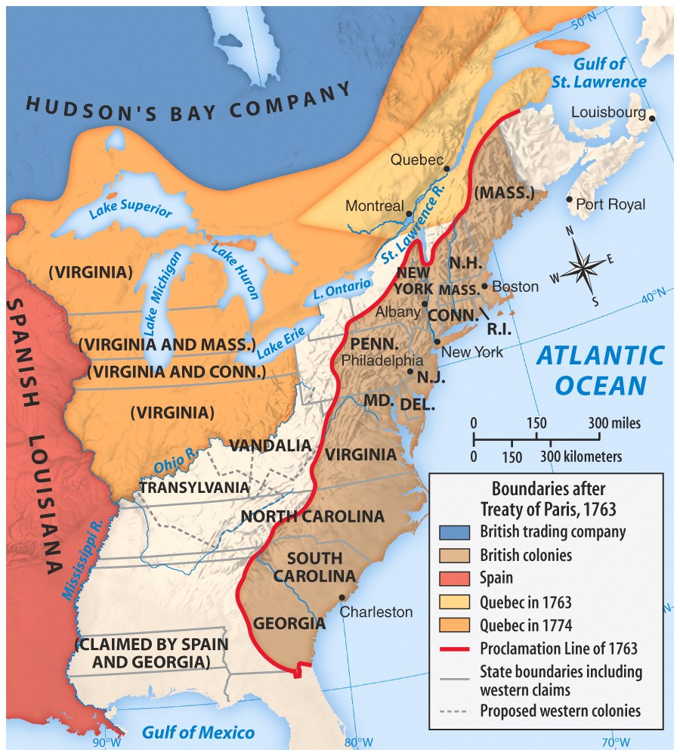
Indian Attacks force British to build forts to protect settlers moving westward
Northwest Territory

