Slide 1
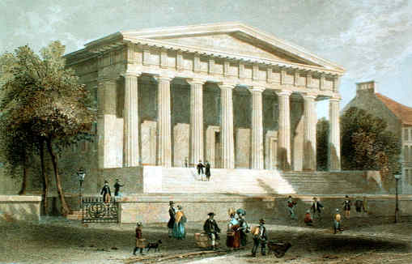
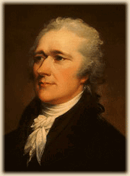
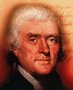
BANK OF THE U.S.
BUS
HAMILTON
Safe place to deposit and transfer money
Provide loans to government and state banks
A national currency---$$$$$
An investment by people to buy stock into US bank
Constitution did not forbid a national bank….Loose construction of Constitution
National debt good for country
JEFFERSON
Against the Constitution
State banks would collapse
Only wealthy could invest in bank and would control bank than control the government
Hurt the common man
Strict construction…If it is not mentioned in the Constitution than there can’t be a national bank.
Against a national debt

