Slide 1
Influencing Laws

Slide 2
Mass Media
Media that communicates broadly to the “Masses” (General public) such as television, radio, newspapers, web sites, books, movies, etc…
Ex: CNN, News & Observer, “An Inconvenient Truth” (Movie), etc…
Can influence public opinion which can influence law-makers and policy

Slide 3
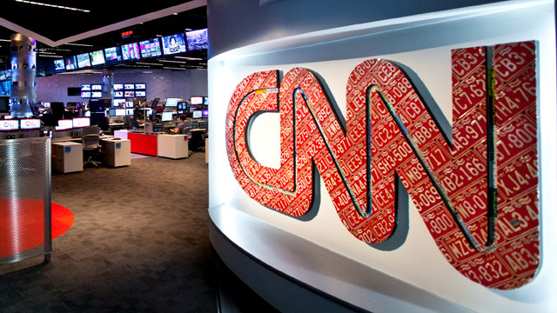
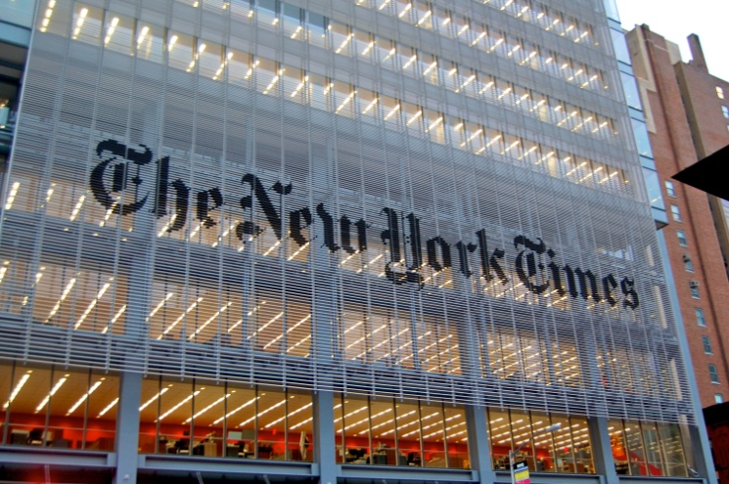
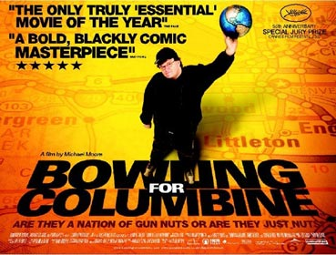

Slide 4
Interest Groups
Groups of individuals who share a common belief or interest that unite to promote their cause
Ex: NRA, AARP, NAACP, PETA
Can influence voters; run political ads; give money to candidates; influence laws and policy

Slide 6
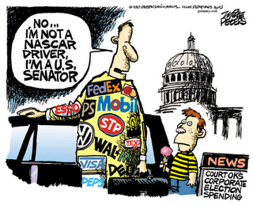

Slide 7
Lobbyists
Representatives of interest groups who are in direct contact with lawmakers and government officials
Ex: Special Interest Groups (See above), Major Industries (Car Makers), Local Governments, Teachers, etc…
Can influence the decisions of lawmakers and put pressure on political parties

Slide 8
