Slide 1
US Citizenship Test– Can You Pass It?
Answer the following Qs at the top of your notes. You should TRY every question, even if you don’t know! You do NOT need to write the question.
1. The idea of self-government is in the first three words of the Constitution. What are these words?
2. What do we call the first 10 amendments to the Constitution?
3. How many amendments does the Constitution have?
4. What is the “rule of law”?
5. Who makes federal laws?
6. How many justices are on the Supreme Court?
7. What is one responsibility that is only for United States citizens?
8. When was the Constitution written?
9. Name 2 American Indian tribes in the United States.
10. Why does the flag have 13 stripes?

Slide 2
What is civics?
Why are we here?

Slide 3
Civics
The study of rights and duties of citizens
Concept of citizenship dates back more than 2,500 years
Who is considered a citizen?

Slide 4
Citizens
Community members who owe loyalty to the government & get protection from it
What do citizens do?
Agree to follow set of rules
Accept government’s authority

Slide 5
What are some characteristics of a good citizen?
Please list at least 5 qualities.

Slide 6
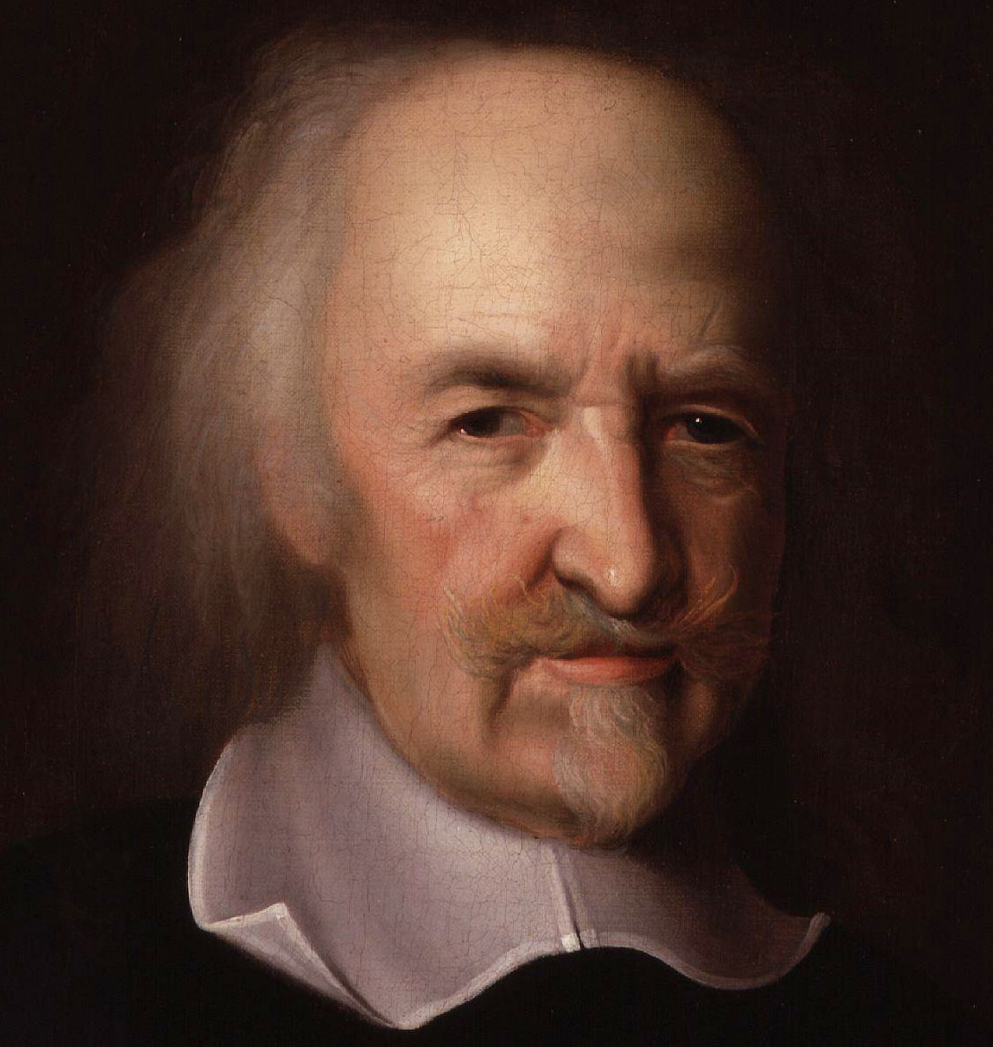
Government
For there to be citizens, there has to be a government
Thomas Hobbes: without government life would be ‘solitary, poor, nasty, brutish, and short’
Do you agree? Record your thoughts in complete sentences

Slide 7
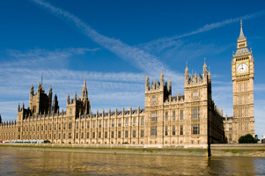
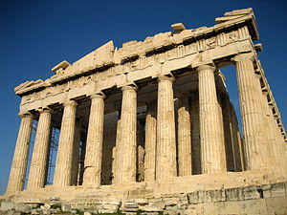
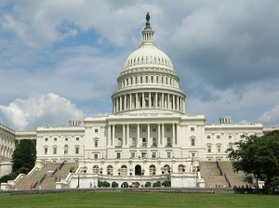
So what is government?
Ruling authority for community
Organization that has power to make & enforce laws & decisions for members

Slide 8
What does government do?
Keep order
Settle conflicts
Guide community
Provide services individuals can’t provide independently
With a partner, think of 1 example of each of these functions. Record in your notes in the space beneath each category.

Slide 9
Levels of Government
National ----- USA
State ----- NC
Local ------ ????
We will study all of these this year!

Slide 10
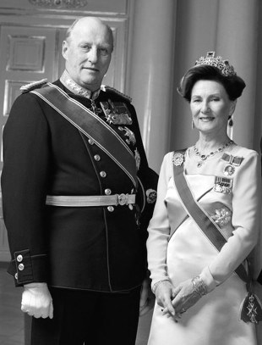
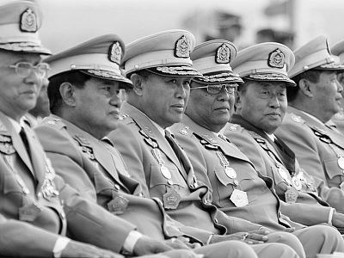
Types of Government
Autocracy: one person has power
Monarchy: king/queen; family line; usually share power
Dictatorship: one ruler has absolute control
Oligarchy: “rule by the few” (small group/ social class)

Slide 11
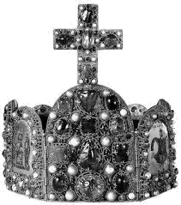
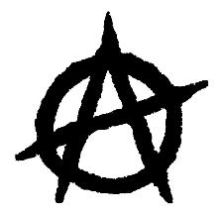
Theocracy: gov’t w/ God as ultimate authority
Anarchy: no one is in control

Slide 12
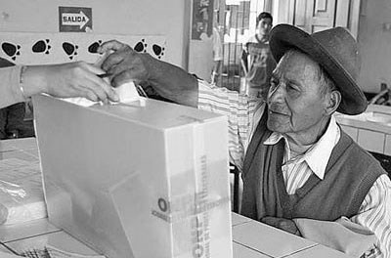
Democracy: citizens hold political power
Direct democracy: each citizen has right/ responsibility to participate in gov’t; all citizens have equal voice
Representative democracy: citizens choose smaller group to represent them/ make laws; citizens remain the source of gov’t authority

Slide 13
American Democracy
What type of democracy do we have in the US?
Representative democracy
Principles
Power of government comes from citizens
Americans run government through representatives
Purpose of government is to make America a better place

Slide 14
“Who Rules?”
Directions: Complete the “who rules?” worksheet using your BRAIN and your CLASS NOTES on the types of government that we just talked about.
You may work with ONE PARTNER, if you wish.

