Slide 1
Introduction to Economics

Slide 2
What is Economics?
We all have wants and needs but no one can have everything. This is the first lesson of economics.
Economics: The study of how people choose to use scarce resources to satisfy their needs and wants
Microeconomics: study of individual parts on an economy
Macroeconomics: study of an economy as a whole

Slide 3
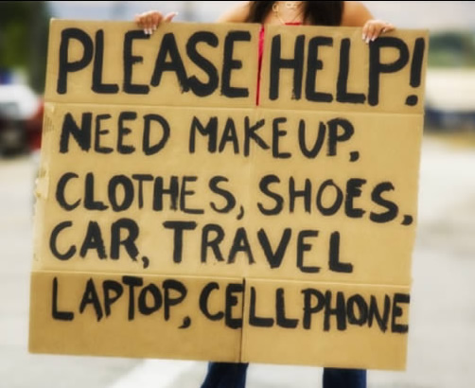
Wants v. Needs
Wants: Things you would LIKE to have
Needs: Things you MUST have to survive

Slide 4
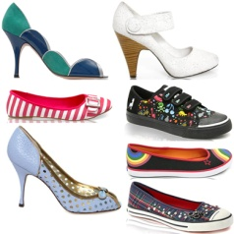
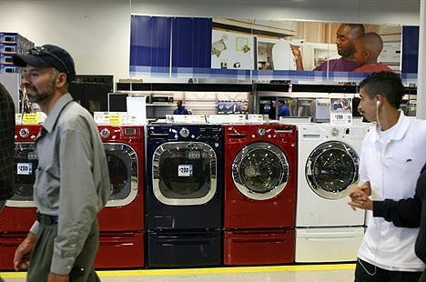
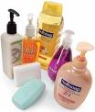
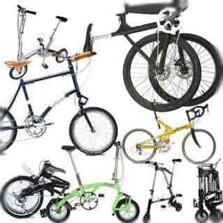
Goods v. Services
Goods: Tangible items (can be touched)
Services: Useful work; intangible

Slide 5
Goods v. Services
Goods and Services must be made or produced
The business owners who make the CDs, shoes, and bikes are producers. Doctors, barbers, and bus drivers are also producers. The users of goods and services are consumers.
Lineberger’s Bistro
Service
Producers
Consumers
Goods

Slide 6
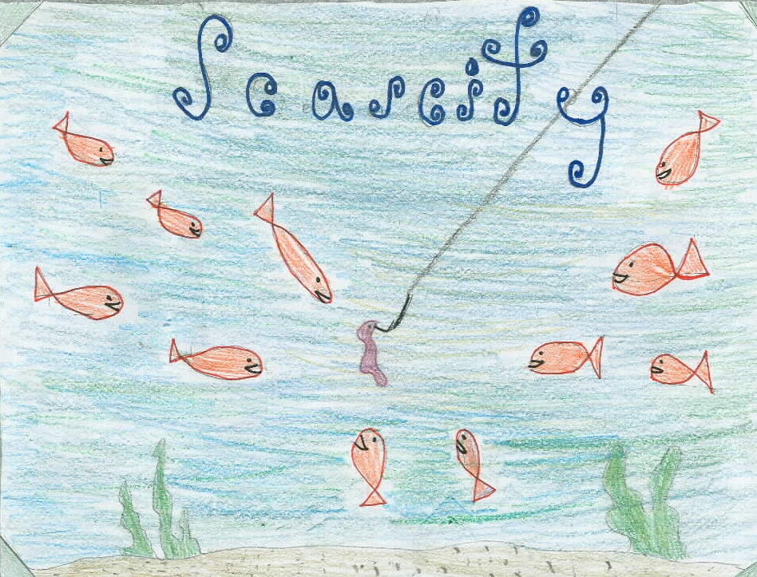
Scarcity
There are not enough resources to meet the wants and needs of all of the people all of the time
This is the driving force
behind economics!
Anything we pay money
for is scarce (or else we
wouldn’t have to pay
for it)

Slide 7
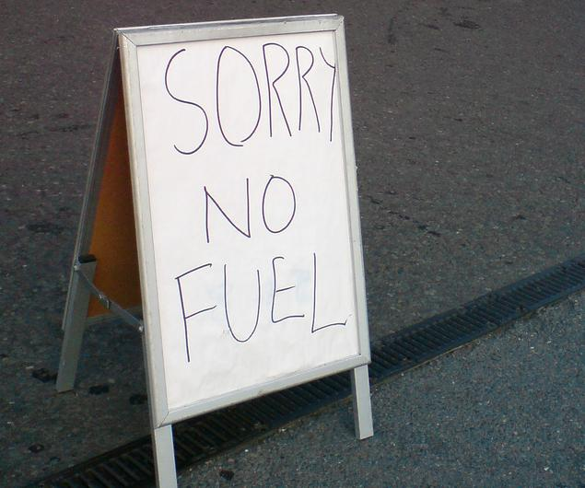
Shortage
TEMPORARY lack of a resource or product
Products are always scarce, but a shortage is more immediate and extreme. A shortage often causes prices to rise.

Slide 8
Economic Decisions
BECAUSE OF Scarcity:
There is not enough of everything to go around. ALL resources are limited
PEOPLE MUST MAKE Trade-offs:
(economic choices) Goods or services that must be given up in order to get what you want
This
That
FOR

Slide 9
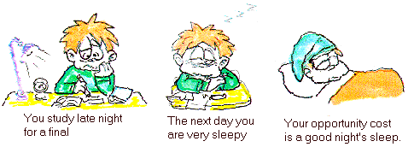
Opportunity Cost
When making a decision, the opportunity cost is the value of the next best alternative – what was given up FIRST
Consider your own opportunity costs:
1) Buying a $50 shirt
2) Playing video games until 2am
3) Studying for your Civics quiz

Slide 10
Personal Financial Literacy: Budgeting

Slide 11
Income
Disposable Income: Money after all taxes have been paid
Discretionary Income: Money after all necessities have been paid for (can be used on wants)

Slide 12
BUDGET: A plan for managing your money in a way that meets your personal wants & needs Helps you to manage your money & make it go farther

Slide 13
HOW TO CREATE A BUDGET: 1. Set financial goals 2. Estimate your income 3. Record what you spend 3. Assign priorities 4. Budget for expected AND unexpected expenses 5. Review & evaluate/revise monthly

Slide 14
What’s in a Budget?
INCOME
Simply any money earned or contributed to your household from either personal finances or a business.
EXPENSES:
Money that you spend.
This includes anything you purchase, including planned AND unplanned expenses.

Slide 15
Budget for Actual and Unexpected Expenses
Actual Expenses:
Identify fixed expenses (i.e. rent, car payment, student loans).
Record the monthly payment deadline and plan according to your payday date.
Variable Expenses:
Identify recurring expenses the fluctuate (monthly grocery, automobile, etc.) calculate an average based on previous months NOTE: when in doubt, guess high!
Consult with friends and family on what they spend

Slide 16
Budget for Actual and Unexpected Expenses
The FIRST step is to create and maintain an Emergency Fund.
Initially the Emergency Fund should be $500 - $1, 000 depending on your income and debt load.
Eventually you need to increase this to 3-6 months worth of income.
Develop the attitude that this is ONLY used for EMERGENCIES (unemployment, unexpected medical needs or any other financial crisis).
Should you have to use money in this fund for an EMERGENCY the priority for the next month is to re-supply the fund.

Slide 17
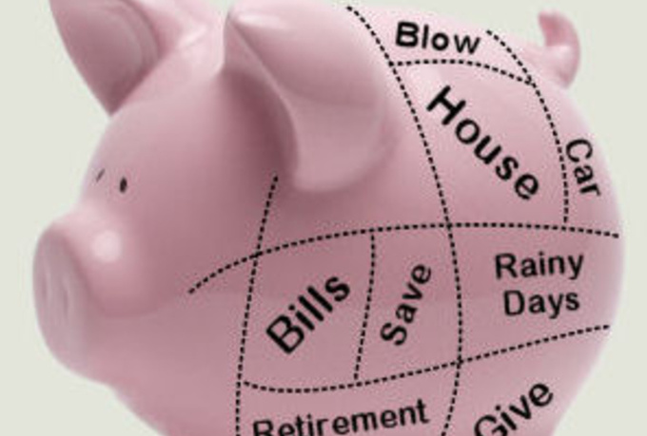
Creating a Budget
What do you want to save each month? Set it aside as soon as you get paid!
Determine FIXED expenses: Do not change from month to month (Examples??)
Estimate/Plan VARIABLE expenses: Can be adjusted by lifestyle (Examples??)
Plan for large expenses/purchases that may be approaching (Examples??)

Slide 18
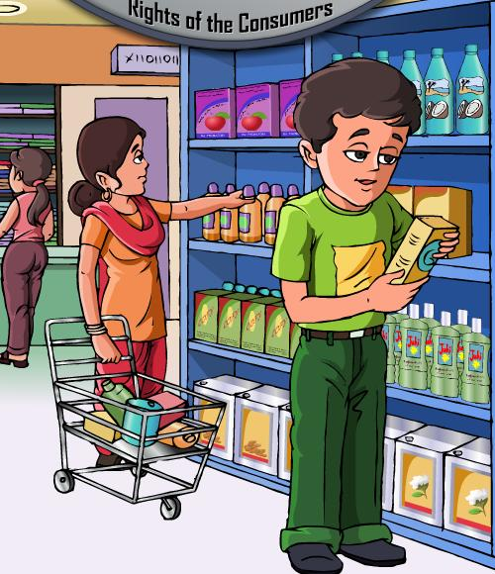
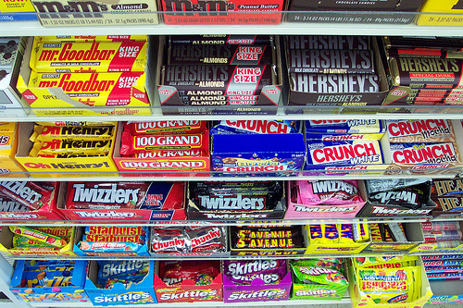
Smart Buying Strategies
Gather information - use consumer magazines, ask friends, etc.
Use advertising, but be careful!
Comparison shop - visit stores, check flyers, magazines, ads, etc.
Utilize coupons and store specials!
Compare brand name with identical generic products
Look at “unit price” (price/volume)
Consider used products
Beware of “impulse buying”

Slide 19
Financial Goal Setting 1. What is one financial goal you would like to achieve by summer vacation? 2. What is one financial goal you would like to achieve by the time you graduate from high school? 3. What is one financial goal you would like to achieve by March 10, 2025? Write a paragraph (5-7 sentences) explaining your plan to achieve each of the above goals (three paragraphs total!).

