Slide 1
Roots of American Law

Slide 2
Ancient Laws
Hammurabi’s Code (1750 BC): First written laws code - Punishment must fit the crime
Ten Commandments (1600 BC): Religious law - Influenced civil and criminal laws globally
Greece (500 BC): First democracy
Rome (250 BC):Introduced the idea that laws must be fair - First interpretation of laws by judges

Slide 3
English Laws
Magna Carta (1215):Established the everyone had to follow the same laws (Even government officials such as the king)
Common Law (1200’s): Law is based on precedent (earlier decisions) and traditions
Parliament (1300’s): First law making body in Europe (Later divided into House of Lords and House of Commons)

Slide 4
Early American Developments
House of Burgesses (1619): First law making body in North America (Used in Jamestown)
Colonial Governments (1600 - 1700’s): Each colony had a legislature - began making their own decisions and laws
Articles of Confederation (1781): First attempt at a national government - had little power to enforce laws
Constitution (1788): Created a stronger national government - Outlined the power of government and the rights of the people

Slide 5
What is Law?
Law: Set of rules governing a society and allowing it to live peacefully
Purposes:
→Provide order/ safety
→Ensure fair treatment
Everyone is expected to follow them
John Adams: “In the United States, we will have a government of laws, not of men.”

Slide 6
Types of Law
What are the major types of law in the US? What are examples of each?
C & E

Slide 7
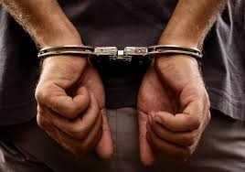
Criminal Law: Prevent people from harming other people or others’ property.

Slide 8
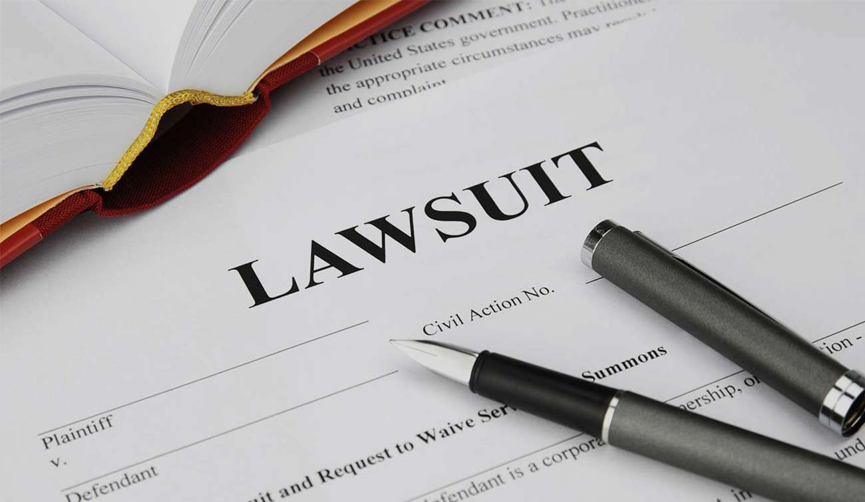
Civil Law: Deals with disputes between people or groups when no law has been broken. Disputes get settled in a court case called a lawsuit. - Tort: a civil case where injury occurs because of negligence. - Family Law: Divorce, custody, child support, adoption.

Slide 9
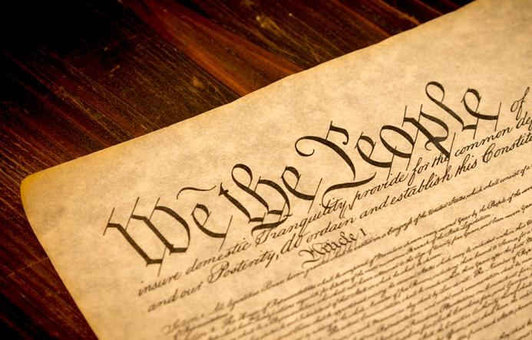
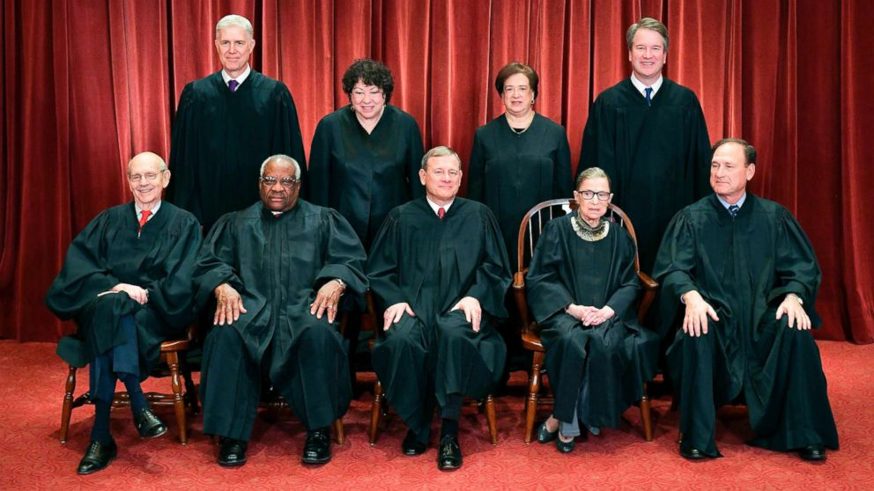
Constitutional Law: rights of citizens and rules setting up how the government functions.

Slide 10
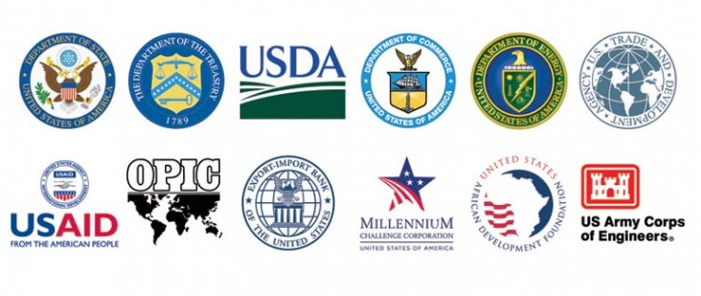
Administrative Law: describes how executive agencies of the Federal government carry out their job.

Slide 11
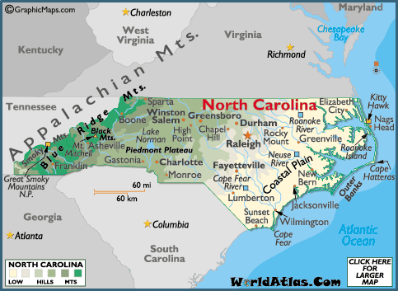
Statutory Law: laws made by states.

Slide 12
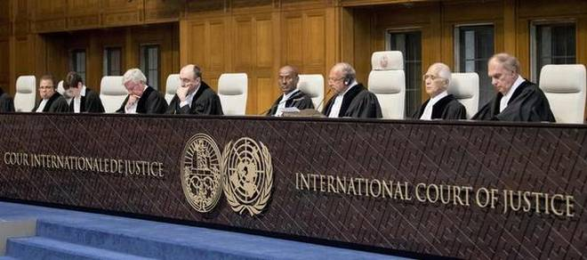
International Law: deal with geographic areas outside of a single country (oceans) and agreements between two or more countries. - International Court of Justice (ICJ): settles disputes between two or more nations. Also prosecutes war criminals.

