Slide 1
Bell work Review: Answer questions in notebook
What is the percentage Indians that remained after contact with Columbus?
What motivated Spain’s conquest?
How were the Spanish able to succeed?
What were the effects of Popẽ Rebellion?
Who was Las Casas and what was his impact?
Describe the economic system in the Spanish Colonies.
How were the Spanish Empire and the French Empire different in North America?

Slide 2
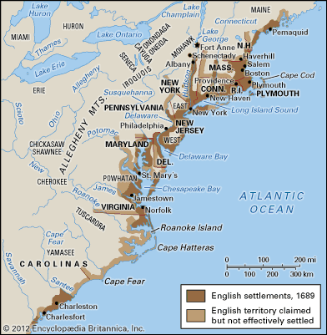
The English Empire in America
First English settlements were disasters!
Roanoke Island – 2 attempts failed (1587 colony lost)
VA. Co. → Jamestown – 1607
Of 144 who arrived first – 38 survived the first year
Starving time
No gold or silver
Powhatan and Indian Wars
As late as 1642, only 8000 lived in VA,

Slide 3
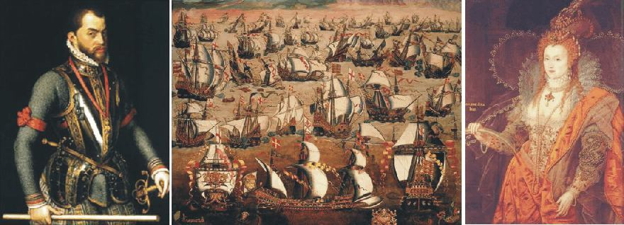
Factors contributing to the English colonization of America
Strategic interests of England
Rivalry with Spain. Spain, naval power based on gold and silver from Americas, threat to Protestant England
Need for timber

Slide 4
Economic Factors
Economic Distress in England →settlement in Virginia, and Southern Colonies
“surplus population” moved to cities → fear of disorder
America opportunities for indentured servants
Capitalists
Joint stock companies—helped individuals finance colonies (Virginia Co.) → Jamestown;
Headright system –you could receive 50 acres in exchange for paying for someone else’s passage to the colony.

Slide 5
Religious Motivations
Puritans (NE)
Great Migration – City on a Hill (model communities to provide example for reform),
Separatists (Plymouth) – escape sinful England
Quakers – (PA), (23K) by 1715 - religious opportunity
Catholics – Maryland,
OVER TIME ECONOMIC FACTORS FOR MIGRATION OVERWHELMED RELIGIOUS REASONS

Slide 6
American Colonies different regions very different cultures! No unity! Beginnings of localism and sectionalism!
Southern
Chesapeake (VA, MD)
Carolinas
Georgia
New England
MA Bay, CT, NH
RI
Middle
New York,
PA (NJ, DE)

Slide 7
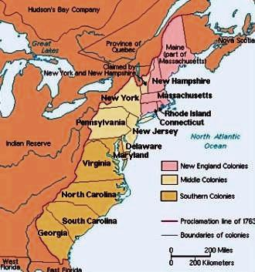

Slide 8
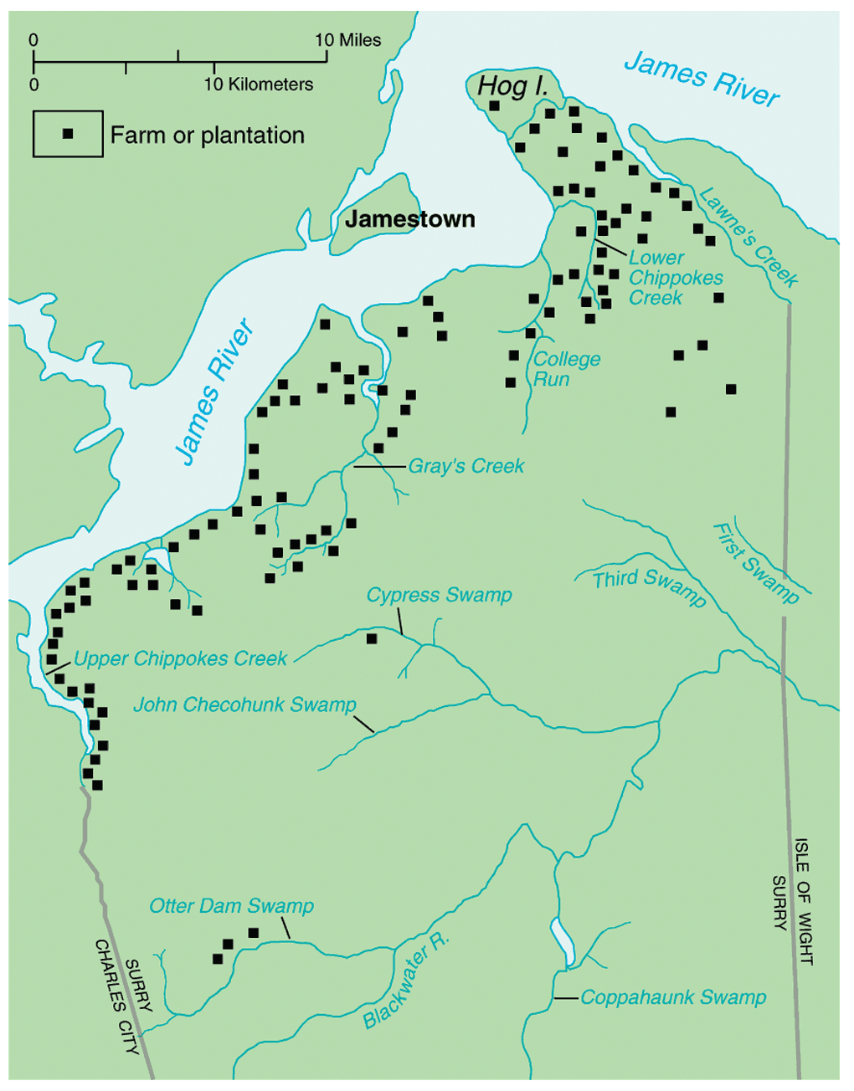
Virginia and Tobacco
Tobacco became basis of economy (Rolfe)and saved failing colony
Need for labor
Indentured servants
¾ of VA immigrants 1640 – 1675
Soil butchery →
Expansion
Problems with Indians

Slide 9
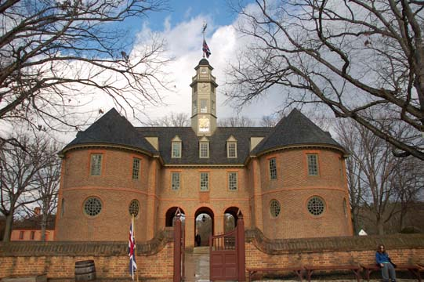
The House of Burgesses - first legislature in English colonies (1619)

Slide 10
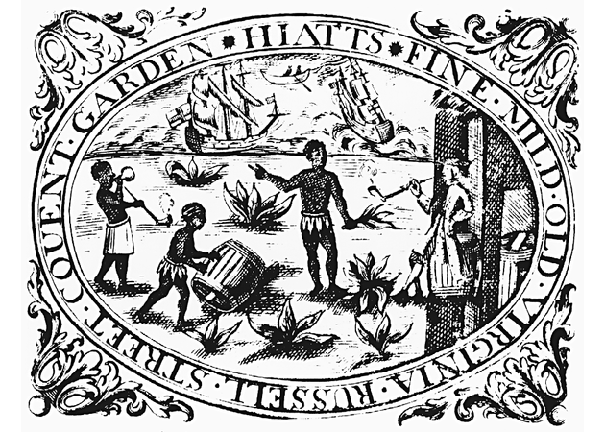
First Africans arrived (1619)
perhaps slaves, perhaps indentured servants.
Slavery not that important until the end of the 17^{c!}

Slide 11
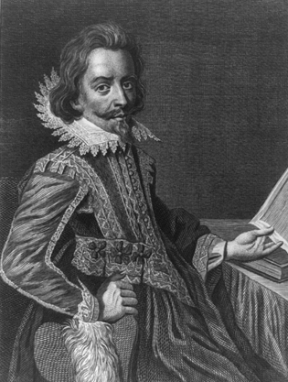
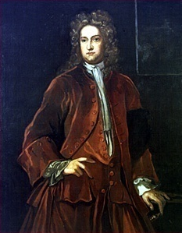
Nathaniel Bacon’s Rebellion: 1676
1,000 piedmont Virginians in a rebellion against Governor Berkeley
Freed indentured servants – concerns = high taxes, Berkeley’s unwillingness to exterminate Indians
In the end rebellion failed but…
planters searched for laborers less likely to rebel and a way to lessen class differences→ BLACK SLAVES!!
Nathaniel Bacon
Governor William Berkeley

