Slide 1
The Presidency of JAMES MADISON
While the War of 1812 produced no clear winner, it gave Americans a strong sense of national pride.

Slide 2
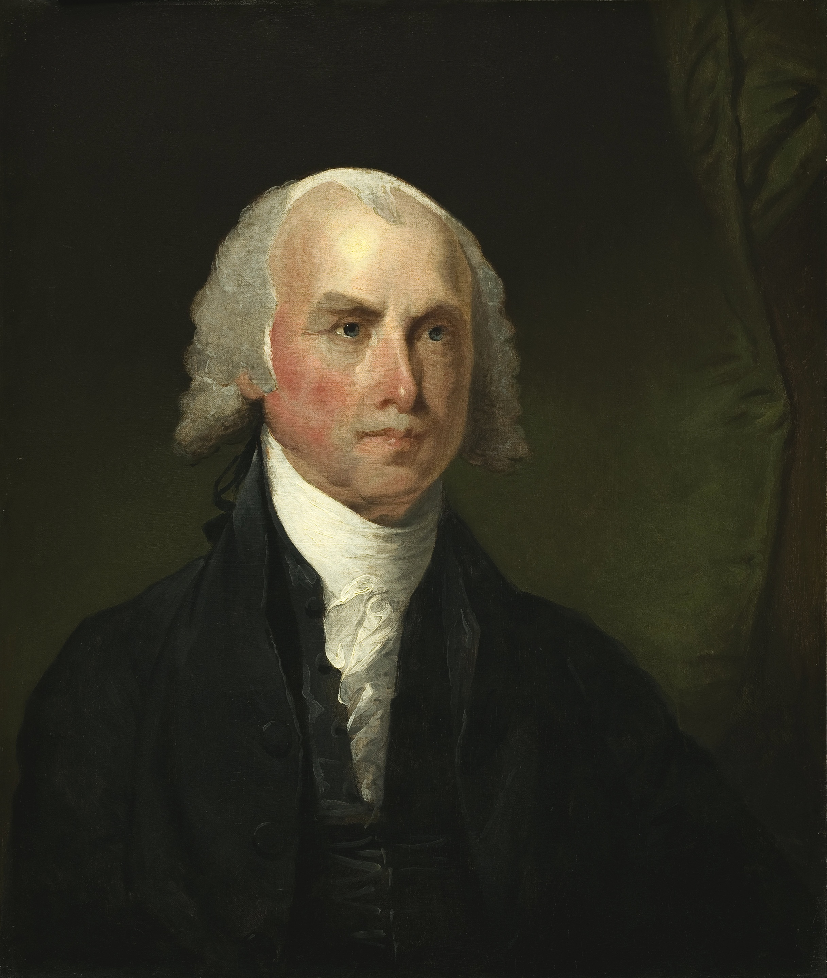
The Election of 1808
Republican Party
James Madison

Slide 3
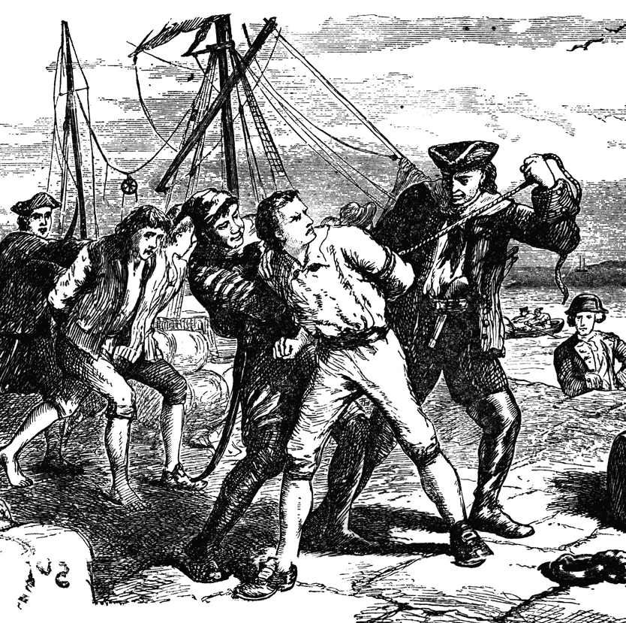
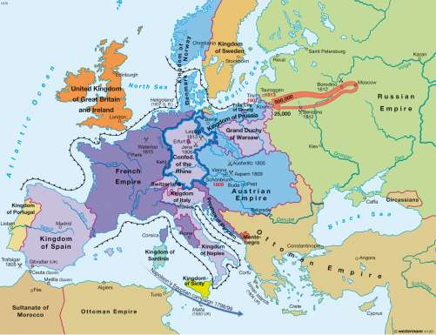
The Causes of the War of 1812
British blockade of French ports
American trade was hurt
British impressment
Chesapeake incident angered Americans
Embargo Act of 1807
Hurt trade, farming, and shipping

Slide 4
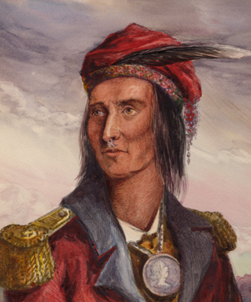
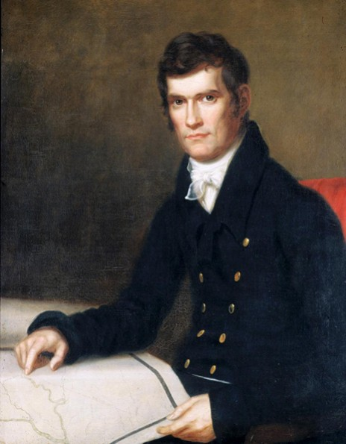
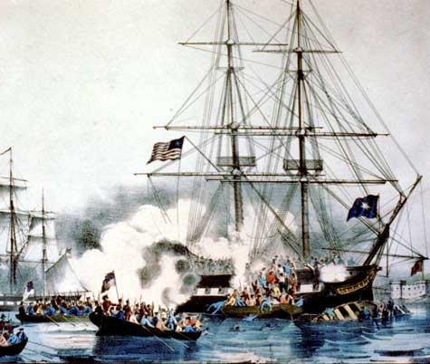
The Causes of the War of 1812
War Hawks
Young Congressmen who wanted to begin war with Britain
British support of Native Americans
Americans thought the British were helping the Native Americans in Canada
Madison’s desire for freedom of the seas

Slide 5
The Battle of Tippecanoe
When? It occurred in Nov. of 1811.
Who? Tecumseh, the Shawnee chief, and William Henry Harrison, the governor of the Indiana Territory, had a falling out.
Why? The Shawnee wanted to unite with other NA tribes.
Effect: The battle shattered the Native Americans’ confidence & most fled to Canada.
The Americans wanted to wage war on the British for “helping” us. We never asked for help.

Slide 6
War is declared… …but there are problems
America had too few soldiers to fight a war.
Public opinion was divided.
Pres. Madison never felt a consensus from the American people.
There was no money for the war

Slide 7
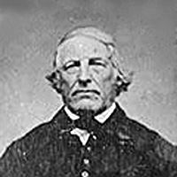
The Origins of Uncle Sam
For more information about “Uncle Sam” Wilson, visit
http://www.cnn.com/2007/LIVING/wayoflife/10/17/mf.uncle.sam/

Slide 8
The Important Battles
The British Raid on Washington, D.C.
Aug. 1814
British set fire to the Capitol & the White House
Dolly Madison saves the day, painting, and papers!

Slide 9
The Important Battles
The Battle of Fort McHenry
Occurred on September 13, 1814
British bomb the Baltimore area
Francis Scott Key writes the “Star Spangled Banner”

Slide 10
The Important Battles
The Battle of New Orleans
Occurred January 1815
Andrew Jackson & his Tennessee volunteers defeated to numerous British troops under Gen. Packenham
The battle happened after the signing of the Treaty of Ghent

Slide 11
The Hartford Convention
Dec. 1814
New Englanders angered by War
Which party was in NE?
First time secession announced

Slide 12
The Treaty of Ghent
December 24, 1814
The borders remained the same between the countries.
Nothing else was negotiated.
Ended the Second War for Independence.

Slide 13
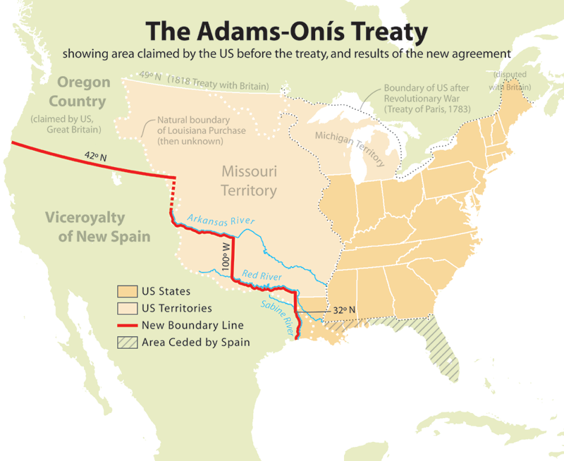
Adams-Onís

