Slide 1
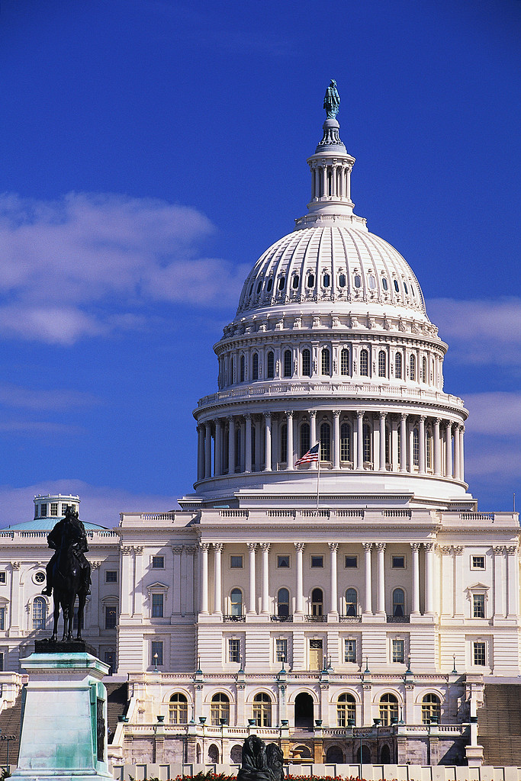
“Congress”
Legislative Branch

Slide 2
Article I of the Constitution
Bicameral
Congress is a ____________ legislature which means ____________
Comes from the ___________________
________________ is the “upper house”
________________ is the “lower house”
Two houses
Great Compromise
Senate
House of Representatives

Slide 3
The Voice of the People
Who elects the members of each house? _______ called “__________”
Representatives must listen to their ____________ if they want to get re-elected
voters
constituents
constituents

Slide 4
People in Congress
Political party with the most members in a house
Majority Party:
Minority Party:
Incumbents:
Political party with less members in that house
Representatives running for RE-election (already have the job)

Slide 5
Sessions of Congress
term
Each ______ of Congress lasts 2 years
Each year of that term is called a __________
Special Sessions – called by the _________
Joint Sessions -
session
President
House of Reps and Senate meet together (State of the Union Address from President)

Slide 6
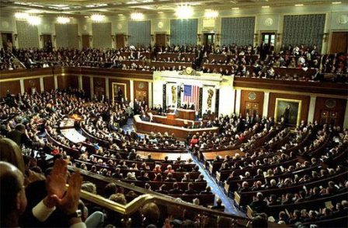
Joint Session of Congress

Slide 7
Committees in Congress
Standing Committee –
Select Committee –
Joint Committee –
Permanent committee; discuss specific types of bills/issues (Ex: Senate Foreign Relations Committee)
Temporary committee formed for a specific function/purpose (Ex: Select Committee on Energy Independence and Global Warming)
Included members from both the House and Senate (Ex: Joint Committee on the Library of Congress)

Slide 8
Committees in Congress
Serving on Committees:
Everyone must serve on at least one
Membership based on…
- _______________ - priority given to those members who have been there longest
- Chairmen comes from _______________
Percent of each party mirrors percent
in house as a whole
Seniority System
Majority party

Slide 9
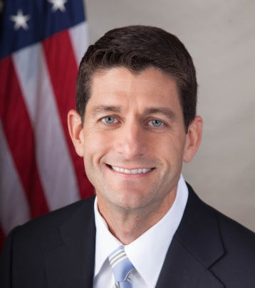
Leaders in Congress
House of Representatives
Leader: ________________
Jobs:
Speaker of the House
Leads Discussions (Moderates Debate)
Decides who may speak
Rules on Procedures
Announces results from votes
Can discipline members
(3rd in line of Presidential Succession!)

Slide 10
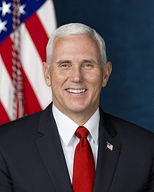
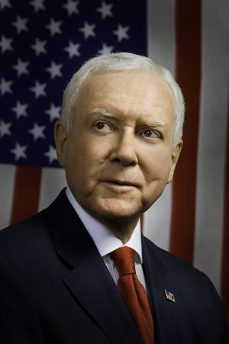
Leaders in Congress
Senate
“President of the Senate”: ________________
Job:
Day-to-Day Leader:
___________________
Vice President
Break Ties – only votes when there is a TIE
President Pro Tempore

Slide 11
Leaders in Congress
Both Houses
Floor Leaders
Majority Leader and Minority Leader
Job:
Whips
Majority Whip and Minority Whip
Job:
Lead debate for their party
Get the members from their party to show up and vote

Slide 12
House of Representatives
Each state’s representation is based on _____________
Total # of (voting) Representatives: _____
population
435

Slide 13
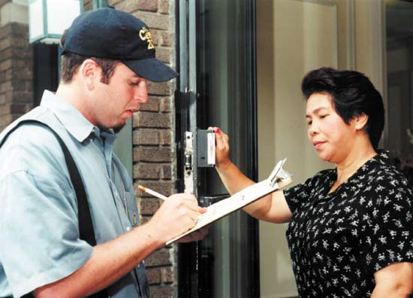
House of Representatives
How many of those reps go to each state?
Every 10 years - _________ to count population
Apportionment:
census
Divide up the 435 seats based on census results (some states get more, some less)

Slide 14
House of Representatives
**When states gain reps, they must draw new districts
Gerrymandering –
Drawing district boundaries for political reasons (trying to make a “Republican” or “Democrat” District)

Slide 15
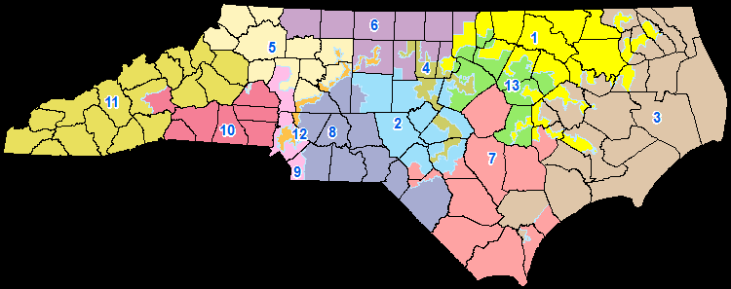
Gerrymandering?

Slide 16
House of Representatives
Qualifications
1)
2)
3)
Length of Term: ______ Years
25 years old
US Citizen for 7 yrs.
Live in the state you represent
Two

Slide 17
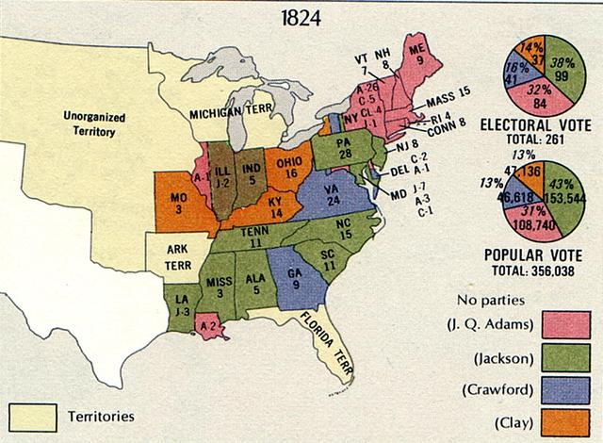
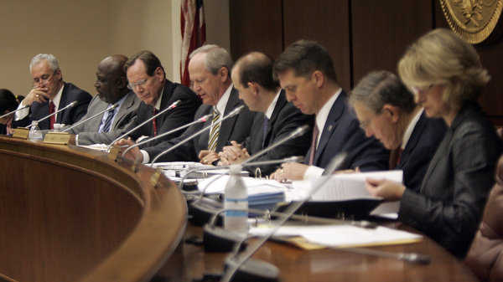
House of Representatives
“Lower House” – More people (each individual has less power); represent individual districts within a state
Special Powers:
1)
2)
3)
All appropriations (money) bills must start here
Bring impeachment charges against pres./judges
Decide elections if no Electoral College majority

Slide 18
Senate
Equal
Representation – ________
___ per state = ____ Total Members
Length of Term: ____ Years
Elections: ____ elected every ____ years
2
100
6
1/3
2

Slide 19
Senate
Qualifications
1)
2)
3)
30 years old
US Citizen for 9 yrs.
Live in the state you represent

Slide 20
Senate
“Upper House” – Less people (each individual has more power); represent whole states
Special Powers:
1)
2)
3)
Approve Presidential appointments (cabinet/judges/etc) – 2/3 vote
Approve (Ratify) President’s Treaties
– 2/3 vote
Try Impeachment Cases (they are the jury)
– need 2/3 vote to convict

