Slide 1
Manifest Destiny to Mexican American War
Chapter 9 American History 1

Slide 2
Discussion
What does “opportunity” mean to you?
What opportunities do you have in your life?
What role does technology play in your life?
Favorite piece of technology (Ipad, Iphone, computer, fitbit), etc)?
Americans in the 1830’s and 1840’s were faced with plenty of new opportunities and technologies.

Slide 3
Crash Course Video
https://www.youtube.com/watch?v=RNftCCwAol0

Slide 4
Market Revolution
The expansion of the American marketplace in the early and mid 1800’s. Americans bought and sold goods rather than making them for their own use.
Shift from earlier American economies focused on local markets and farming for self sufficiency.
New goods and services available
New transportation and communication devices.

Slide 5
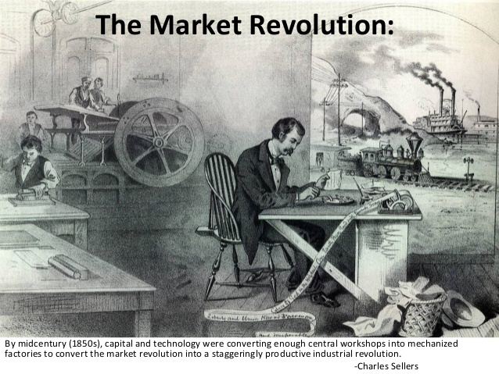

Slide 6
Market Revolution
Two economic concepts
Capitalism- private businesses and individuals control the means of production, used them to earn profits.
Entrepreneurs-investors in new industries. Risk/Reward?

Slide 7
Market Revolution
“America is a country in which fortunes have yet to be made…All cannot be made wealthy, but all have a chance of securing a prize. This stimulates to the race, and hence the eagerness of the competition.” – Alexander Mackey, Scottish journalist.

Slide 8
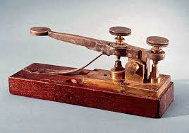
Market Revolution
Samuel Morse
Northeasterner
Invented the telegraph in 1837
1844 with government funding telegraph line completed between Washington, D.C. and Baltimore. “What hath God wrought?”
Transformed communication in country
Morse Code
1854 23,000 miles of copper wire telegraph

Slide 9
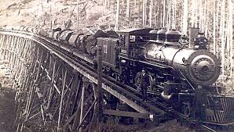
Market Revolution
Railroads!!!
Expansion westward
Linking of Markets
Improved travel time
Greater connectivity

Slide 10
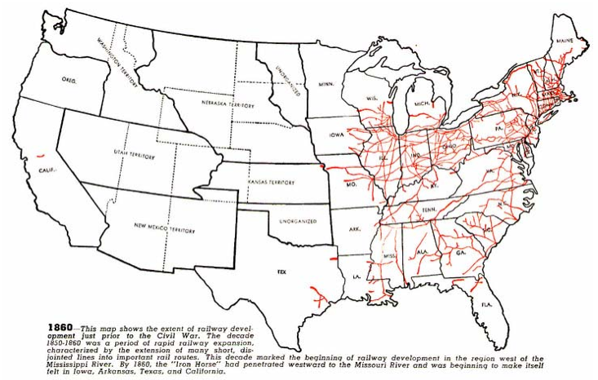

Slide 11
Market Revolution
John Deere
1837 invents the Steel Plow, in Illinois.
Able to handle the conditions of sticky Midwest soil.
Increased agricultural production.
“The plow that broke the plains”

Slide 12
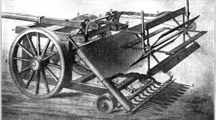
Market Revolution
Cyrus McCormack
Inventor of the Mechanical Reaper, 1831
Increased agricultural production
Prior to invention reaping done by hand
Mechanical reaper automatically cut, threshed, and bundled grain while being pulled through a field by horses.

Slide 13
Group Learning Activity
Students in their pod groups will be provided with a randomized set of terms associated with a Colonial Economy and a Market Economy. Students will have to sort each term into its designated economy and produce a sentence for each reasoning its placement.
Students will share their reasoning at the end of activity.

Slide 14
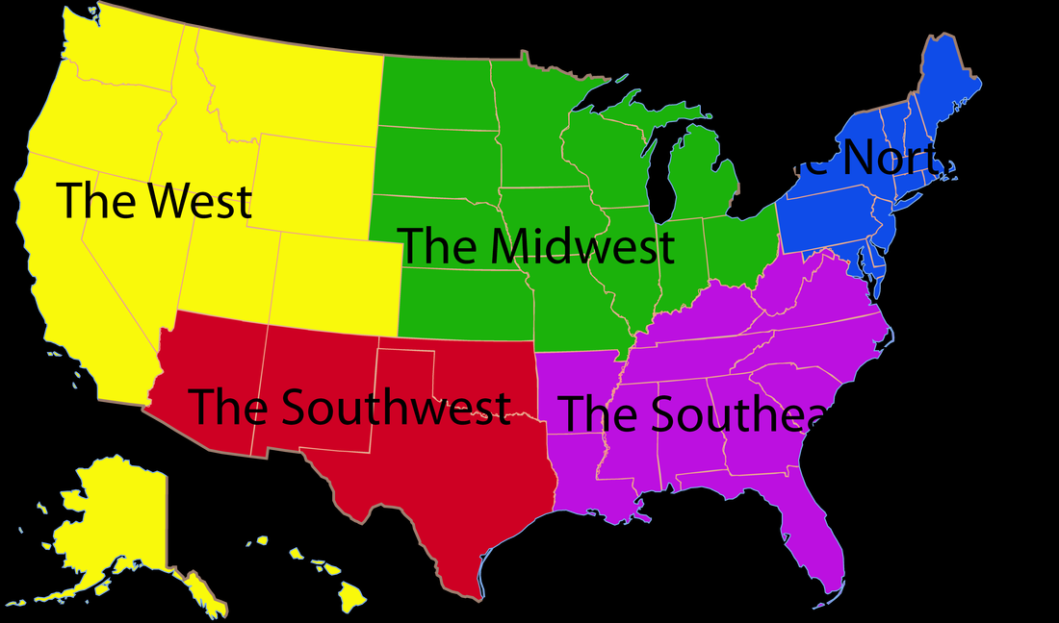
Market Revolution
Interconnectivity between the states!
Interconnectivity?
Specialization- each region produced certain goods

Slide 15
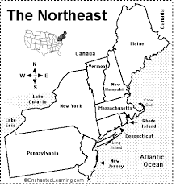
Market Revolution
Northeastern States
Shipping and Manufacturing
Port of New York
Textiles
Link to European Markets
Factories

Slide 16
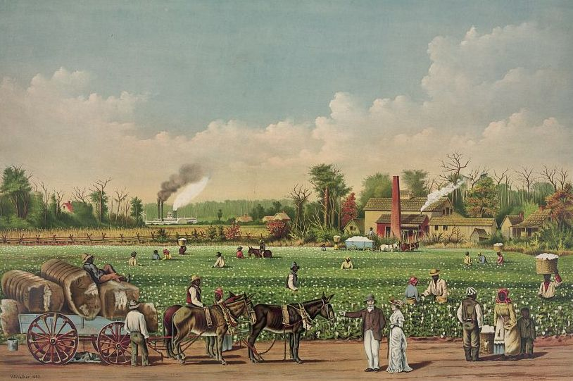
Market Revolution
Southern States
Agriculture
Plantation System
Tobacco and Cotton
Great Britain?

Slide 17
Market Revolution
Midwestern States
Farmers
Land needed to be cultivated
Area greatly aided by mechanical reaper and steel plow
Corn and wheat

Slide 18
Market Revolution

Slide 19
Market Revolution
Students in their pods will be handed construction paper and tasked to draw a map of the United States in 1850 with markers and colored pencils.
The map should include illustrations that characterize the unique aspects of each region of the United States (South, Northeast, and Midwest). What were the key products produced in each region? The map should also include graphics (railroads, canals, telegraph lines, ports) representing increased levels of interconnectivity between the regions. Pods will be asked to present their maps to the class, they will share their favorite illustration that depicts each region and a graphic that represents linked markets.
Include at least two cities from each region.
BE CREATIVE

Slide 20
Manifest Destiny

Slide 21
Manifest Destiny

Slide 22
Manifest Destiny Bellwork
Read the primary source on the Oregon Trail and answer the questions.
What time in the morning was the signal to march?
How many wagons made up a platoon?
Why did the order of wagons in each platoon rotate?
Why do you think one wagon was left behind?
What season (fall, winter, spring, summer) did most western settlers start their journey?

Slide 23
Manifest Destiny
Rightful expansion westward
Divine Right
Sea to shining sea
New land and economic opportunities

Slide 24
Reason for Manifest Destiny
Escape religious persecution
Find new markets of commerce
Locate harbors on the Pacific
Claim land for farming, ranching, and mining
Seek employment and avoid creditors after the Panic of 1837
Spread virtues of democracy

Slide 25
Santa Fe Trail
780 miles from Independence, Missouri to Santa Fe, New Mexico.
These traders established first visible American presence in New Mexico and the Mexican province of Arizona.
Traders traveled in large wagon groups while in Indian lands fearing attacks.
International Trade Route, trading of manufactured goods for gold, silver, and furs.
Travel interest economic driven

Slide 26
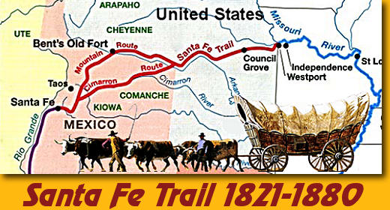

Slide 27
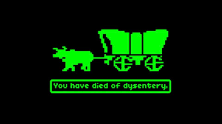
Oregon Trail
Started in Independence, Missouri ended in Portland, Oregon
Originated as a Christian missionary route
Traced some of Lewis and Clark’s old trails
Fertile soil and abundant rainfall in Oregon Territory attracted settlers.

Slide 28
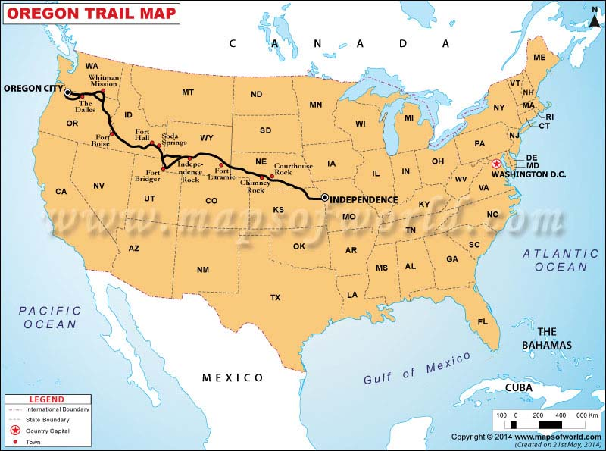

Slide 29
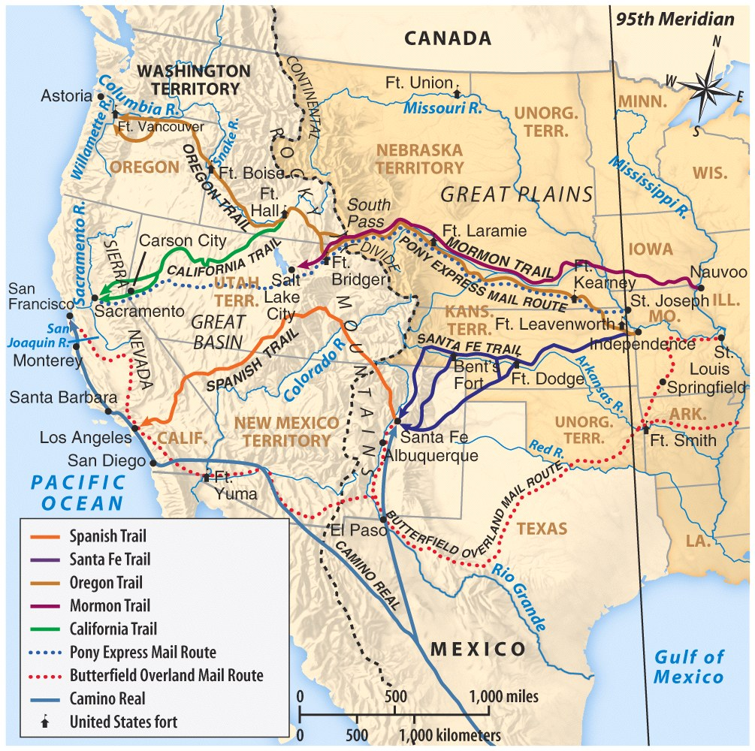
Trails
TRAILS WESTWARD

Slide 30
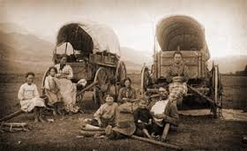
Manifest Destiny
Pioneer life
Hard work and dangerous
Covered wagons
Few supplies

Slide 31
Quotes about life on the Trails.
"The road to-day was very hilly and rough. At night we encamped within one mile of Fort Hall. Mosquitoes were as thick as flakes in a snow-storm. The poor horses whinnied all night, from their bites, and in the morning the blood was streaming down their sides.“
"There is some of the largest rattle snakes in this region I ever saw, being from 8 to 12 ft. long, and about as large as a man's leg about the knee. This is no fiction at all.“
"Raining all day...and the boys are all soaking wet and look sad and comfortless. The little ones and myself are shut up in the wagons from the rain. Still it will find its way in and many things are wet; and take us all together we are a poor looking set, and all this for Oregon...I am thinking as I write, 'Oh Oregon, you must be a wonderful country'"

Slide 32
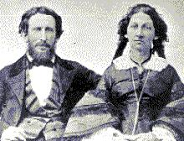
The Doomed Donner Party
CANNIBALISM ! !
Margaret Patrick John Breen Breen Breen
Of the 83 members of the Donner Party, only 45 survived to get to California!
James Reed & Wife

Slide 33
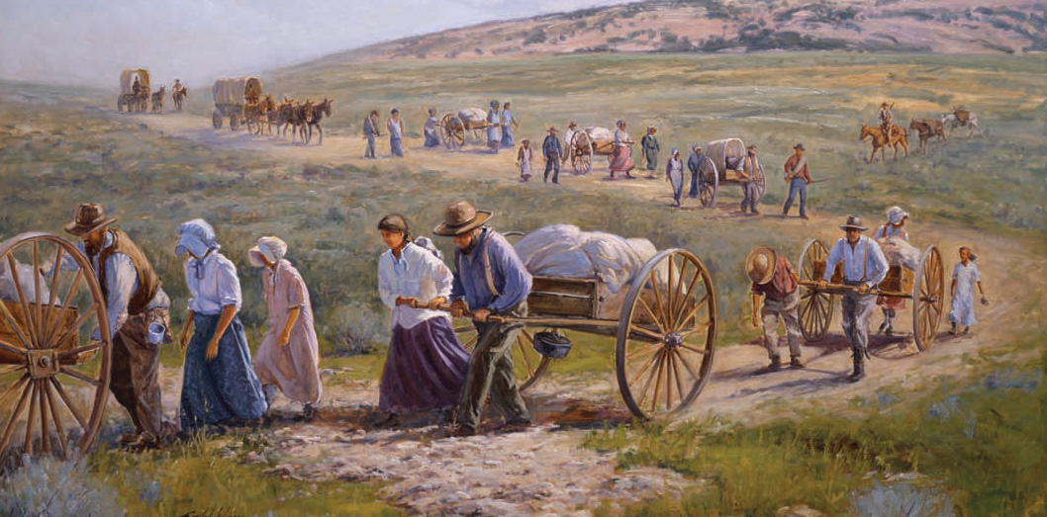
Manifest Destiny
Mormon Migration
Joseph Smith
Brigham Young
Utah Settlement
Religious Persecution

Slide 34
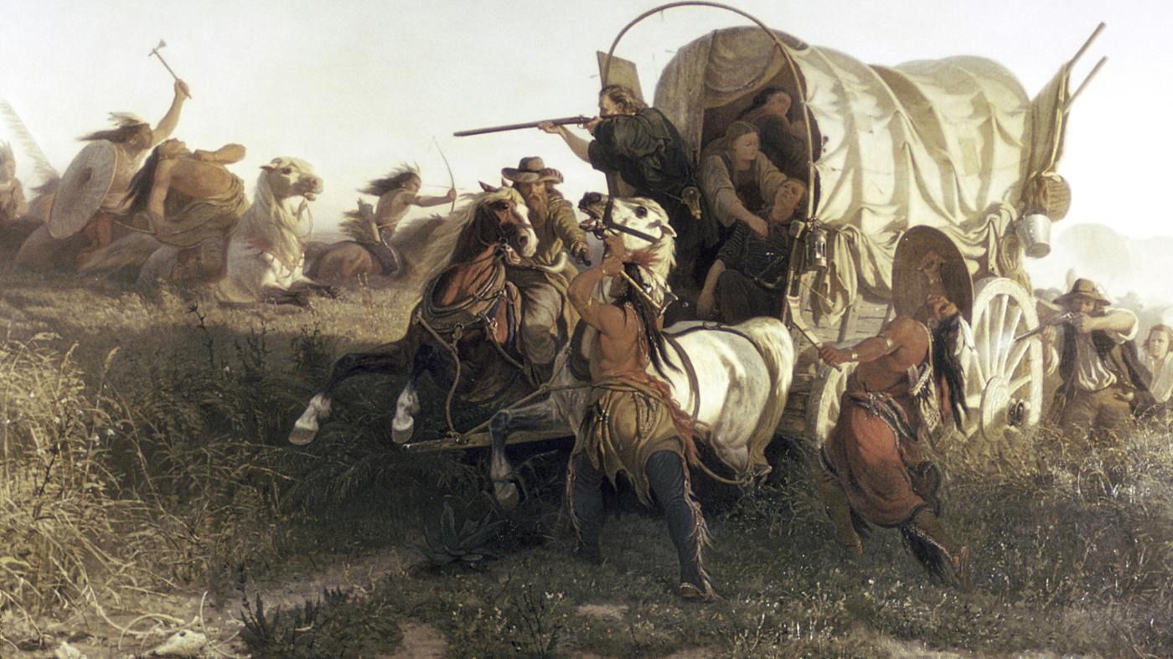
Manifest Destiny
Many conflicts with Native Americans
Territorial disputes
Black Hawk War, 1832, Saux tribe
Reclaim lost land in Illinois
Led to creation of U.S. Calvary
Abraham Lincoln
Zachary Taylor
Winfield Scott
Jefferson Davis

Slide 35
Treaty of Fort Laramie
1851 conference near Laramie, Wyoming
Cheyenne, Arapaho, Sioux, Crow tribes meet with U.S. representatives.
Swore to maintain good faith and friendship in all their mutual intercourse, and to make an effective lasting peace.
Treaty granted tribes control of land and an annual payment in exchange for not attacking settlers or interfering with construction of forts and roads.
Treaty was unsuccessful, (terms were violated).

Slide 36
Treaty of Fort Laramie

Slide 37
Manifest Destiny
Oregon Territorial dispute with Great Britain
Joint Occupation of Oregon Territory since 1818
Fifty Four Forty or Fight! (Northern limit of disputed territory)
Driven by President Polk the expansionist
Compromise reached at 49th parallel
British settlers out numbered greatly in Oregon territory, fur trade in decline.

Slide 38
Oregon Treaty 1846

Slide 39
Manifest Destiny

Slide 40
Review Thesis Statements
http://writingcenter.unc.edu/handouts/thesis-statements/

Slide 41
Writing Assignment Part 1
Students are tasked to create a chart comparing the effect manifest destiny had on the experiences of white settlers, Native Americans, and Mormons. What were settler’s reasons for moving? What impact did it have on Native Americans? Use specific references to support responses.

Slide 42
Writing Assignment Part 2
After Pros/Cons charts are complete, students will respond to the prompt Who did Manifest Destiny help the most? Why? Responses should be written at a honors level, minimum of 5-7 sentences paragraph. Responses should feature a clear argument.

Slide 43
Test your knowledge
What two inventions changed agriculture in the Midwest?
What crop formed the backbone of the Southern economy?
What is a market economy?
What did Samuel Morse invent?
Describe the Oregon Trail?
Describe the Santa Fe Trail?
What American author coined the term Manifest Destiny?
Fifty four forty or fight related to what territorial dispute?
Who led the Mormons to Utah, and why?

Slide 44
Texas Independence

Slide 45
Texas Independence
Early Spanish Mission System used in initial settlement of Texas
1821 Land Grants are offered to Americans from Mexican government to increase settlement. Settlers pledged to obey Mexican laws and practice Catholicism.
Was sparsely populated and had Native American conflicts
Empresarios- American settlers of Texas
Tejanos- Mexican settlers of Texas
Why do you think Texas was hard for the Mexican government to control?

Slide 46
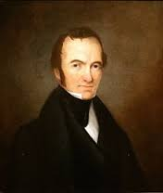
Texas Independence
Stephen F. Austin
Most prominent American settler of Texas
Started a colony with 300 land grants
Attracted by farmland and livestock potential
Empresarios soon outnumbered Tejanos
U.S. government makes attempts to purchase Texas. First by John Quincy Adams, later Andrew Jackson.

Slide 47
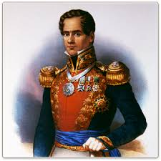
Texas Independence
Conflicts emerge
Catholics vs Protestants
Slavery abolished in Mexico in 1824
Cultural differences
General Santa Anna
1830 Mexico seals its borders

Slide 48
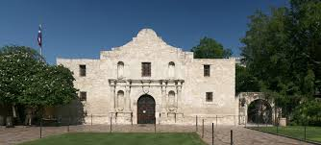
Texas Independence
1835, Texans want Self Government
Texas Revolution
Battle of the Alamo
Davy Crocket, Jim Bowie, William Travis
Goliad Massacre, 300 Texans dead
Victory of the Battle of San Jacinto
Lone Star Republic, 3/2/1836
Sam Houston- First President

Slide 49
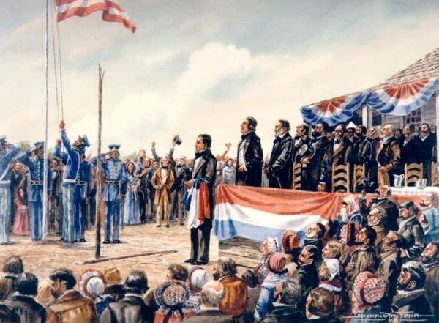
Texas Independence
Annexation to the United States?
Issue over Slavery
Balance between Free and Slave States
Texas Republic 1836-1845
President Polk annex's Texas 12/29/1945
Mexican government is furious, factor that leads to Mexican American War.

Slide 50
Why did Texas Declare Independence from Mexico?
Were Texans justified in declaring independence?
Were these honorable men, fighting for freedom, or greedy slaveholders?
What evidence from the documents supports your position?
Which of these pieces of evidence do you find more/less trustworthy? Why?
Why do historians still debate this question?
Once Texas declares and wins its independence, is the U.S. free to annex it? Why would Mexico object to the American annexation of Texas?

Slide 51
Test your Knowledge?
What were the American settlers of Texas called?
Why did Americans move to Texas?
Why did the Mexican government encourage American settlement of Texas?
Who was Sam Houston? Who was Santa Anna? Who was Stephen F. Austin?
Why wasn’t Texas immediately annexed by the United States?

Slide 52
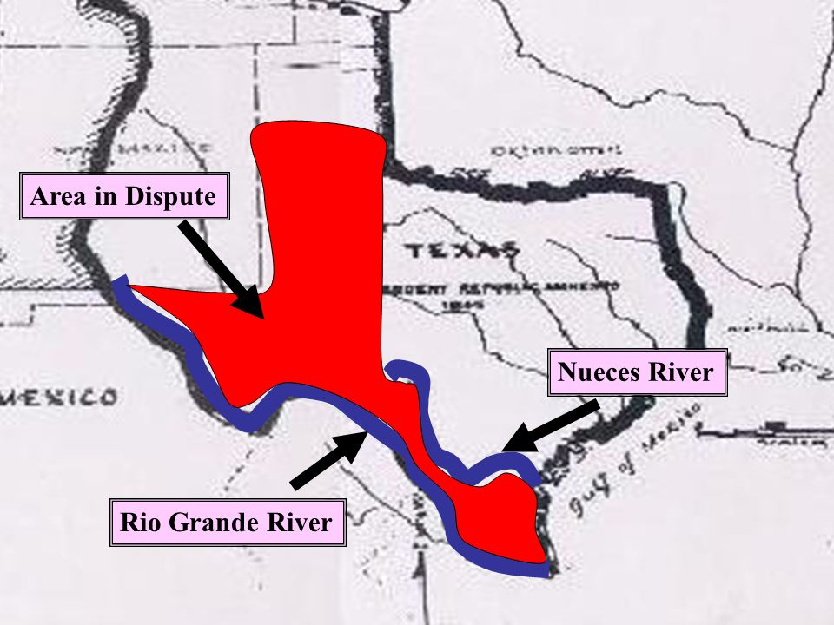
Mexican American War
Eventual annexation of Texas created border dispute between Mexico and United States
Rio Grande River (Border recognized by Texas)
Nueces River (Border recognized by Mexico)
John Slidell negotiations-failed to purchase CA.

Slide 53
Mexican American War
President James K. Polk had an agenda for a war with Mexico
Manifest Destiny must be complete
Placed troops into disputed territory, resulting in a military conflict
Zachary Taylor marches troops to Rio Grande.

Slide 54
Mexican American War
Division in public opinion on war
South pro war- opportunity to extend power of slavery
North against war
However after first battle the Senate and House of Representatives overwhelmingly support the war in response to loss of American life.

Slide 55
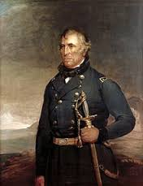
Mexican American War
General Zachary Taylor- initially starts the war
General Winfield Scott- Captures Mexico City and Veracruz
General Stephen Kearny-Captures Santa Fe then California
American General’s and troops made quick work of Mexican army. (leadership, training, supplies)

Slide 56
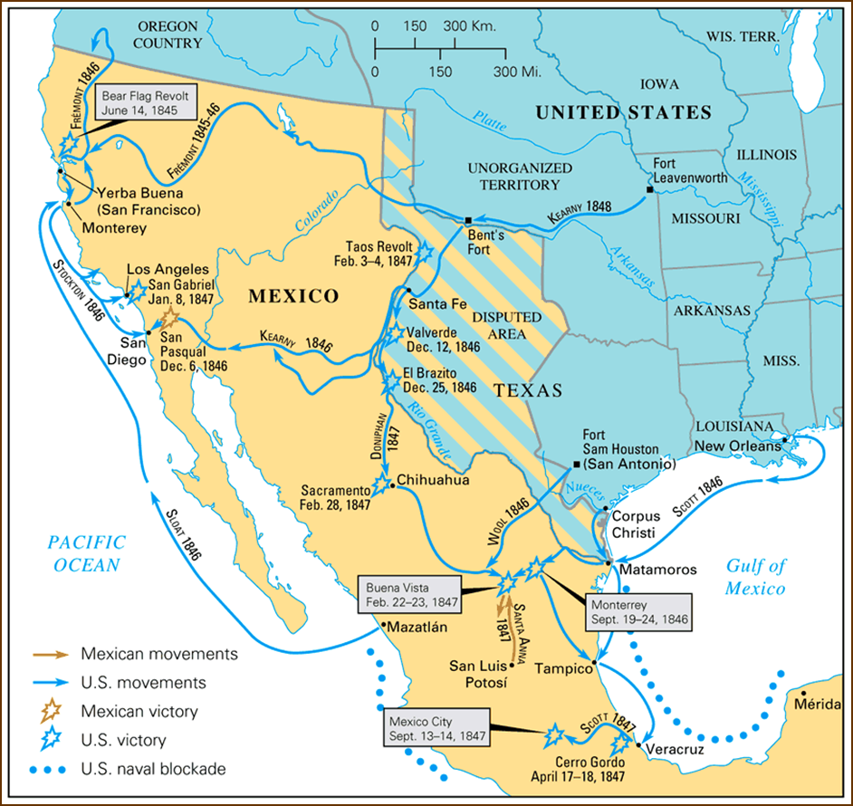

Slide 57
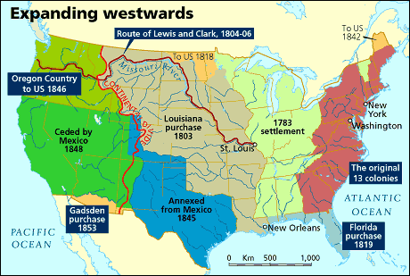
Mexican American War
April 25, 1846- February 3, 1848
Short War
Huge Territorial Gains
Manifest Destiny Complete
American Patriotism and Pride

Slide 58
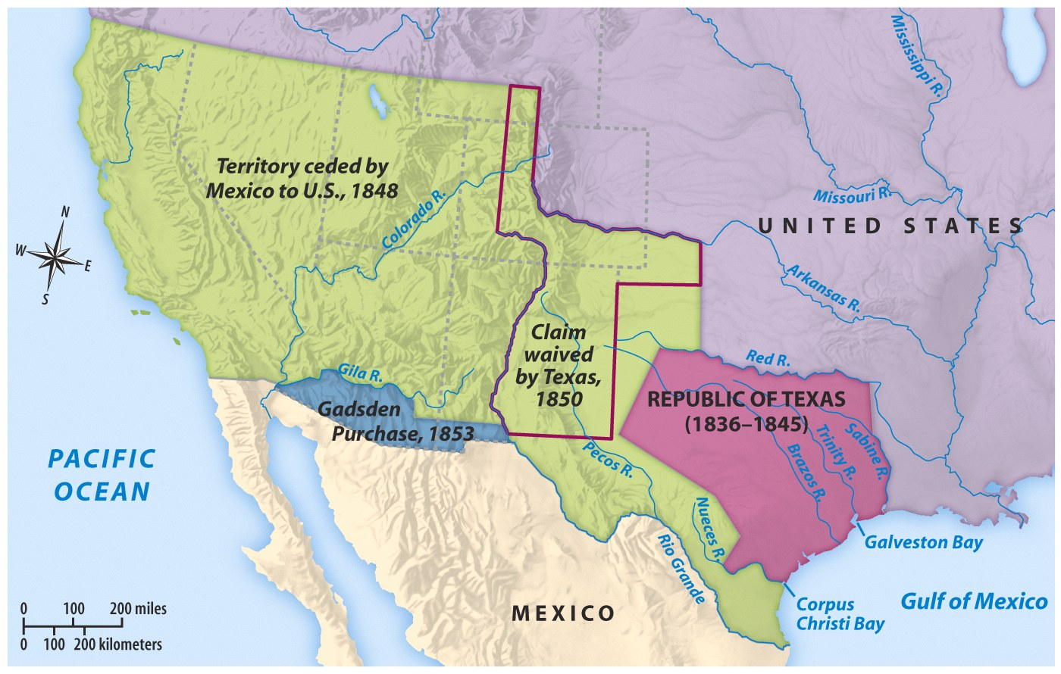
Treaty of Guadalupe Hidalgo
Mexico ceded the Mexican Cession to U.S.
Rio Grande River boundary between U.S. and Mexico
U.S. paid Mexico $15 million

Slide 59
Mexican American War
Treaty of Guadalupe Hidalgo ended the War
Mexico lost half its country and 25,000 lives
United States lost 13,000 (11,000 due to disease)
Was the Mexican American War necessary?
Did President Polk go to far in provoking the war?
Legacy of the war? Resentment from Mexico, issue of slavery in new territories, and military training for future Civil War generals.

Slide 60
Bellwork Worksheet Questions
What two rivers bordered the disputed territory between the United States and Mexico?
What year did the United States acquire California?
What was the Gadsden Purchase? And What year?
What disadvantages do think Mexicans living in the newly acquired United States territories would face?

