Slide 1
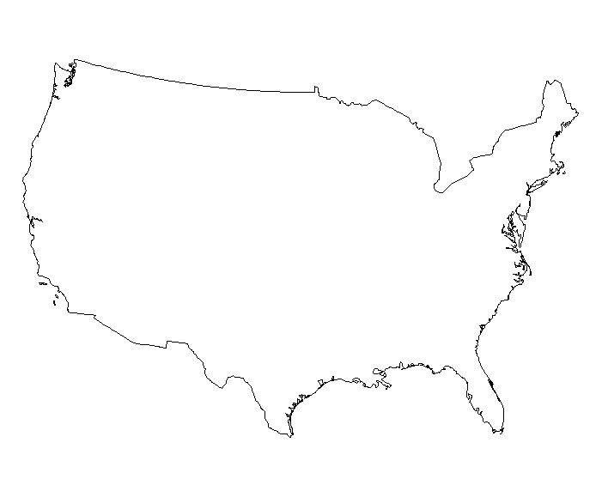
NATIONALISM
SECTIONALISM
American Unity
&
American Division
(1801-1860)

Slide 2
Review
Summarize the Monroe Doctrine
Describe Nationalism
What did Sectionalism look like in America
List two inventions from the Transportation Revolution.

Slide 3
Nationalism

Slide 4
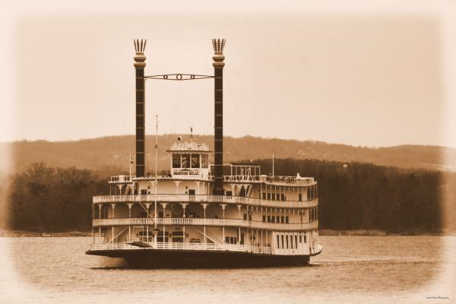
Transportation Revolution
1807 – Robert Fulton and his steamboat spark a new era in which the US begins to use steam power for transportation
1811 – Construction of a National Road begins
1825 – Erie Canal is completed, links the Atlantic to the Great Lakes, NYC booms
1825 – Steam locomotive invented
Railroad Revolution
Fast
All-terrain
Can operate regardless of weather

Slide 5
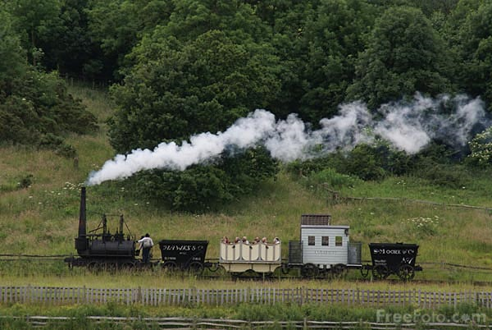
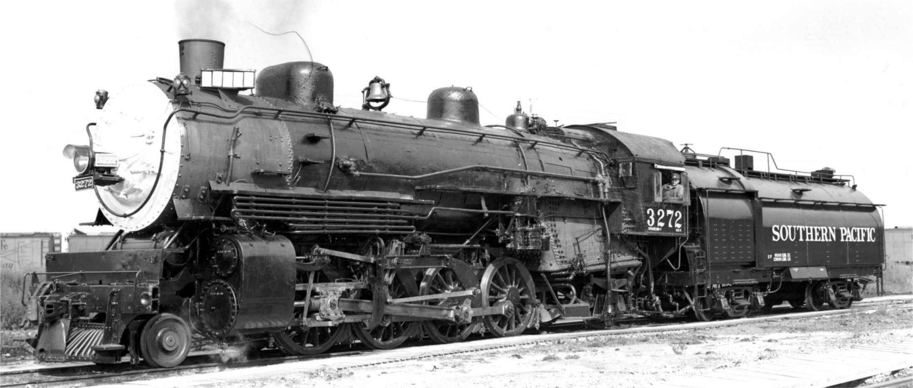

Slide 6
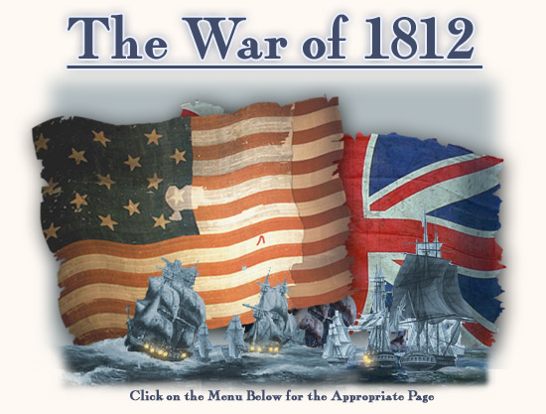
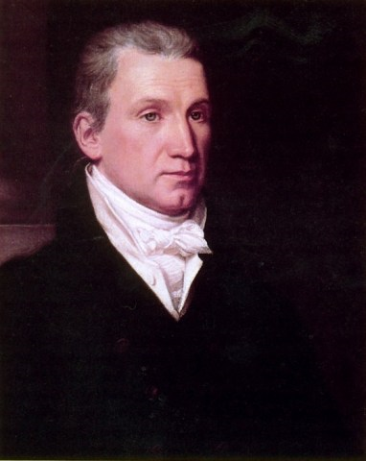
Nationalism
“Victory” in the War of 1812
Era of Good Feelings – During Monroe’s presidency there were no oppositional political parties

Slide 7
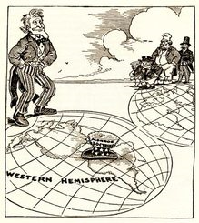
Monroe Doctrine
European countries could not colonize in the Western Hemisphere;
Emphasized that the United States was becoming a power country

Slide 8
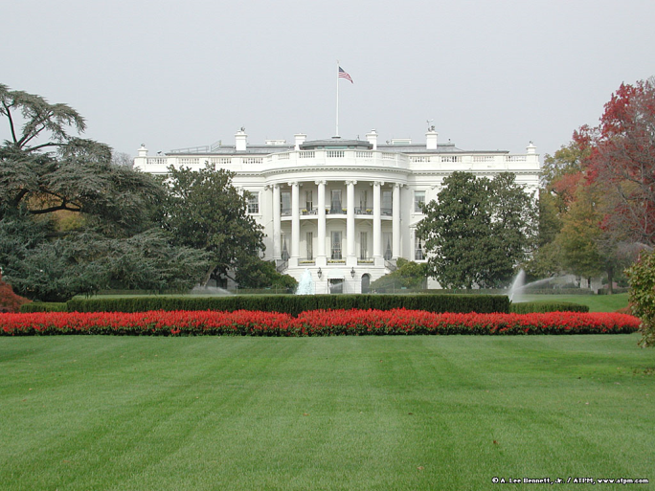
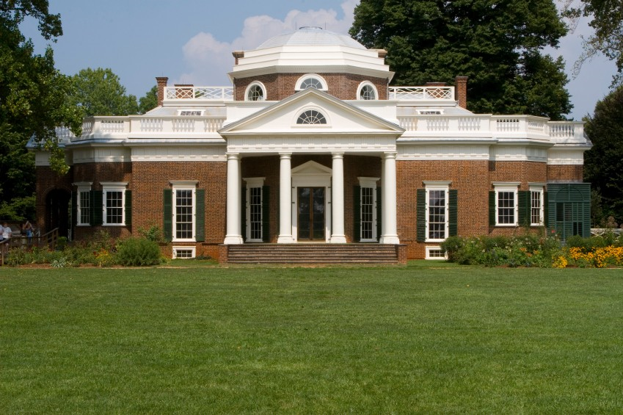
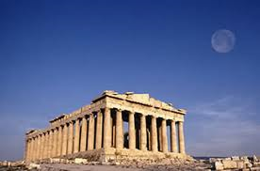
American Art
The Hudson River School of Art: reflected the spirit of nationalism with majestic scenery
Neoclassical Architecture: style popularized in the mid 1800s based on Ancient Greek architecture

Slide 11
Sectionalism

Slide 12
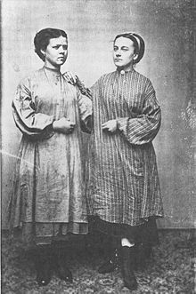
Industry in the North
Lowell Mills
Massachusetts
Mechanized textile industry
Women and children work for poor
wages in terrible conditions
Agriculture declines in the North – markets provide food for those working in factories

Slide 13
Cotton in the South
Eli Whitney invents the cotton gin 1793 – revolutionizes cotton industry
Increase in slave demand/dependence, cotton production increases 6,000%
“Cotton is King” “King Cotton” – nicknames for the importance of cotton in the South
Plantation system allows the rich to get richer from slave labor… _________ % of white southerners owned slaves

Slide 14
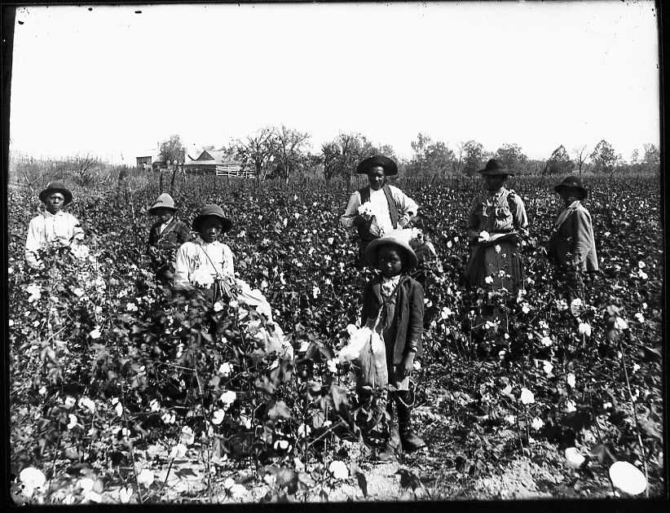

Slide 15
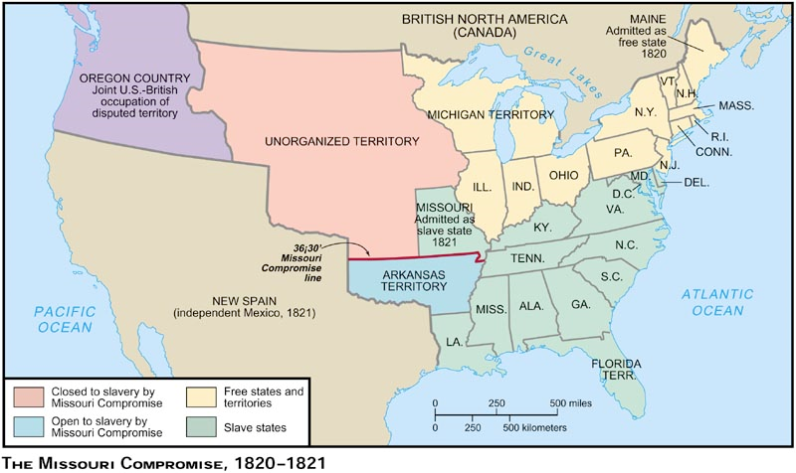
Slavery
Missouri Compromise (1820) – Slavery is prohibited in the former Louisiana Territory above the 36˚ 30˚ parallel
Maine = Free State. Missouri = Slave State.

Slide 16
Slavery
Nat Turner’s Rebellion (1831) – slave and preacher – believed that he had a divine mission to deliver his people from slavery
a. Organized revolt in which 160 people (black & white) were killed
b. Slave Codes (laws restricting conduct & activities of slaves) were made tighter and strictly enforced, Turner & others are hanged
c. Evidence of growing unrest in the South regarding slavery

Slide 18
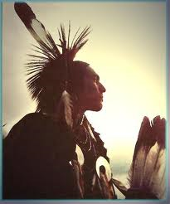
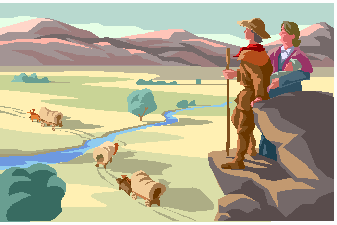
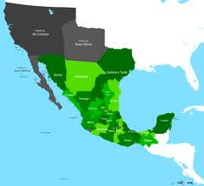
Expansion
Idea of Manifest Destiny is introduced in the 1840s – It was the destiny of the United States to extend across North America all the way to the Pacific
Issue of slavery in new territories

Slide 19
Economy
Industry in the North, Cotton in the South – increased competition and tensions due to trade with foreign countries
Protective Tariffs
Tariff of 1828 was issued to protect the interests of Northern merchants, labeled the “Tariff of Abominations” by the South
The South was hurt because they were now being taxed on goods their region could not produce, and Britain was buying less cotton because they could not afford to export their goods to the US

Slide 20
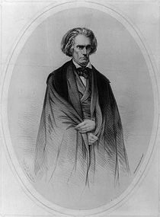
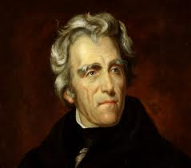

Slide 21
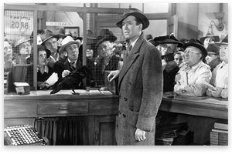
Economy
Panic of 1819 - 2nd national bank offered credit (citizens began borrowing & moving west)
1. Banks in Great Britain demanded US banks repay British loans
2. US banks recalled loans made to US citizens
3. Citizens rushed to withdraw their money

Slide 22
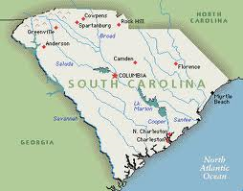
States’ Rights
Indirectly tie into each factor of sectionalism
Nullification Crisis: In response to the extension of the Tariff of 1828 (Abominations), South Carolina leader John C. Calhoun claims that the tax is unconstitutional and that South Carolina plans to nullify it

