Slide 1
The nc court system

Slide 2
Nc court hierarchy
The lowest court in NC is the NC District Court.
NC has a second trial court called the NC Superior Court.
Appeals cases from the trial courts are heard at the NC Court of Appeals.
The highest court in the state is the NC Supreme Court.
NC Supreme Court
NC Court of Appeals
NC Superior Court
NC District Court

Slide 3
Nc district court
NC’s District Court has original jurisdiction in cases involving misdemeanors, juveniles, and civil cases dealing with less than $10,000.
Cases appealed from the NC District Court go to the NC Court of Appeals.
All judges in NC are elected by the people to 8 year terms.

Slide 4
NC superior court
NC’s Superior Court has original jurisdiction in felony cases and civil cases dealing with more than $10,000.
Cases appealed from the NC District Court go to the NC Court of Appeals, except for First Degree Murder cases resulting in the Death Penalty – they go straight to the NC Supreme Court.

Slide 5
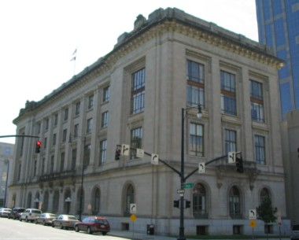
NC court of Appeals
NC’s Court of Appeals hears all reviews of cases from the District and Superior Courts. (Appellate jurisdiction)
Made up of a panel of 15 judges state wide.
Only 3 judges sit in on each case.

Slide 6
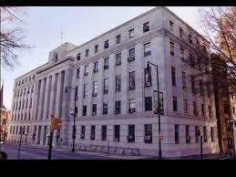
NC supreme Court
Highest court in the state
Made up of 7 SC Justices
Hear all cases appealed from the lower courts in NC

