Slide 1
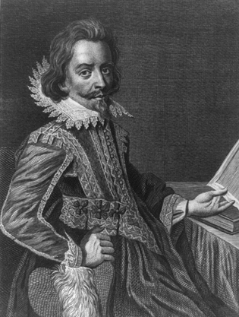
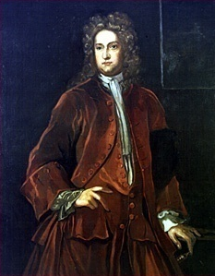
Nathaniel Bacon’s Rebellion: 1676
1,000 piedmont Virginians in a rebellion against Governor Berkeley
Freed indentured servants – concerns = high taxes, Berkeley’s unwillingness to exterminate Indians
In the end rebellion failed but…
planters searched for laborers less likely to rebel and a way to lessen class differences→ BLACK SLAVES!!
Nathaniel Bacon
Governor William Berkeley

Slide 2
Bellwork: Identify
First legislative body in the new world.
He helped improved conditions for Indians.
This revolt delayed Spanish control in New Mexico (present-day southwest US).
1st English settlement in the new world.
Fabled route to Asia through North America.
Gave 50 arces of land to planters who brought new people to the Virginia.
Saved Jamestown
1st French settlement in the new world.
Forced labor system in the Spanish colonies for Indians.

Slide 3
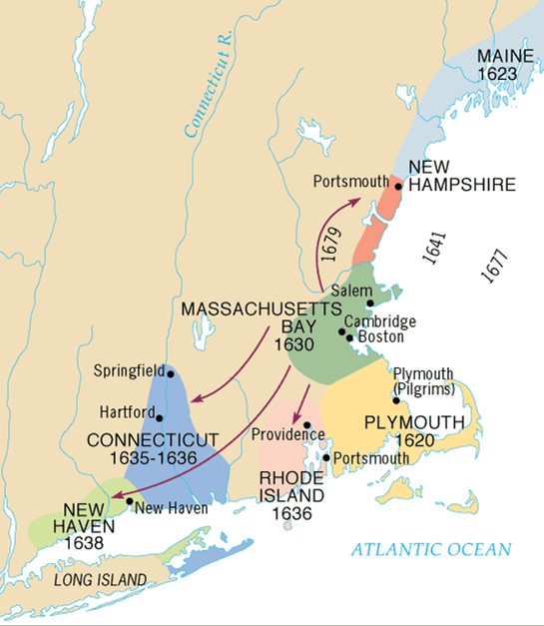
Puritans And Separatists (Pilgrims) and Their Impact
Puritan legacy very important
Not the same as Separatists coming to Plymouth
Great Migration (1630 – 1642) – 20K before 1640, population of 100,000 by 1700

Slide 4
Reformers of COE
Calvinism
Predestination.
Puritans:
Want to radically reform [purify] the corrupt Church of England and society
Desire to recreate independent villages not threatened by kings and bishops
Separatists (Pilgrims)(Mayflower):
believed in a total break from the Church of England.

Slide 5
Puritans and Covenant Theology
“Covenant of Grace”:
A responsibility of community to serve God
“Social Covenant”:
Between members of Puritan communities with each other.
Social reciprocity
Required mutual watchfulness.
No toleration of deviance or disorder.

Slide 6
Massachusetts – John Winthrop and Puritans (1630)
City on a Hill, missionary vision
Bible Commonwealth – theocracy (not ministers), elect vote (not wealth)
Community! Watchfulness, just prices, charity → tension with individualism
ORDER! (not freedom)

Slide 7
Importance of education and work ethic
Harvard – 1636
MA public schools - 1647
Town meetings. Limited power to the central government
Healthy conditions, growing population
Eventually Puritanism faded (loss of enthusiasm)
Intolerance
Hutchinson, Williams, Quakers, witches

Slide 8
Rhode Island – Roger Williams - 1636
Williams: separation of church and state, and freedom of religion,
Anne Hutchinson – challenged male hierarchy
refuge for dissenters, most democratic and free (like NC) , first Jewish community

Slide 9
Pennsylvania – William Penn - 1681
Society of Friends (Quakers)
Belief in equality - pacifists.
Advertised → → diversity especially Germans and Scotts Irish
City of Brotherly love, Holy Experiment
Dealt fairly with Native Americans
No established church
All landowners voted

Slide 10
New York – Duke of York - 1664
Duke of York given territory - a royal colony by English King

