Slide 1
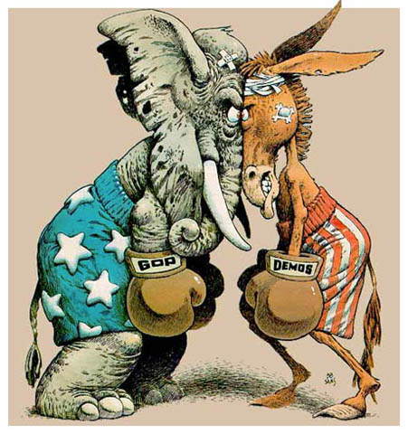
Political Parties

Slide 2
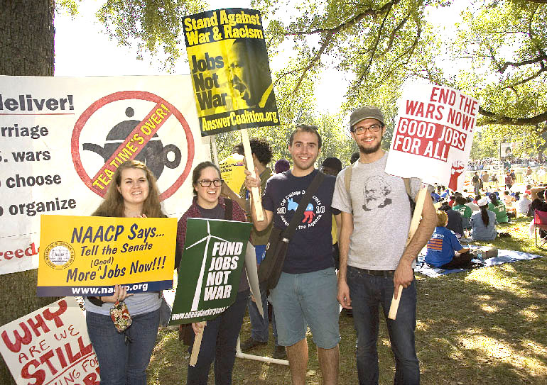
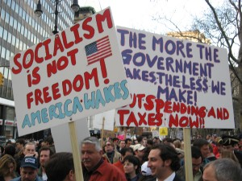
What is a Political Party??
A group of people with similar ideas about how government should be run

Slide 3
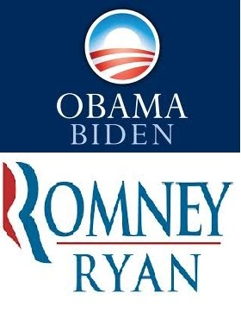
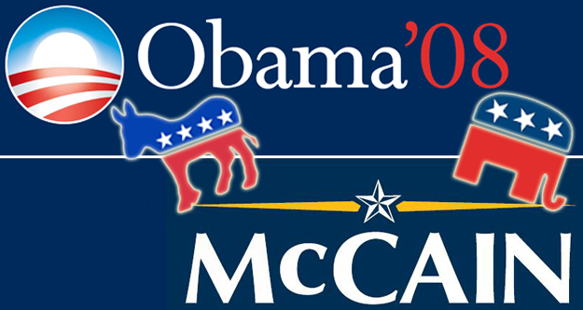
What is a Candidate?
A person who represents a party in an election

Slide 4
One Party System
All candidates are from the same party
No opposition
Goal: maintain power
Example: China
Unity
Efficiency
No gridlock
No options
Corruption
No checking

Slide 5
Two Party System
Two main parties dominate gov’t
Other parties may exist but have difficulty competing
Example: US
Divides country
Hard for minority views to be heard
Only 2 choices
Two Options
Mostly stable
Parties check each other

Slide 6
Multi Party System
Many parties exist
Could have dominant parties, but lesser parties have influence
Example: France
Many options to choose from
Vote splits too many ways; hard to get majority

Slide 7
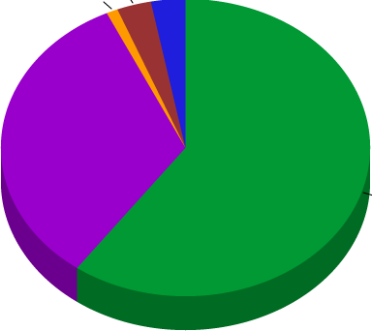
Multi Party System Terms
Majority: More than half
Plurality: More than any other (but maybe not half)
Coalition: Parties join together; temporarily work together to get majority

Slide 8
Multi Party System Terms
A
18%
B
11%
C
36%
D
31%
E
4%
Who has the MAJORITY?
Who has the PLURALITY?
Who might form a COALITION?

Slide 9
What does a party believe?
PLATFORM: A list of issues and stances that a party believes in
PLANK: Each individual issue
Improve HEALTH CARE
LOWER TAXES
END THE WAR
AGAINST ABORTION
End the death penalty
Raise teacher pay ☺
A platform is made up of many planks

Slide 10
1st US Political Parties
Democratic-Republicans
Federalists
Hamilton
Jefferson
Business
Common Man
National Bank
No Bank
More Gov’t Power
Less Gov’t Power
Loose Interpretation
Strict Interpretation

Slide 11
Third Parties
Purpose: Represent minority views; another option to main parties
Significances/Impacts:
- Can split votes (take support from main party candidates)
- Can bring attention to new issues (may eventually be adopted by a main party)

Slide 12
Types of Third Parties
ISSUE BASED: Formed around one major issue (Examples: Prohibition Party, Free-Soil Party)
BELIEFS/IDEAS BASED: New overall plan for gov’t; many issues (Examples: Libertarian Party, Socialist Party)
CANDIDATE BASED: Support an Independent candidate (Examples: George Wallace, Ross Perot)

Slide 13
Democrats vs. republicans
Issue | Democrats | Republicans
Taxes
Military
Health Care
Education
Abortion
Gay Rights
Social Programs
Gun Control
Government
Tax Rich More, Cut taxes on lower/middle class
Tax Cuts for ALL
Less $ on Defense
More $ on Defense, National Security
Gov’t provides health care to those without it
Private Health Care from employer, no gov’t h.c.
More funding for public/charter schools
Vouchers for Private school; competition
Pro-Choice
Pro-Life
In favor of gay rights
Against gay rights
More $ for programs to help poor
Less spending on social programs
More gun control (restrictions on guns)
2nd Amendment right to own guns
More gov’t – regulation, programs, etc.
Less gov’t – spending, involvement, etc.

Slide 14
Who supports which party?
People | Democrats | Republicans
Gender
Age
Race
Socio-Econ.
Geography
Religion
Professions
Women
Men
Younger
Older
Minorities
White
Poor/Middle
Upper Class
Urban Areas
Northeast/West
Rural Areas
South/Midwest
Minority/non-affiliated
Christian
“Blue Collar”
“White Collar”
** Please note these are TRENDS and do not apply to ALL members of the party or group**

Slide 15
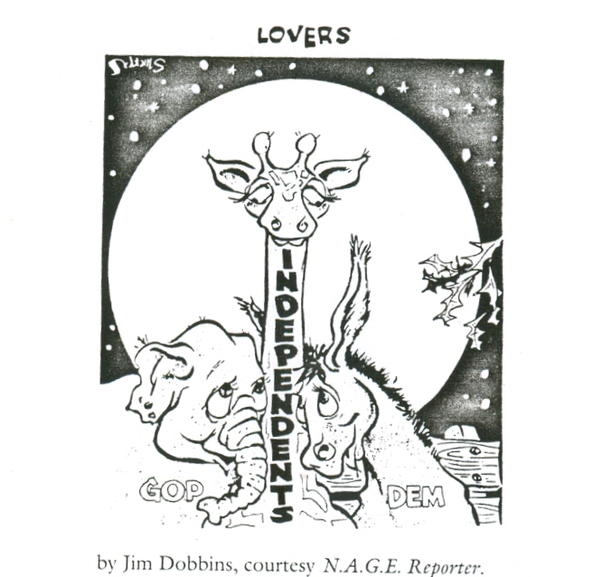
. . . Or Maybe Independent?

