Slide 1
The Powers of Congress

Slide 2
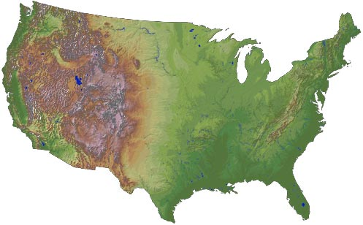
Expressed Powers – powers that are stated in the Constitution
2. Indirect tax – first paid by one person and passed on to another; indirectly paid by the second person (sales tax)
3. Limits- only tax
For public purposes
No taxing exports!
Power to Tax
Direct Tax – must be paid by the person on whom it is imposed (income tax)
No taxes on exports

Slide 3
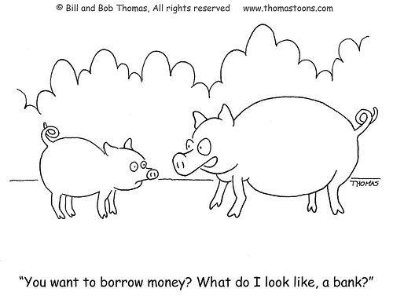
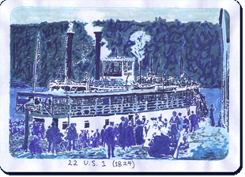
Expressed Powers
Commerce Power – regulate interstate and foreign trade
Court Case: Gibbons v. Ogden: Only Congress can regulate something that crosses state lines
Power to Borrow – there is no constitutional limit on the amount

Slide 4
Expressed Powers
Foreign Relations Powers and War Powers
Declare war
Raise and support armies and navies
Regulate foreign commerce
Act on matters affecting the security of the nation

Slide 5
Expressed Powers
Judicial Powers – Congress creates lower courts

Slide 6
Expressed Powers
Postal Power: Create post offices and regulate mail
Coining money

Slide 7
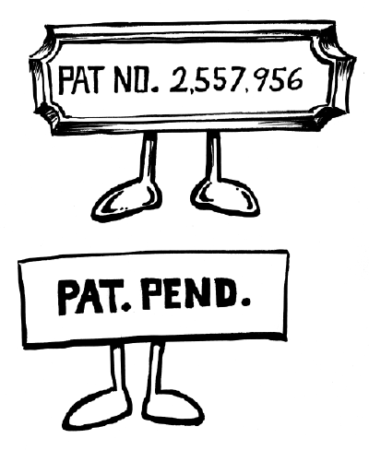
Expressed Powers
Copyrights: Words/Symbols that cannot be used without permission
Patents: Ideas for inventions that others cannot steal and make money from

Slide 8
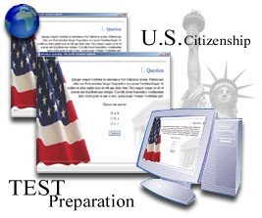
Expressed Powers
Weights and measures
Naturalization – process for becoming citizens

Slide 9
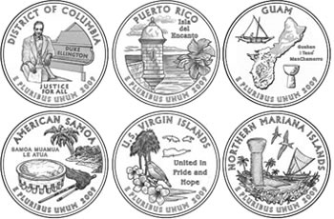
Expressed Powers
Power over Territories and other Areas
Acquire property and admit new states
Rule over US territories
Eminent Domain- the power to take private property for public use

Slide 10
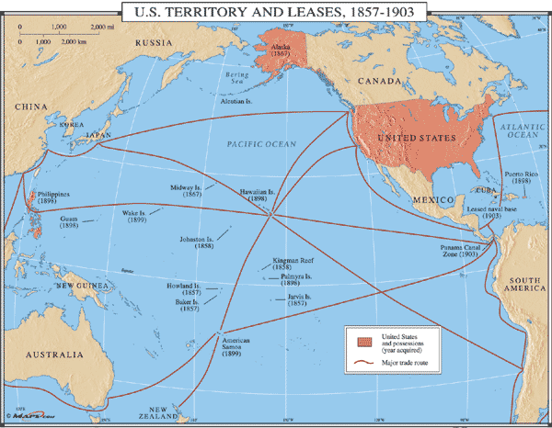

Slide 11
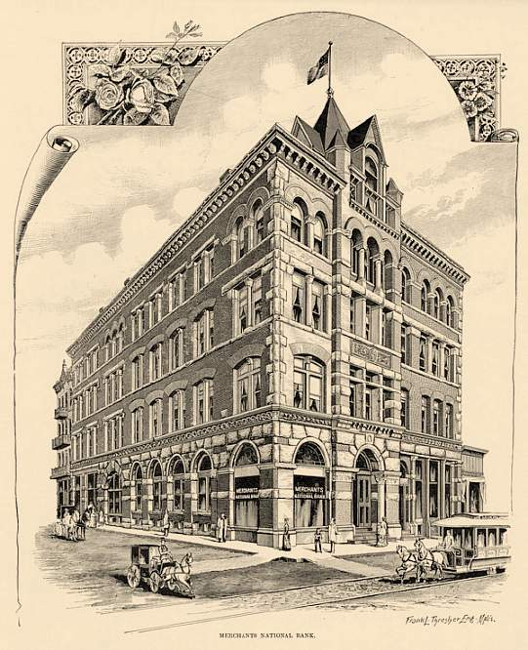
Implied Powers
The Necessary and Proper Clause – in Constitution; gives Congress the power to “make laws which shall be necessary and proper” for carrying out the expressed powers. Also called
the Elastic Clause
- McCulloch v. Maryland: gave Congress the ability to use the Necessary and Proper Clause to interpret its delegated powers
Powers that are not listed in the Constitution but are needed to carry out the expressed powers.

Slide 12
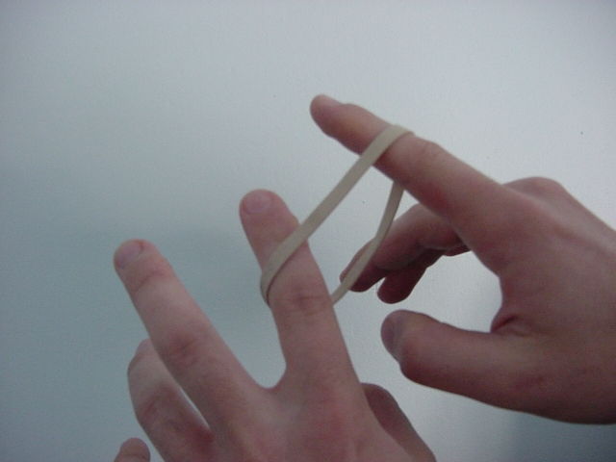
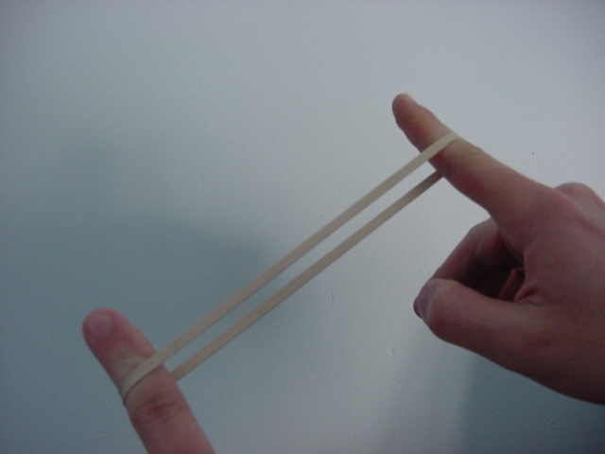
Constitutional Interpretation – Strict vs. Liberal Constructionists
Strict- Congress should exercise only the powers the Constitution expresses.
Loose/Liberal – Congress has a broad range of powers not stated in the Constitution (use the elastic clause more!)

Slide 13
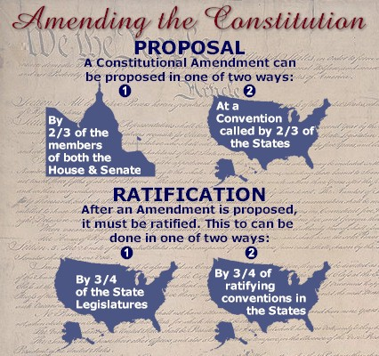
Non-Legislative Powers of Congress
Investigation – research for law-making purposes
Impeachment proceedings: to accuse an official of committing a crime
House – brings impeachment charges
Senate – tries the case and votes to convict or acquit
Constitutional Amendments- Congress may propose an amendment to the constitution by a 2/3 vote in each house

Slide 14
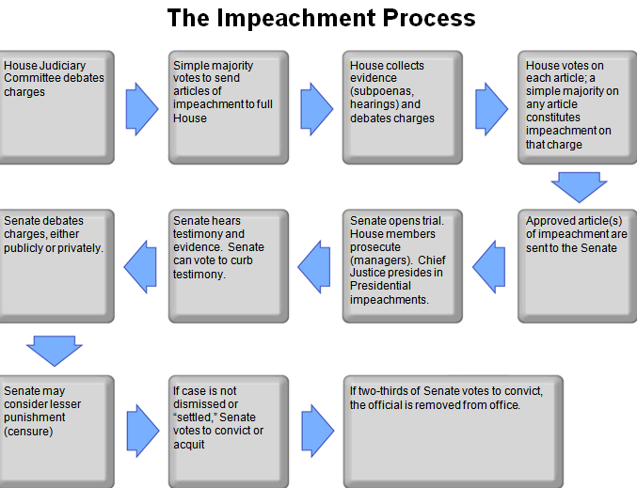

Slide 15
Congress May Not…
Tax exports (they CAN tax imports which is called a tariff)
Favor one state over another
Interfere with state powers or rights of individuals

Slide 16
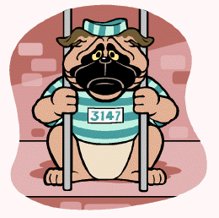
Congress May Not…
Pass Bills of Attainder (punishing a person who did not receive a fair trial)
Pass Ex Post Facto Laws (punishing people for something done before there was a law against it … retroactive punishment)
Suspend Habeas Corpus (a person’s
right to appear before a judge and know
their charges when held in jail)

Slide 17
