Slide 1
PROPAGANDA & POLITICS

Slide 2
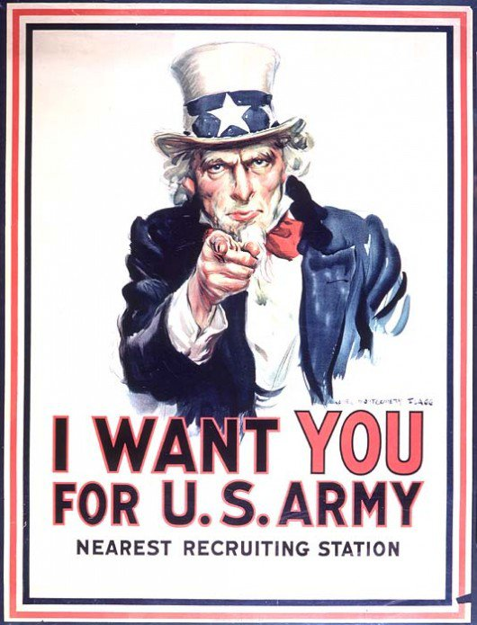
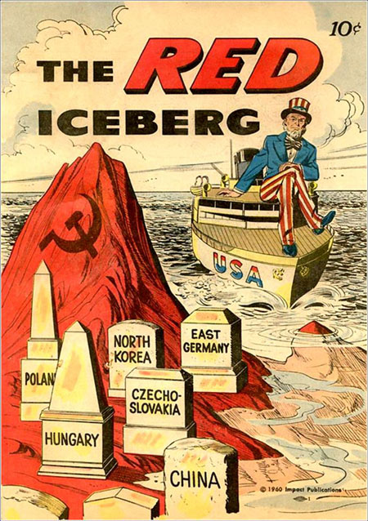
PROPAGANDA: Media designed to influence people's thoughts and behaviors

Slide 3
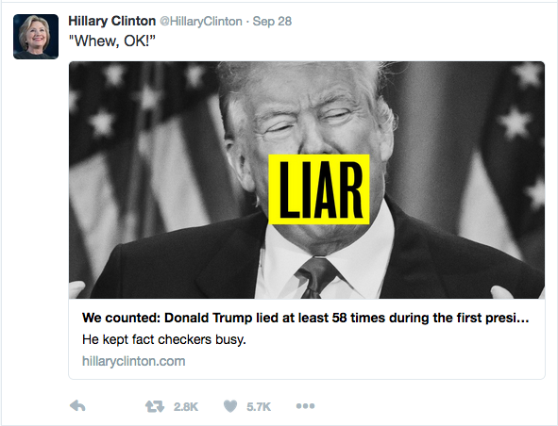
NAME CALLING: Links a person or idea to a negative symbol

Slide 4
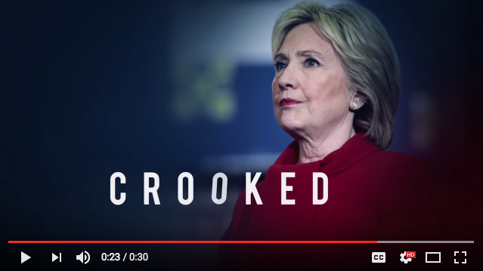
https://www.youtube.com/watch?v=erVHi4_DKQM

Slide 5
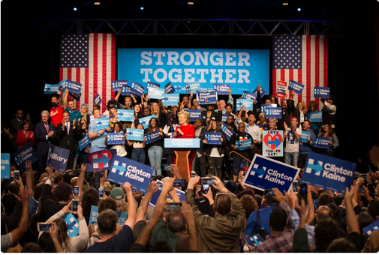
GLITTERING GENERALITIES: Use of virtue words to link a person or idea to a positive symbol (ex: democracy, patriotism)

Slide 6
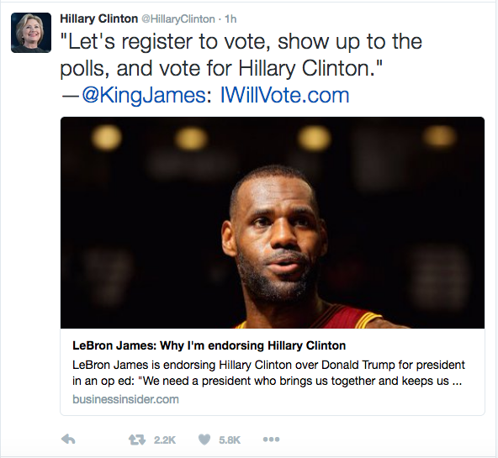
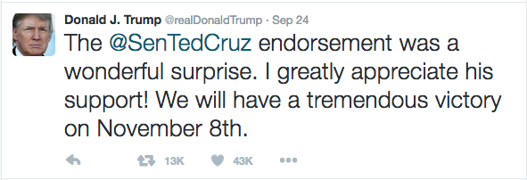
TESTIMONIAL: A public figure or celebrity endorses a product, policy or political candidate

Slide 7
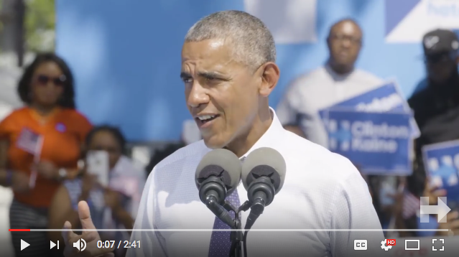
https://www.youtube.com/watch?v=IeCWs4xf7EU

Slide 8
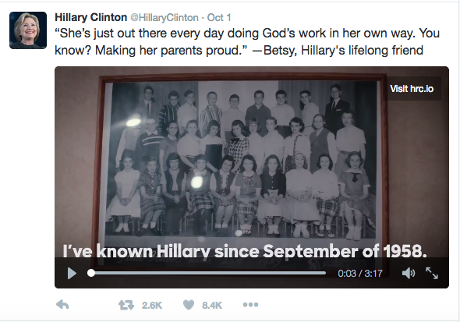
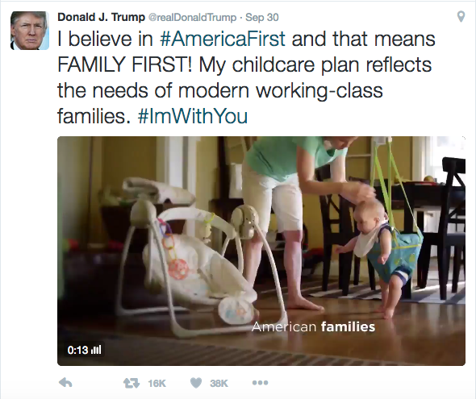
PLAIN FOLKS: Attempts to convince the audience that the candidate is of the people/a regular Joe

Slide 9
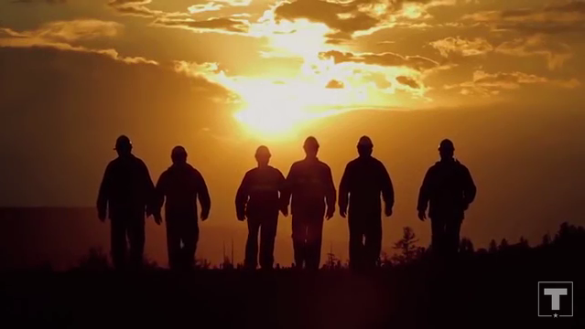
https://www.youtube.com/watch?v=k0J_EKmvYZk

Slide 10
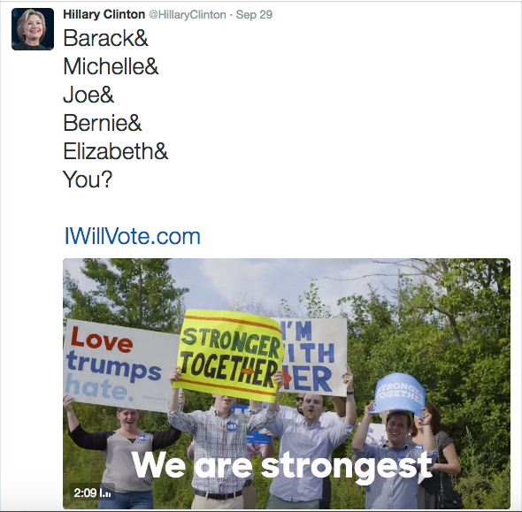
BANDWAGON: The idea that everyone else is doing it, and you should too

Slide 11
FEAR: Warns the audience that disaster will result if they do not follow a particular course of action

Slide 12
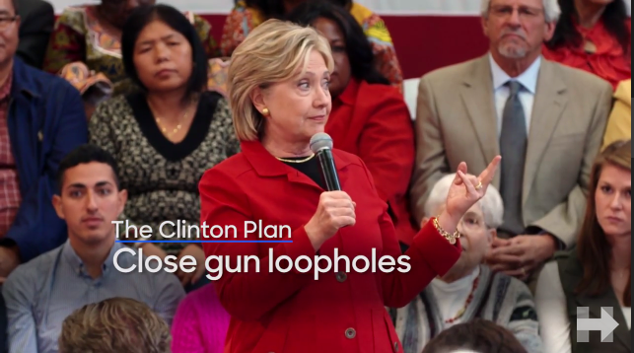
https://www.youtube.com/watch?v=wPJNqeCm9iM&list=PLt9jO9QkAAofYCfhjpEdDLtpvHnnbmr6I&index=22

Slide 13
You & a partner are going to create a storyboard + a script for a TV advertisement for a fake candidate that uses at least three of the propaganda techniques you learned today
Storyboard: 6-10 images

Slide 14
