Slide 1
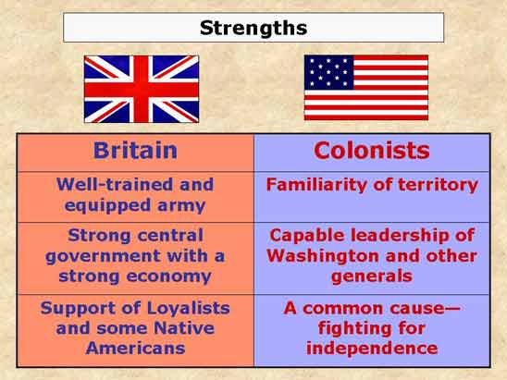

Slide 2
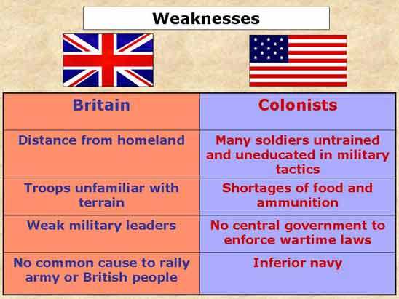

Slide 3
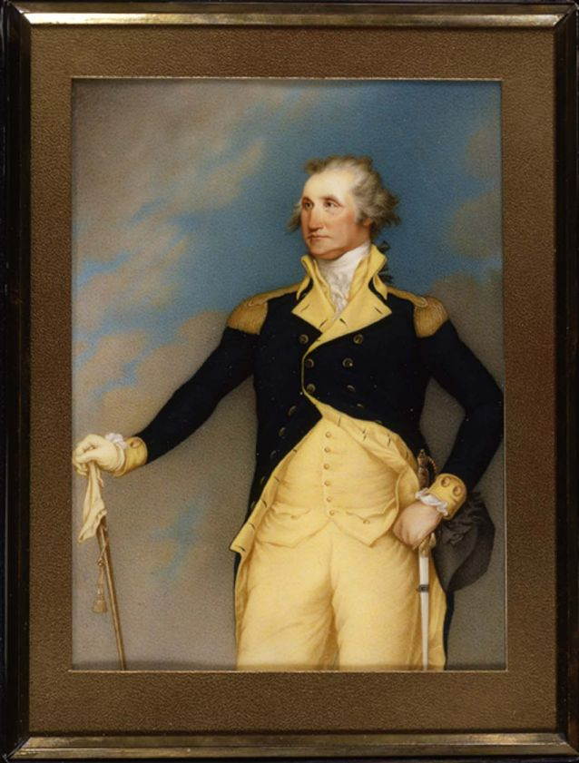
George Washington
Continental Congress selects GW to head army
Cons
  Age 43, never risen above rank of colonel
  Had only commanded 1200 men at most
  Lost more battles than he had won

Slide 4
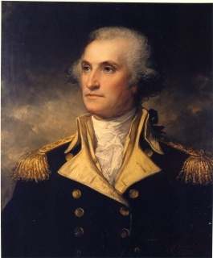
George Washington
  PROS:
    Outstanding powers of leadership
    Strength of character
    Patient, courageous, self-disciplined
    Rallying point for the cause
    Trusted and prepared
    Served without pay
      Wealthy planter – would not be accused of hunting fortune
      But! He did have $100K expense account
    From VA
      Largest & most populated colony at time
      Not a New Englander (hot headed, untrustworthy, mob rule)

Slide 5
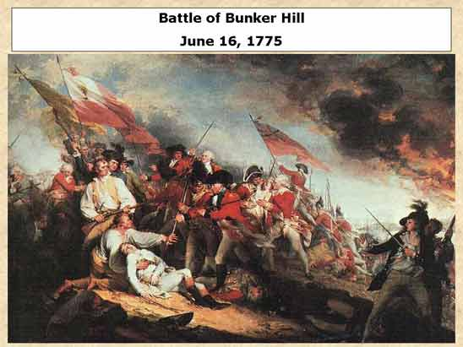
First major battle after Lexington and Concord
Actually Fought on Breed’s Hill
British victory but encourage American morale

Slide 6
Olive Branch petition
July 1775
attempt to avoid a full-blown war with Great Britain.
petition was rejected

Slide 7
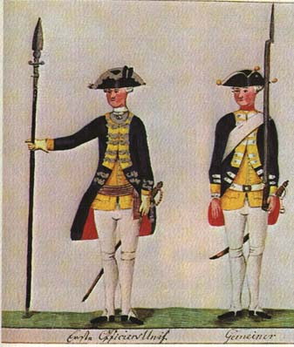
HESSIANS
German princes need money & King Geo needs men
Called Hessians, because 12,992 of the total 30,067 men came from Hesse-Kassel.
The Hessians fought in almost every battle
Colonial response: why take problem outside the family? And Hessians had rep of brutality
Notes:
the men were mainly conscripts, debtors, or the victims of impressment; some were also petty criminals. Pay was low; some soldiers received nothing but their daily food

Slide 8
Battle at Saratoga
Turning Point: September 19 and October 7, 1777
Military victory
  British forces under John Burgoyne try to link up with other British troops & cut off New England
  Benedict Arnold and Horatio Gates attack British troops into surrender
Diplomatic victory
  France forms an alliance with America
  Forces Britain to divert resources away from America to deal with France

Slide 9
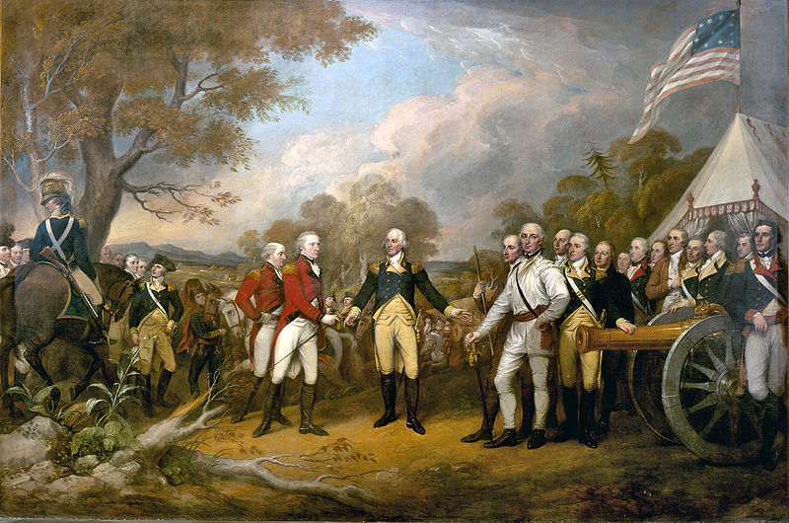
Surrender of General Burgoyne by John Trumbull, 1822
This painting hangs in the United States Capitol Rotunda
Notes:
Burgoyne: campaign to divide New England from the southern colonies
Burgoyne's surrender was instrumental in formally bringing France into the war as an American ally, having previously given supplies, ammunition and guns
Combined with earlier news that General William Howe had sailed his army from New York City on a campaign to capture Philadelphia instead of moving north to meet Burgoyne, and the departure of most of his Indian support following the loss at Bennington, Burgoyne's situation was becoming difficult

Slide 10
Valley forge
" . . . you might have tracked the army from White Marsh to Valley Forge by the blood of their feet."
- George Washington
25 mi west of Philadelphia, the campground of 11,000 troops of GW’s Continental Army from Dec. 19, 1777, to June 19, 1778.
suffering endured: hungry, poorly clothed, badly housed, 2,500 died during the harsh winter
Valley Forge came to symbolize the heroism of the American revolutionaries.
Despite circumstances, Baron Friedrich von Steuben drilled the soldiers regularly and improved their discipline.
Notes:
von Steuben was only a captain, not a former Prussian general; but he was a superb drillmaster. Although they were good individual fighters, the Americans' ignorance of the elementary principles of drill or maneuvering often put them at a fatal disadvantage against their well-trained enemy. Von Steuben set out to change all this, and incidentally kept the men well occupied during the Valley Forge winter.

Slide 11
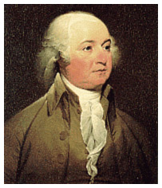
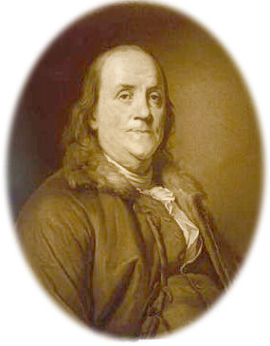
American diplomats
JOHN ADAMS
served in France and Holland in diplomatic roles
helped negotiate the Treaty of Paris
BENJAMIN FRANKLIN
Official diplomat to France
helped negotiate the Treaty of Paris
Notes:
The colonies indeed needed help of every description--men, money, equipment, ships, and all things to fight a successful war. The long years of enmity between France and Britain opened the way for the leadership of Franklin. And he was not only the man to exploit it, but also the reason for the acceptance of thirteen states as a recognized nation in the world of nations.

Slide 12
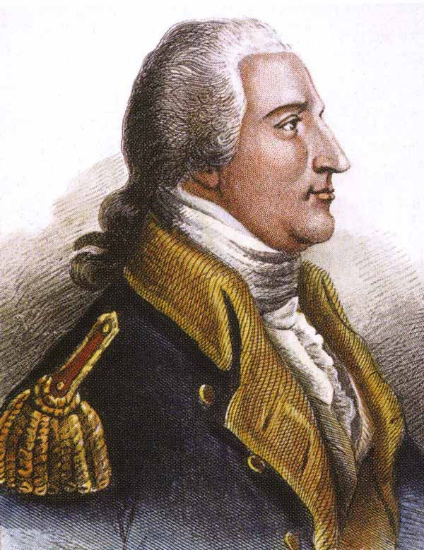
Benedict Arnold:
A BLOW TO AMERICAN MORALE
began his career as an American Patriot in May 1775, when he and Ethan Allen led the brigade that captured Fort Ticonderoga on Lake Champlain
Faced with financial ruin, unhappy about no promotions from continental congress
1779 wrote to Sir Henry Clinton, British commander, promising to deliver West Point and its 3,000 defenders for 2O,OOO sterling (about $1 million today), he hoped for collapse of the American cause.
Notes:
Persuading Washington to place the fort under his command, Arnold moved in September 1780 to execute his audacious plan, only to see it fail when Andre, was captured. Andre was executed as a spy, Arnold received 6,000 from the British government and appointment as a brigadier general. Arnold served George III with the same skill and daring he had shown in the Patriot cause. In 1781 he led devastating strikes on Patriot supply depots: In Virginia he looted Richmond and destroyed munitions and grain intended for the American army opposing Lord Cornwallis; in Connecticut he burned ships, warehouses, and much of the town of New London, a major port for Patriot privateers.

Slide 13
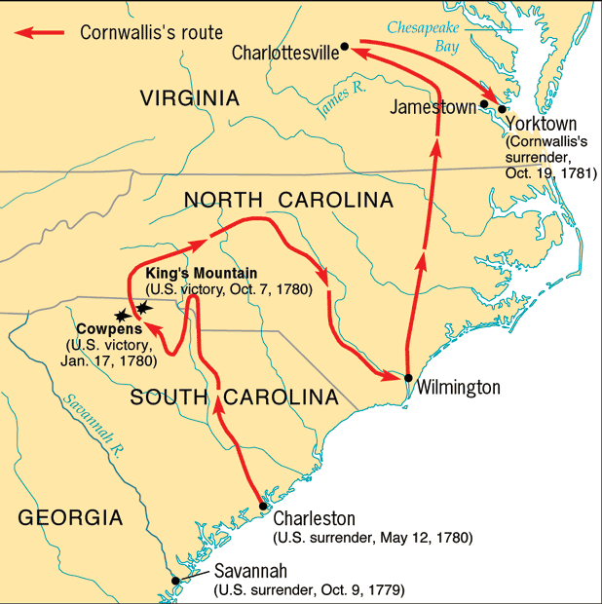
War in the South 1780-81
Large amount of loyalists
Colonies cities in GA and SC
Tide turns in Carolinas

Slide 14
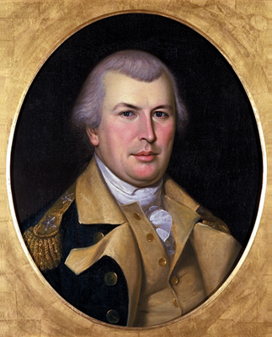
Nathaniel greene
Son of Quaker from RI
Commands continental army in the South
Battle of Guilford Courthouse (Greensboro, NC 1781)
Loss to Cornwallis – BUT – it pushed Cornwallis towards Yorktown

Slide 15
SEIGE OF YORKTOWN
American forces led by General Washington
French forces led by the Comte de Rochambeau
British commanded by Lieutenant General Lord Cornwallis
last major land battle of the American Revolution
surrender of Cornwallis's army prompted the British government eventually to negotiate an end to the conflict

Slide 16
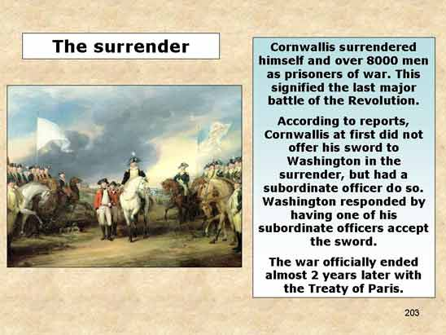

Slide 17
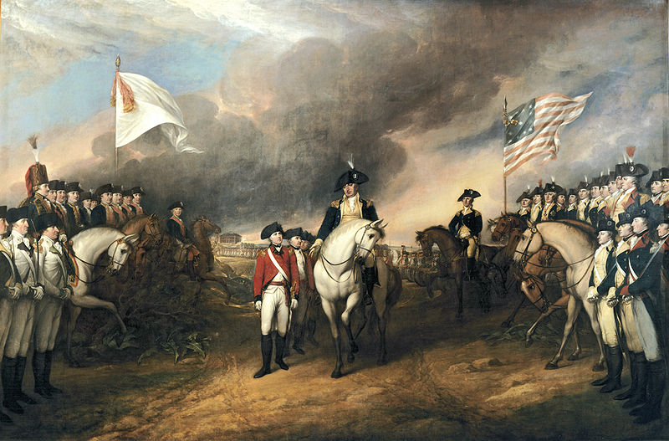
CORNWALLIS SURRENDERS AT YORKTOWN, VA 1781

Slide 18
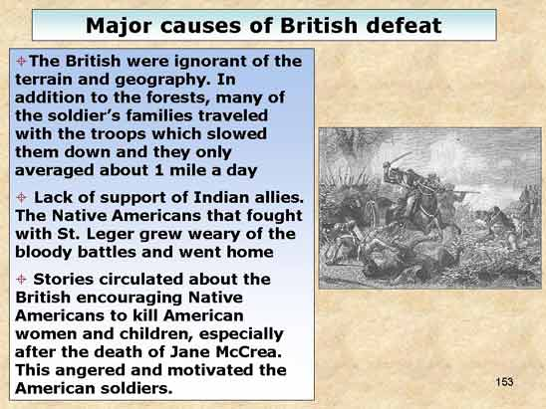

Slide 19
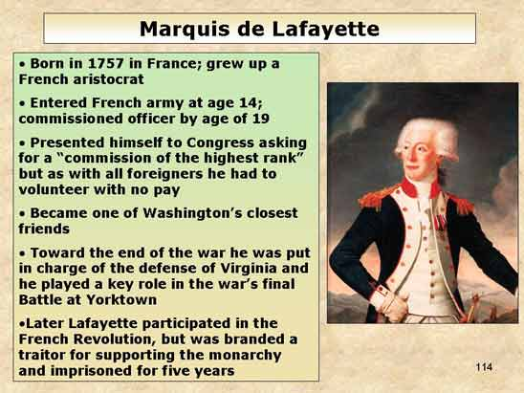

Slide 20
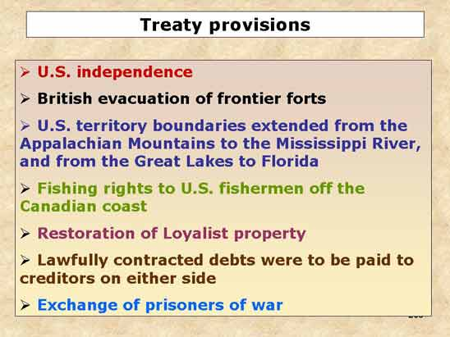
Treaty of Paris 1783

Slide 21
African Americans
At the beginning of the war southern states persuaded congress to ban African Americans from fighting.
Lord Dunmore, the royal governor of Virginia, announced that slaves who fought on the British side would be freed, and many men answered his call.
As the need for soldiers grew, some states ignored the ban and let African American fight.

Slide 22
African Americans, continued
Lemeul Hayes and Peter Salem were two famous African American patriots.
African Americans fought for the same reasons other Americans fought-they believed in the cause or they needed the money.
Some African Americans earned their freedom by fighting.

Slide 23
Native Americans
Although some Indians helped the Patriots, more of them sided with the British, who seemed to present less of a threat than the Americans did.
Settlers continued to push westward, threatening the Native Americans’ way of life.
Mohawk chief Joseph Brant led a number of brutal attacks against American settlements in southwestern New York and northern Pennsylvania.
Henry Hamilton–who commanded the main British base in the west, Detroit– was called the “hair buyer” because of rumors that he paid Native Americans for the scalps of settlers

Slide 24
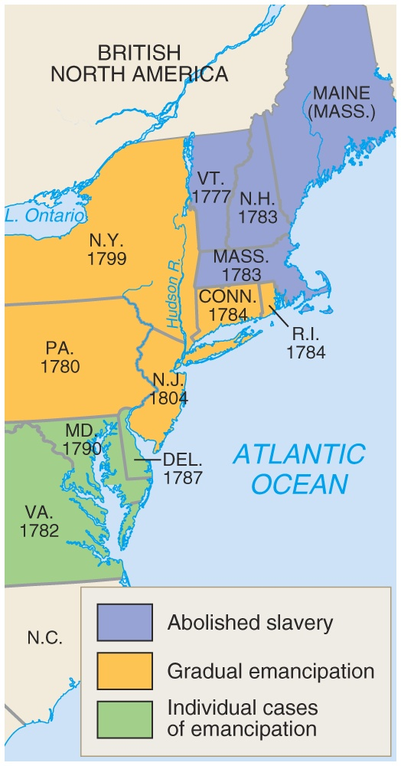
slavery
“All Men Created Equal”
New England states are the first to abolish slavery after the Revolution.
Middle States would abolish later….
  In 1791, the Quakers formed first Anti-Slavery Society and Underground Railroad
Southern States would expand slavery after the invention of the cotton gin.
As country expands, North and South would compromise over the issue of slavery……

Slide 25
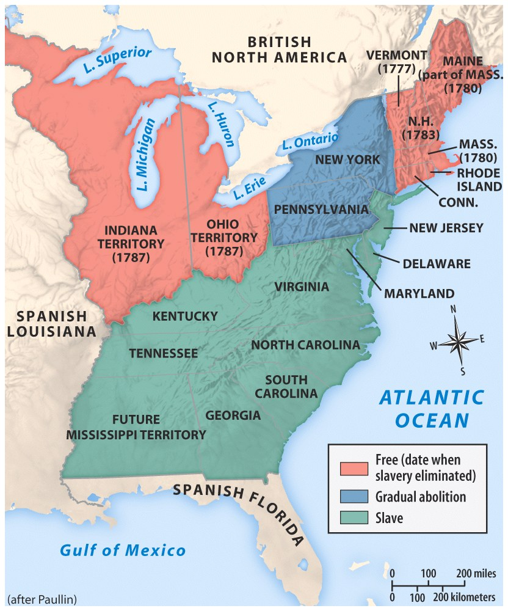
“All Men Created Equal”
Mason Dixon Line set the precedent over dividing the country over slavery.
Ohio River would be the dividing boundary between North and South.

Slide 26
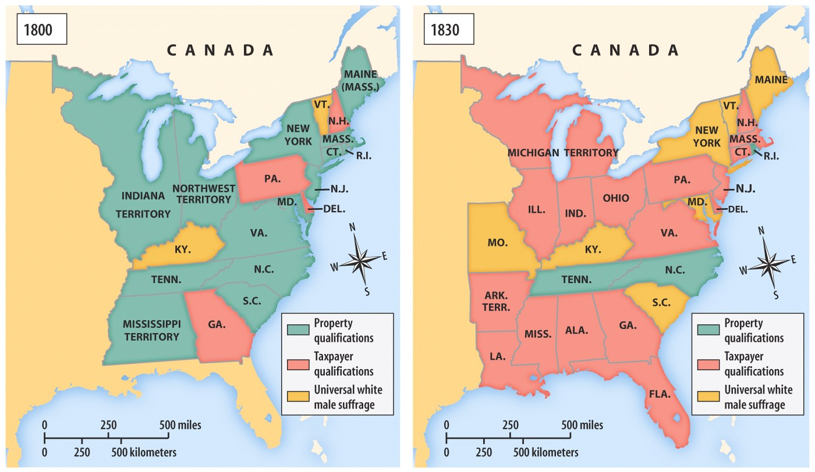
voting
1790
WMA 21 yrs. old, educated and property owner…….
Several states would drop property qualifications and education…….

Slide 27
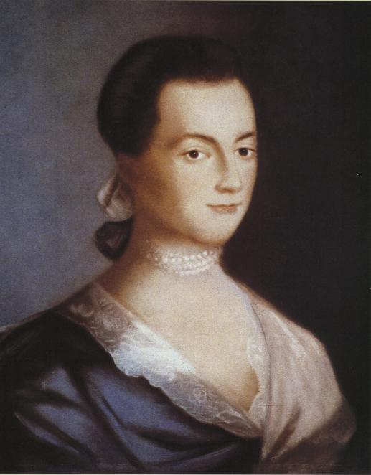
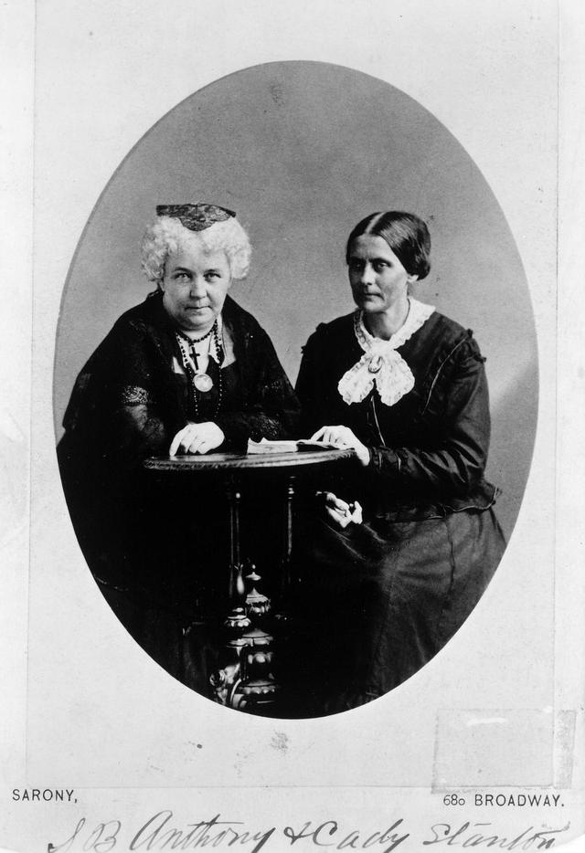
Picture/Anthony & Stanton
WOMEN'S RIGHTS
Abigail Adams—1790’to early 1800’s
Elizabeth Cady Stanton and Susan B. Anthony---1830’s to 1900’s
Women’s rights reformers
  citizenship
  right to vote
  education
Supported the abolition of slavery
Republican motherhood
Despite their contributions, women’s rights did not progress and would remain 2nd class citizens
Republican motherhood
Concept that a woman’s role was to stay at home and raise the next generation of PATRIOTS.
This was a role to be proud of because a woman’s responsibility was to teach and raise their children in REPUBLICANISM.

Slide 28
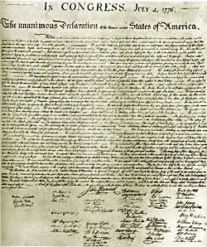
State Constitutions & State Governments
Common aspects
  Each state listed the basic rights and freedoms that belonged to all citizens
  Representative Government
  Separation of powers
  All white males with property could vote

