Slide 1
Saving
and
Investing

Slide 2
Why should you save money?
Retirement
Kids/College
“Rainy Day”
Big Purchases
Why should you invest money?
Earn more money!!

Slide 3
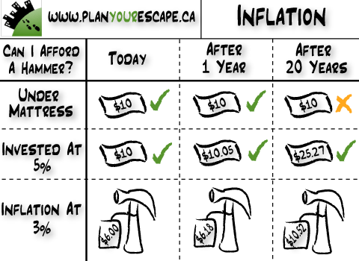

Slide 4
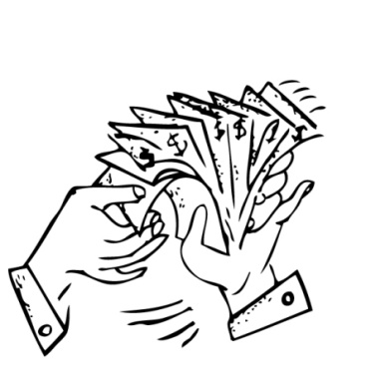
What’s the best way to save or invest?
Things to consider...
Safety: How secure is your money? Is it guaranteed to be there later?
Rate of Return: How much can you earn from your money?
Liquidity: How easily can you get your money or convert it into cash?

Slide 5
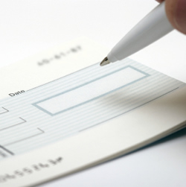
Savings Accounts
Interest-Bearing Checking Account – normal checking account, write checks from it, earn a little interest
Money Market Account – must keep a high minimum balance, write checks from it, earn more interest

Slide 6
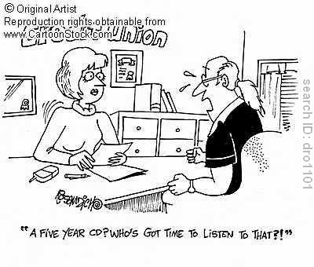
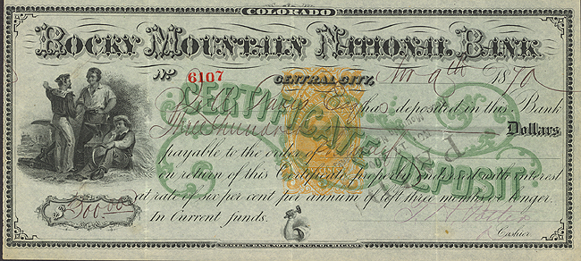
Savings Accounts
CD – Certificate of Deposit – high minimum investment (ex. $1000), must keep for a certain amount of time (ex. 5 years), but high interest rate

Slide 7
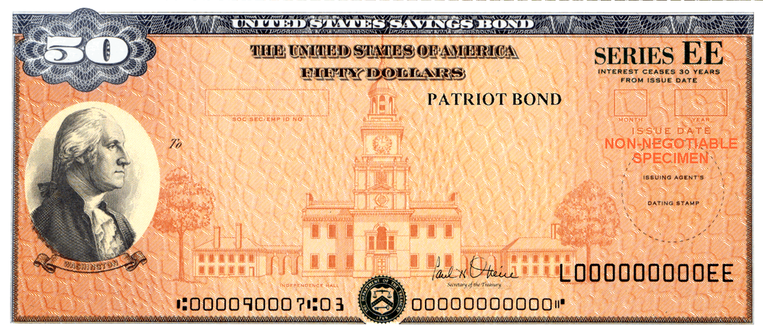
Government Bonds
Savings Bonds / War Bonds – Buy a bond (ex. $25), get it back later (ex. 10 years) with interest added to it; easy and affordable; helps fund government

Slide 8
Retirement Account
Pension Plan/Individual Retirement Account (IRA) – Some of each paycheck is deducted; you get it when you retire

Slide 9
Stock Market
Stocks – buy a portion (“share”) of a company
Collect Dividends (portion of companies profits given out each quarter)
Sell it for more than you bought it; “Buy low, sell high” – Capital Gains

Slide 10
Stock Market
DEMAND determines the price of stocks
If a company is doing well (or people believe it is doing well), the price of the stocks go up; If a company is struggling, its stock prices will go down

Slide 11
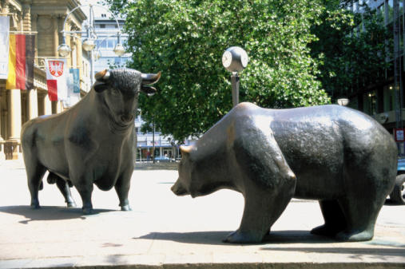
Stock Market
Bull Market
**Good/Strong Market = __________________
**Bad/Weak Market = __________________
Bear Market

Slide 12
Real Estate
Real Estate – Buy property; make improvements and re-sell later; values usually go up; sell it for more than you paid for it

Slide 13
Managing Debt
Your debt is the money you owe to creditors. People build debt by taking loans for homes, cars, education, starting a new business, etc.
People also build debt when making purchases with credit cards. Buying on credit is like taking a small loan.
Every loan will include interest. Banks and credit card companies charge interest on loans in order to make money.
Different kinds of loans have higher interest rates, especially credit cards. The higher the interest rate, the more money you end up paying back.

Slide 14
Managing Debt
Building debt is not always bad.
Most people will need to take a loan of some kind during their lives.
Banks are more willing to offer loans, or low interest rates, to people with a good credit history/credit score.
You can build a good history/score by paying back your debts on time or early.
- Credit cards only help your score if you pay back the money quickly.
- You can also build credit by having bills and utilities in your name and paying them on time every time.

Slide 15
Building Wealth
There are many strategies you can use to make the money you make work for you.
1. Put money in savings accounts and CDs: The money will grow at a slow rate of interest, but it is guaranteed to grow.
2. Buy US Government Bonds and Treasury Bills: Similar to a CD, when you buy a US govt. bond, you can sell it back to the government years later at a much higher price.

Slide 16
Building Wealth
3. Buy a home: In most economic situations, house prices rise over time. When you buy a house, you should be able to sell it several years later for more money.
4. Invest in the Stock Market: When you buy shares of stock you are buying pieces of ownership in a corporation.
- You can make money from stocks in two ways: 1) Dividends: You get a piece of the company’s profits for owning some of the company. 2) Capital Gains: Selling your shares of stock at a higher price than when you bought it.
Which wealth building strategies are safe? Which are risky? Why do people use the risky strategies?

