Slide 1
State and Local Government
What is the structure of state and local government in North Carolina? How does it compare to the federal government?
C & E

Slide 2
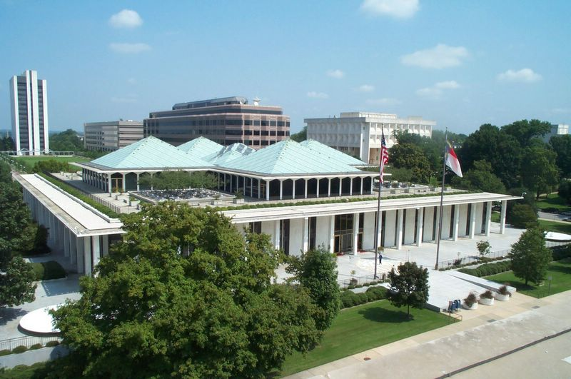
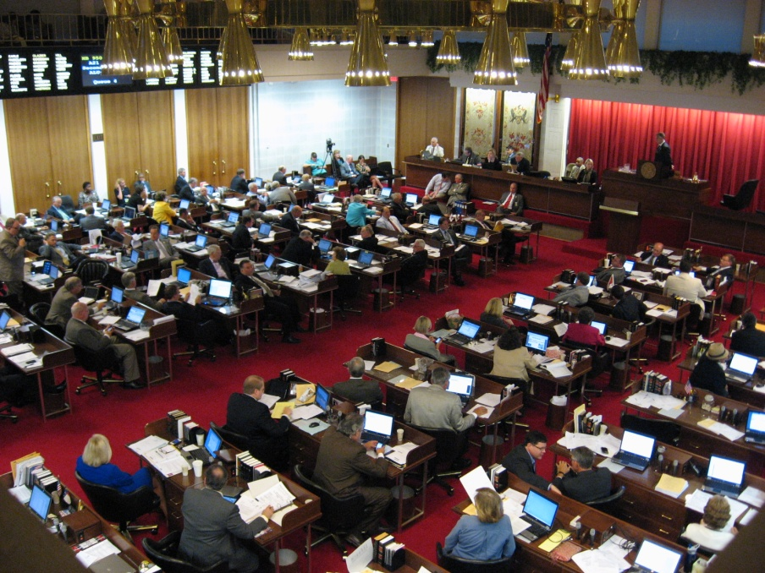
NC General Assembly (State)
State legislative branch (Established in state constitution)
Bicameral System
Most important job: Make laws (Statutes)

Slide 3
Organization:
 | House of Representatives | Senate
Membership | 120 members (elected from districts) | 50 members (elected from districts)
Qualifications | 21 years old 1 year resident of NC | 25 years old 2 year resident of NC
Terms | 2 years (Unlimited) | 2 years (Unlimited)
Leadership | Speaker of the House | Lt. Governor President Pro Temp.

Slide 4
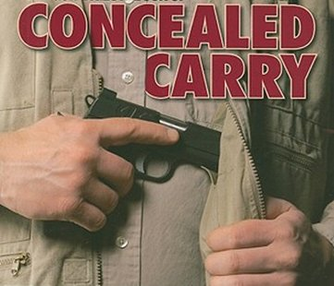
Powers:
→Pass statutes: apply statewide (Ex: seatbelt laws, marriage, sexual assault, etc…) (Reserved Powers)
→Performs oversight (reviews gov’t actions)
→Impeach officials
→Appoints members to UNC Board of Governors
→Creates voting districts (Gerrymandering)

Slide 5
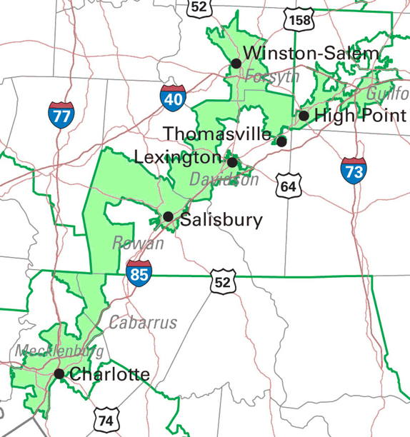
Above: NC Congressional Districts
Left: District 12

Slide 6
Governor (State)
Heads the state executive branch (Established in state constitution)
Most important job: Carries out state policy
Elected by the entire state
Overview:
→Qualifications: 30 years old; US citizen for 5 years; 2 years resident of NC
→4 year terms
→Limited to 2 consecutive terms
Lt. Governor takes over if something happens
Governor and Lt. Governor are elected separately

Slide 7
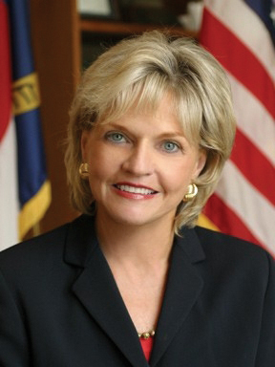
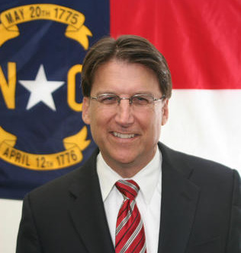
Former Gov. Beverly Perdue: 1st female governor in NC
Gov. Pat McCrory: 1st Republican governor in NC since 1993

Slide 8
Powers:
→Enforces statutes and policy
→Appoints government officials (Ex: Cabinet)
→Coordinates state agencies
→Proposes and administers the budget
→Pardon criminals/ Commutes sentences
Cabinet: made up of 10 departments (Ex: Corrections, Crime Control and Public Safety, etc…)

Slide 9
The Council of State:
→8 different agencies (Ex: Attorney General, State auditor, etc…)
→Heads elected by the people
→Do not report to the Governor
→Divides executive power

Slide 10
Municipalities (Local)
Cities and towns
Incorporated (recognized as a city) by the General Assembly
City Council:
→Elected by residents (Districts or At-large)
→Make laws (Ordinances)
→Provide services: Trash, water, sidewalks, etc…
Mayors and City Managers:
→Carry out ordinances
→May be elected or appointed

Slide 11
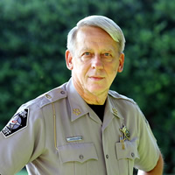
Counties (Local)
100 counties in NC
Carry out state statutes
County Commissioners
→Elected by residents
→Oversee elections, alcohol distribution, schools
School Board (LEA): Operates schools
Sherriff: Oversees law enforcement

Slide 12
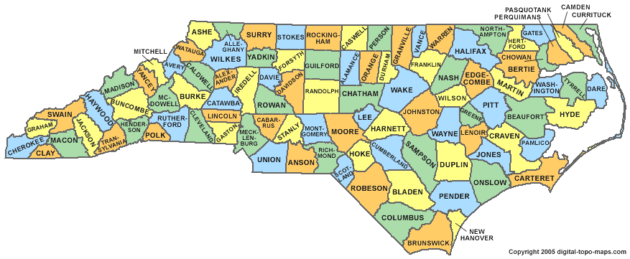
Counties of North Carolina

