Slide 1
The End of Salutary Neglect
1763-1774

Slide 2
Salutary Neglect
During the early years of the existence of the colonies, Parliament opted for a policy of salutary neglect or non-interference
It was too difficult to control the situation in the colonies when they were 3000 miles away

Slide 3
Impact of the F&I War…
Proclamation of 1763…
Increased British Army presence…
Colonial pride…
Developing “national” perspective…

Slide 4
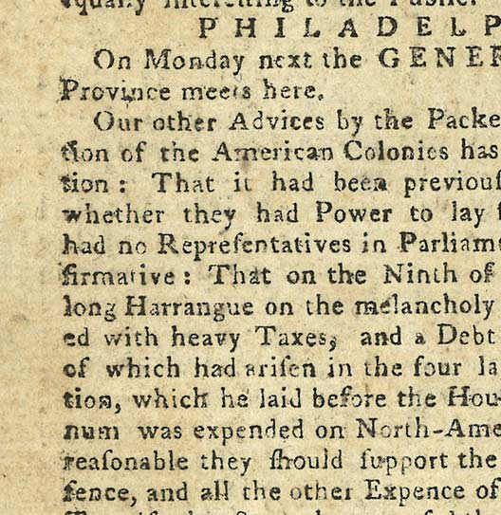
Sugar Act, 1764 Why?
ACTION | REACTION
Need for British revenue Duty on sugar & molasses | Inc. in Br. court action “No taxation without representation”

Slide 5
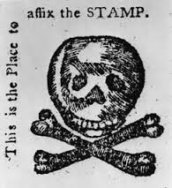
Stamp Act, 1765
ACTION | REACTION
First DIRECT TAX Tax on printed materials | Sons of Liberty form & issue boycotts Virtual v. actual representation? Reps from 9 colonials meet– Stamp Act Congress
REPEALED in 1766

Slide 6
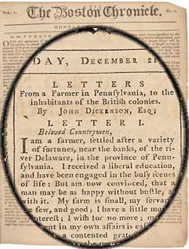
Townshend Act, 1767
ACTION | REACTION
Duties on glass, lead & tea | John Dickinson writes “Letters from a Pennsylvania Farmer”-calling for UNION Virginia Resolves- only House of Burgesses can tax VAians Boston Massacre (1770)

Slide 7
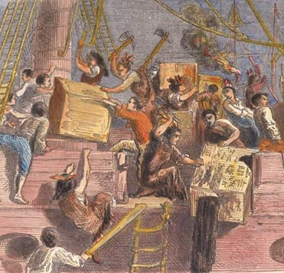
Tea Act, 1773
ACTION | REACTION
Gaspee Affair (‘72)- Col. take Br. Ship that ran aground Tea Act passed | Committee of correspondence formed (‘72) Boston Tea Party (Dec. 1773)- 342 chests into the Harbor

Slide 8
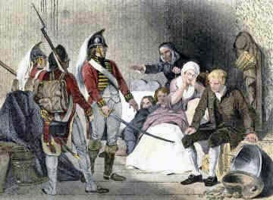
Intolerable Acts, 1774
ACTION | REACTION
Close Boston Harbor No more jury trials for colonists MA colonial charter annulled Quartering act | First Continental Congress met in Philly (Sept.’74) Wrote the “Declaration of Rights & Grievances”- loyalty to King Geo III, but condemned the Acts

Slide 9
Colonists ORGANIZE for war…
Colonists gather militias
In MA, minutemen organize
Collect weapons
Greater communication btw colonies w/ committees of correspondence.
Poll Everywhere

