Slide 1
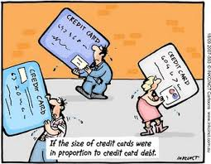
Using Credit Cards Wisely
How does your ability to manage debt and protect your credit worthiness impact your ability to become a responsible consumer and borrower?

Slide 2
Terms
Credit line/limit – amount that can be charged to a card
Balance – the amount borrowed
APR – Annual Percentage Rate: interest rate charged on the balance each month
Finance Charge – the amount of interest and fees ($$)
Fixed rate – interest rate that does NOT change
Variable rate – interest rate that will fluctuate (as national interest rates change)

Slide 3
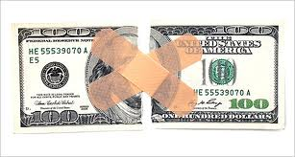
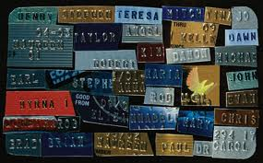
Terms (cont)
Default – failing to meet payment dates
Credit Score – 3-digit number summarizing how a person has handled debt; measures risk for lender
Balance Transfer – moving the balance on one card to another
Minimum Payment – lowest amount you are required to pay on your credit card each month (usually 3-5% of balance)

Slide 4
When Getting a Credit Card…
1 – There are different types of cards
A. private label retail – Belk, Target, etc
B. general purpose – used anywhere
2 – There’s no perfect number of cards you should have
3 – Study your card’s interest rates and fees
4 – Comparing cards is vital
5 – The contract IS binding.
6 – You can pay in full…or not.
7 – You have rights – Truth in Lending Act, Fair Credit Billing Act

Slide 5
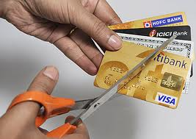
Worst Credit Card Mistakes
1. Getting too many (avg American has 9!)
2. Misunderstanding the introductory rates (Fine Print)
3. Not rate shopping
4. Choosing a card for the wrong reasons
5. Making minimum payments
6. Paying your bill late
7. Ignoring your monthly statement
8. Buying too much

Slide 6
Things to Know about Credit Card Debt
1– Know when short term loans make sense
($1,500 purchase @ 18%: 4 months = $57; 2 years = $300)
2– Owing is easy, repaying is hard
3– Debt affects your credit score (35% rule)
4– Develop a payment plan
5– Can’t make a payment? Ask for help
6– You can’t go to jail for non-payment, but…

Slide 7
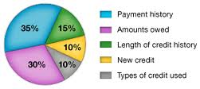
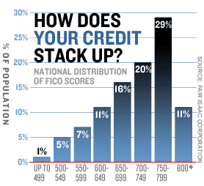
Your Credit Score
Factors
Income
Income/debt ratio
Lines of open credit
Past use of credit/payment behavior
Scale
Bad: 350-619
Fair: 620-699
Good: 700-749
Excellent: 750-850

Slide 8
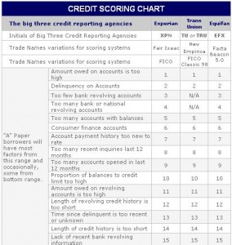

Slide 9
Credit Score Estimator
http://www.creditcards.com/credit-score-estimator/
FICO – Credit Scenario
http://www.creditcards.com/credit-card-news/fico-credit-score-points-mistakes-1270.php

